Slide 1
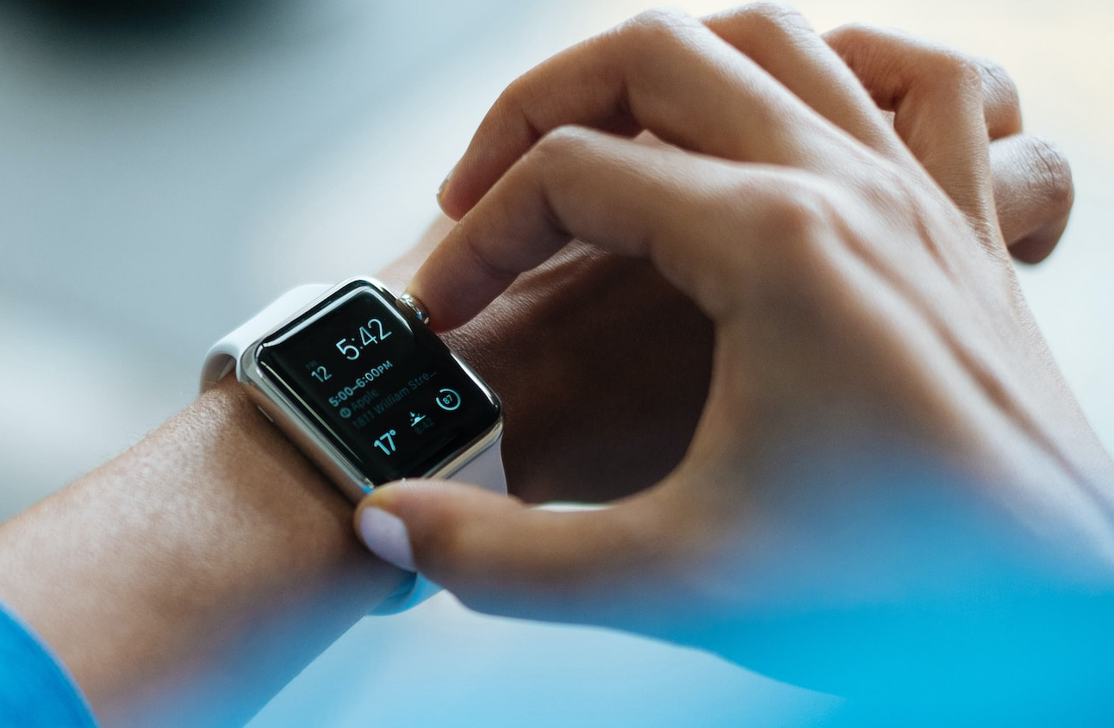
Research-based
Student Selected Components (SSCs)
Slides available at: 10.5281/zenodo.8321579 (CC BY 4.0)
Photo by Luke Chesser on Unsplash

Slide 2
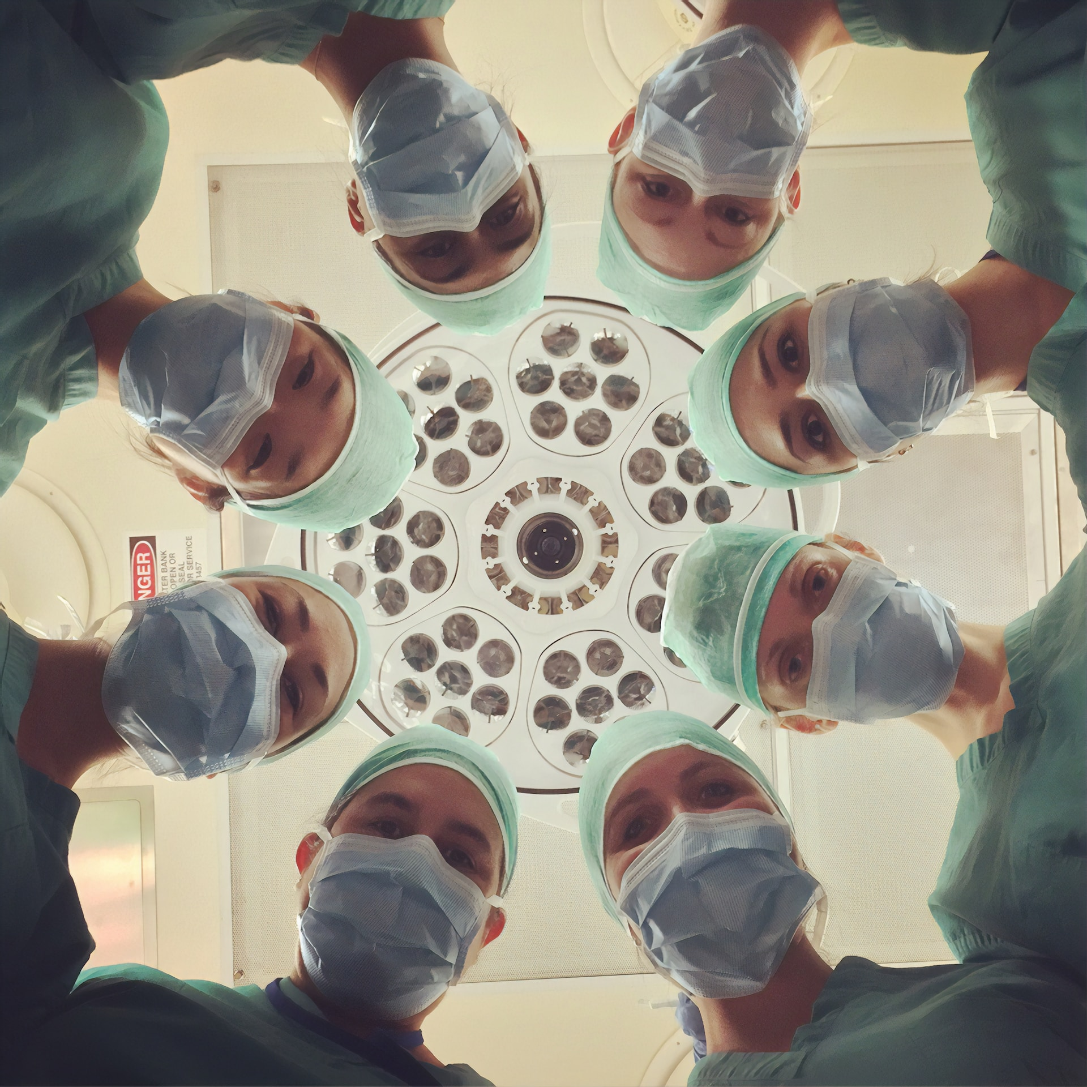
National Cancer Institute, unsplash.com/photos/701-FJcjLAQ (Unsplash Licence)
Notes:
big problem: clinicians are ideally placed to identify potential improvements in healthcare, but may not necessarily have the skills/experience/enthusiasm to conduct research.

Slide 3

Scott Graham,
unsplash.com/photos/5fNmWej4tAA
(Unsplash Licence)
Notes:
potential solution: research-based SSCs - providing an introduction to research.

Slide 4
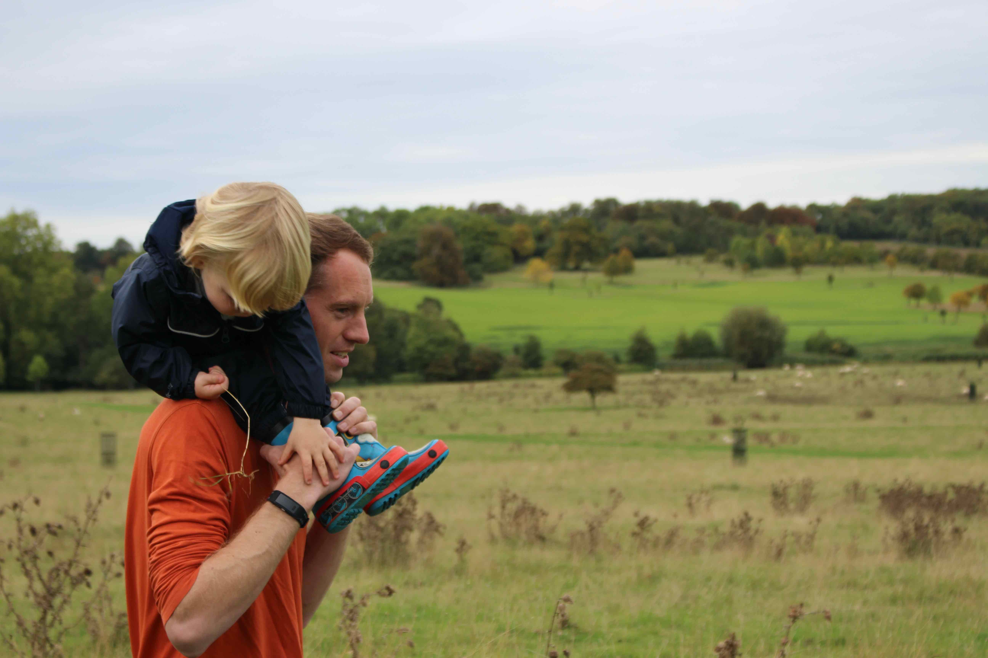
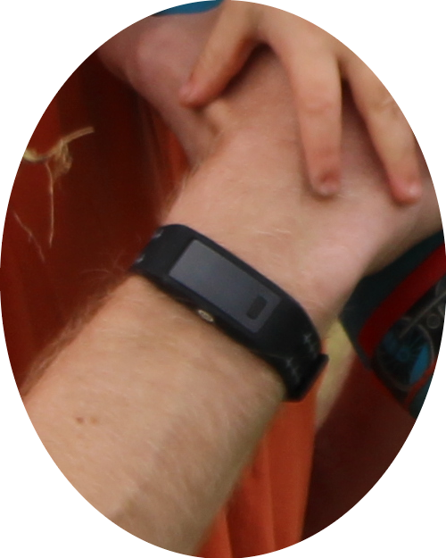
Charlton PH et al., The 2023 wearable photoplethysmography roadmap, Phys Meas., 2023. https://doi.org/10.1088/1361-6579/acead2 (CC BY 4.0)
Notes:
To introduce myself, My name’s Peter Charlton, and I’m a researcher here at the University of Cambridge.
I work alongside clinical colleagues to develop data analysis techniques for wearables, to enable them to be used for clinical decision making.

Slide 5
Why do a research-based SSC?
What does it involve?
Is it for you?
Scott Graham,
unsplash.com/photos/5fNmWej4tAA
(Unsplash Licence)

Slide 6
Why do a research-based SSC?
What does it involve?
Is it for you?
Scott Graham,
unsplash.com/photos/5fNmWej4tAA
(Unsplash Licence)

Slide 7
Why do a research-based SSC?
Because you're interested
Photo by Luke Chesser on Unsplash
Notes:
- **Because you're interested** in the topic of the research, and want to find out more.
- **To gain experience and skills** in conducting research.
- **To consider a career in research**
- **To develop critical appraisal skills:** to be able to critically appraise others' research, and help you decide how it could inform clinical practice.
- **To grow in confidence** by being challenged to undertake a piece of research which requires you to learn new skills and work independently.
- **To enhance your CV:** to be able to say you've presented at a conference or published a journal article.
- **To tick off key skills:** (_e.g._ a piece of medical writing, describing a literature search, giving a presentation, writing an abstract)

Slide 8

Why do a research-based SSC?
Because you're interested
To gain experience and skills
Ilya Pavlov, unsplash.com/photos/OqtafYT5kTw (Unsplash Licence)
Notes:
- **Because you're interested** in the topic of the research, and want to find out more.
- **To gain experience and skills** in conducting research.
- **To consider a career in research**
- **To develop critical appraisal skills:** to be able to critically appraise others' research, and help you decide how it could inform clinical practice.
- **To grow in confidence** by being challenged to undertake a piece of research which requires you to learn new skills and work independently.
- **To enhance your CV:** to be able to say you've presented at a conference or published a journal article.
- **To tick off key skills:** (_e.g._ a piece of medical writing, describing a literature search, giving a presentation, writing an abstract)

Slide 9
Why do a research-based SSC?
Because you're interested
To gain experience and skills
To consider a career in research
To develop critical appraisal skills
To grow in confidence
To enhance your CV
Notes:
- **Because you're interested** in the topic of the research, and want to find out more.
- **To gain experience and skills** in conducting research.
- **To consider a career in research**
- **To develop critical appraisal skills:** to be able to critically appraise others' research, and help you decide how it could inform clinical practice.
- **To grow in confidence** by being challenged to undertake a piece of research which requires you to learn new skills and work independently.
- **To enhance your CV:** to be able to say you've presented at a conference or published a journal article.
- **To tick off key skills:** (_e.g._ a piece of medical writing, describing a literature search, giving a presentation, writing an abstract)

Slide 10
Why do a research-based SSC?
Because you're interested
To gain experience and skills
To consider a career in research
To develop critical appraisal skills
To grow in confidence
To enhance your CV
To tick off key skills
Key skills:
a piece of medical writing
describing a literature search
giving a presentation
writing an abstract
Notes:
- **Because you're interested** in the topic of the research, and want to find out more.
- **To gain experience and skills** in conducting research.
- **To consider a career in research**
- **To develop critical appraisal skills:** to be able to critically appraise others' research, and help you decide how it could inform clinical practice.
- **To grow in confidence** by being challenged to undertake a piece of research which requires you to learn new skills and work independently.
- **To enhance your CV:** to be able to say you've presented at a conference or published a journal article.
- **To tick off key skills:** (_e.g._ a piece of medical writing, describing a literature search, giving a presentation, writing an abstract)

Slide 11
Why do a research-based SSC?
What does it involve?
Is it for you?
Scott Graham,
unsplash.com/photos/5fNmWej4tAA
(Unsplash Licence)

Slide 12
What does a research-based SSC involve?
Broadly two approaches
Contributing to an ongoing piece of research
Running a research project
Notes:
- **Because you're interested** in the topic of the research, and want to find out more.
- **To gain experience and skills** in conducting research.
- **To consider a career in research**
- **To develop critical appraisal skills:** to be able to critically appraise others' research, and help you decide how it could inform clinical practice.
- **To grow in confidence** by being challenged to undertake a piece of research which requires you to learn new skills and work independently.
- **To enhance your CV:** to be able to say you've presented at a conference or published a journal article.
- **To tick off key skills:** (_e.g._ a piece of medical writing, describing a literature search, giving a presentation, writing an abstract)

Slide 13
What does a research-based SSC involve?
Example tasks when running a research project:
Preparation
  Project planning
  Pre-reading
  Learning objectives
Planning
  Literature review
  Research Plan
  Data Access
Experiments
  Experiments
Dissemination
  Project Report
  Project Presentation
  Conference Submission
  Journal Publication

Slide 14
Why do a research-based SSC?
What does it involve?
Is it for you?
Scott Graham,
unsplash.com/photos/5fNmWej4tAA
(Unsplash Licence)
Notes:
potential solution: research-based SSCs - providing an introduction to research.

Slide 15
Is a research-based SSC for you?
Consider:
Are you interested in the research topic?
Are you interested in doing research?
Do you get along with the supervisor?
Are you willing to work largely independently?
Are you happy to learn new skills?
Are you prepared to be proactive and solve problems yourself?
Would the project meet your expectations?

Slide 16
Why do a research-based SSC?
What does it involve?
Is it for you?
Scott Graham,
unsplash.com/photos/5fNmWej4tAA
(Unsplash Licence)

Slide 17
National Cancer Institute, unsplash.com/photos/701-FJcjLAQ (Unsplash Licence)

Slide 18
Scott Graham,
unsplash.com/photos/5fNmWej4tAA
(Unsplash Licence)

Slide 19
For further information:
https://peterhcharlton.github.io
Charlton PH et al., The 2023 wearable photoplethysmography roadmap, Phys Meas., 2023. https://doi.org/10.1088/1361-6579/acead2 (CC BY 4.0)

