Slide 1

Bridging end-user and scientific knowledge to combat ghost nets
Littoral 2022
14 September 2022
Dr. Xenia I. Loizidou
Demetra Orthodoxou, Dr. Michael I. Loizides, Demetra Petsa
ISOTECH Ltd Environmental Research and Consultancy
CYPRUS

Slide 2
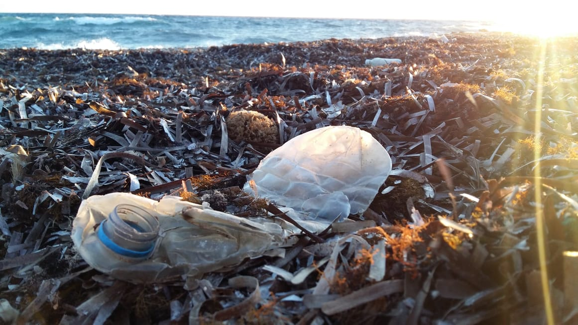
Marine Litter
All human-created, solid material, produced through land-based or sea-based activities and discharged, deliberately or accidentally, into the marine and coastal environment
Major threat to marine ecosystems, the environment, human health, and society
Plastic items make the greatest proportion of marine litter

Slide 3
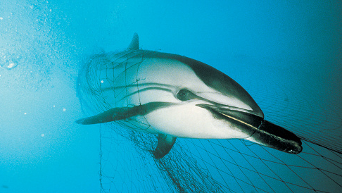
Ghost Nets
At least 10% of marine litter is made up of fishing-related waste
~ 48.4 thousand tonnes of fishing gear are accidentally lost into the marine environment every year
And more is abandoned or discarded into the marine environment
→ ‘Ghost Nets’
  Entanglement
  Entrapment
  Suffocation

Slide 4
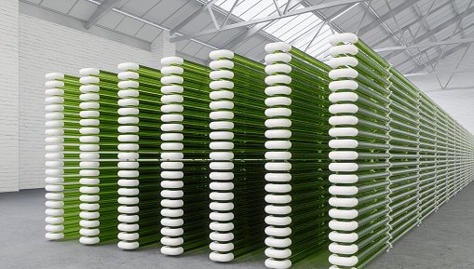
The SEALIVE Project Fishing Nets
SEALIVE (www.sealive.eu), Horizon 2020 Research and Innovation Action
Aims to develop bio-based fishing gears and nets made from alternative materials such as micro-algae
One of these materials is fishing nets
Compostable at an industrial scale
Biodegradable in the marine environment

Slide 5
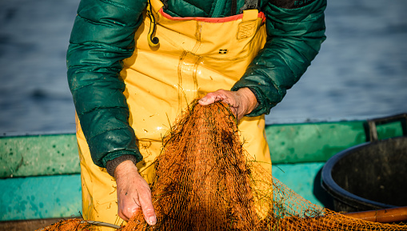
Methodological Framework
Based on End-user – Industry – Academia Collaboration
Core principle: End-users, i.e. fishermen, must be engaged from the beginning to the end
Step-by-step approach

Slide 6

Methodological Steps
Engagement through active participation:
  Fishers identified, contacted, informed about the project, and their interest to participate is recorded
  Fishers provide samples of the types of fishing nets they most commonly use
Material development:
  Samples are shared with the bio-based material primary producer and the fishing net producer
  These partners study the nets to deduce key characteristics that the bio-based nets must replicate (e.g. mono or multifilament, knotted or not, diameter, colour, elongation, tenacity)

Slide 7

Methodological Steps
Development of training material targeting fishing net end-users
  Capacity building and education of fishers about the importance of replacing conventional plastic nets with more sustainable alternatives
  To train the fishers on the reporting requirements for the pilots
  To ensure that fishers are familiar with the end-of-life management that is required for the new nets

Slide 8
Methodological Steps
Fishers participate in research: Piloting studies and monitoring in real conditions:
  Cyprus: 12 months
  Patagonia: 4 months
  Monitoring by fishers themselves
  Regular debriefing meetings between fishers and researchers to record issues and difficulties and identify solutions and way forward
  Photographic evidence to observe signs of degradation, tears, etc.

Slide 9
Methodological Steps
Product development
  Fishers will have active role in product development → ownership of the process, familiar with the new product
  Product developed according to the end-users’ feedback and monitoring records
  Fishers will be informed when the final product will be developed

Slide 10
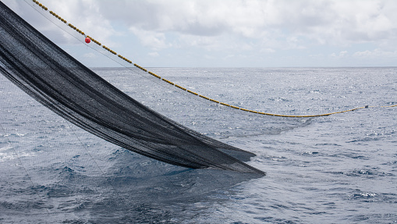
Results
Much needed bridge between end-users, scientists and decision-makers
Tested and operational new material by end-users themselves
Evaluation of the acceptability of the nets by their end-users, economically and socially
Having end-users as part of the development process, makes it easier for the product to enter the market

Slide 11
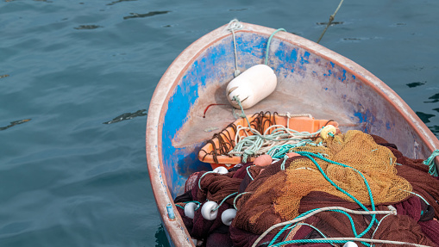
Results
Societal shift within the fishing community
  Greater acceptability of the new products. Fishers are involved from the very beginning, so they become part of the sustainability shift within their own industry
  Fishers receive extended information through their own exposure to the new bio-material, which helps them to better understand bioplastics and the impacts of lost or discarded gears
  Fishers have an increased sense of co-responsibility when it comes to the protection of the marine environment from ghost nets

Slide 12
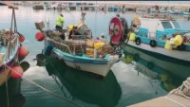
SEALIVE Ghost Nets Video

Slide 13
Thank you
Dr. Xenia I. Loizidou
Civil and Coastal Engineer
Director
ISOTECH Ltd Environmental Research and Consultancy
xenia@isotech.com.cy
www.isotech.com.cy

