Slide 1
Strategies for Publishing in Open Access Journals
Stefano Bollelli Gallevi, Università Degli Studi Di Milano
Sébastien Perrin, Sorbonne Université

Slide 2
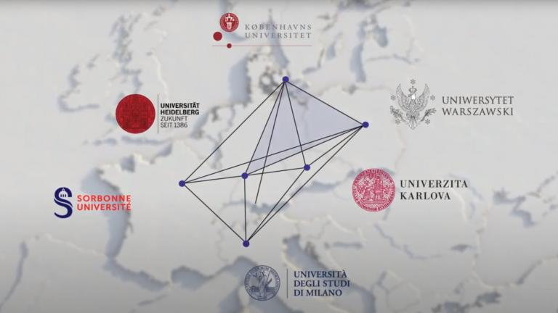
4EU+ Alliance and Open Science
4EU+ is a transnational strategic university association.
Aim: Strengthen the European vision of deepened cooperation and mutual enrichment in research and teaching
Open Science is an integral part of this.
Two 4EU+ projects currently work on Open Science.
„Open for you – an Introduction Series to Open Science“ – 14 session on OS topics!

Slide 3
Content
Two main roads for Open Access
Focus on APC funding
Diamond OA Journals
Spreading your research: free licences

Slide 4
1. Two main roads to Open Access

Slide 5
Green or Gold Open Access ?
GREEN
GOLD
Journal
The authors publish in a subscription journal
The authors publish in Open Access in a journal
Who pay ?
University pays for subscriptions
The authors or their institution pay APC to the publisher
Open repository
They self-archive the article in some open repository
They may save the article in some open repository
5

Slide 6
Green or Gold Open Access ?
GREEN
GOLD
Journal
The authors publish in a subscription journal
The authors publish in Open Access in a journal
Who pay ?
University pays for subscriptions
The authors or their institution pay APC to the publisher
Open repository
They self-archive the article in some open repository
They may save the article in some open repository
Which version of the paper is in OA ?
Postprint or Preprint
Published article
6

Slide 7
Green or Gold Open Access ?
GREEN
Journal
The authors publish in a subscription journal
Who pay ?
University pays for subscriptions
Normally not peer-reviewed, but…
Open repository
They save the article in some open repository
Which version of the paper is in OA ?
Preprint
7

Slide 8
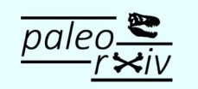


Green or Gold Open Access ?
GREEN
Journal
The authors publish in a subscription journal
Who pay ?
University pays for subscriptions
Open repository
They save the article in some open repository
Which version of the paper is in OA ?
Preprint
8

Slide 9
Can my preprint count as a publication?
Check Peer Community In : a free recommendation process of pre-print
Mostly in Biology, Ecology and related research fields
Deposit your
pre-print in some open repository
Ask a PCI for peer-review
The PCI may recommend your pre-print
You can have it published or release a recommended
pre-print

Slide 10
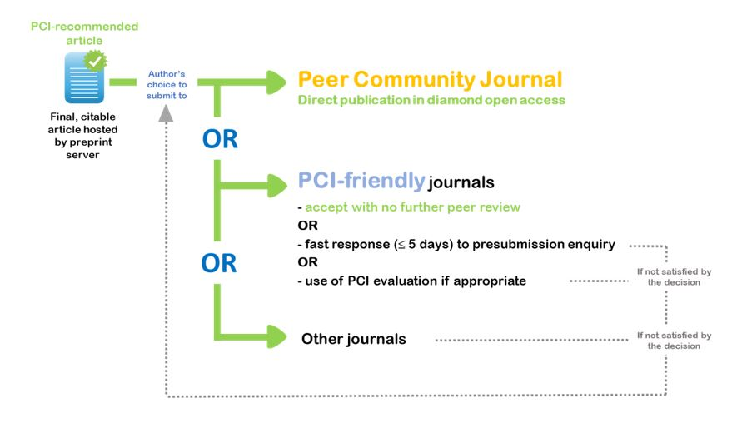
Can my preprint count as a publication?
Check Peer Comunity In : a free recommendation process of pre-print

Slide 11
Green or Gold Open Access ?
GREEN
Journal
The authors publish in a subscription journal
Peer-reviewed
No layout, no logo from the publisher
The last version sent by the authors to the publisher
Who pay ?
University pays for subscriptions
Open repository
They save the article in some open repository
Which version of the paper is in OA ?
Postprint
11

Slide 12



Green or Gold Open Access ?
GREEN
Journal
The authors publish in a subscription journal
Who pay ?
University pays for subscriptions
Open repository
They save the article in some open repository
Which version of the paper is in OA ?
Postprint
Sometimes Publisher Version
12

Slide 13
Green or Gold Open Access ?
GREEN
Journal
The authors publish in a subscription journal
Check the publishers’ conditions on
Sherpa Romeo
Who pay ?
University pays for subscriptions
Open repository
They save the article in some open repository
Which version of the paper is in OA ?
Postprint or preprint
13

Slide 14
Green or Gold Open Access ?
GOLD
Journal
The authors publish in Open Access in a journal
Article Processing Charges
Who pay ?
The authors or their institution pay APC to the publisher
Open repository
They may save the article in some open repository
Which version of the paper is in OA ?
Published article
14

Slide 15
Green or Gold Open Access ?
GOLD
Full Open Access Journal
The journal’s profits come only from APC.
Journal
The authors publish in Open Access in a journal
Who pay ?
The authors or their institution pay APC to the publisher
Hybrid Journal
The journal’s profits come from subscriptions and, sometimes from APC, when some author pays to get his or her article in Open Access.
Open repository
They may save the article in some open repository
Which version of the paper is in OA ?
Published article
15

Slide 16
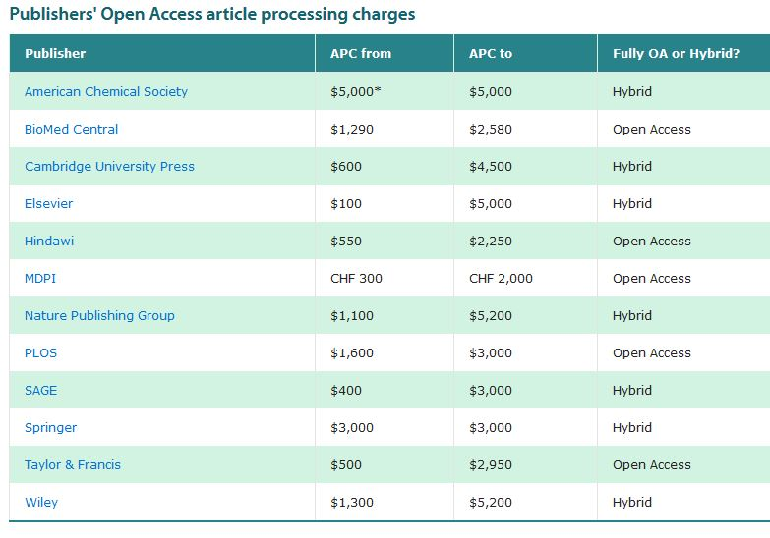
Source : Open Access University of Cambridge – Update : October 2018
16

Slide 17
Green or Gold Open Access ?
GOLD
Full Open Access Journal
Journal
The authors publish in Open Access in a journal
Who pay ?
The authors or their institution pay APC to the publisher
Hybrid Journal
Open repository
They may save the article in some open repository
Predatory publishers!
Which version of the paper is in OA ?
Published article
17

Slide 18
Beware predatory journals!
They mail scholars of all ages (master students, Phd students, early career researchers, professors…)
They target the wealthiest research fields (biomedecine), but also humanities and social sciences
They spread a distorted vision of Open Access

Slide 19

Beware predatory journals!
Here the sad and famous example of OMICS Publishing Group

Slide 20
Beware predatory journals!
Here the sad and famous example of OMICS Publishing Group
I am one of them!

Slide 21
2. Focus on APC funding

Slide 22

What APC means?
article processing charges

Slide 23


APC is a fee
APC is how much has to be paid to a journal
to make an article open access

Slide 24

How much does gold cost?
a journal can ask more than 3000 euros for an article to be open

Slide 25

Who pays?

Slide 26

Journal?
invitation
credit / discount
(e.g. for reviews)

Slide 27




Funder?
check terms, times and procedures

Slide 28

Institution?
publisher’s agreements
(es. transformatives)
dedicated fundings
(terms, times, procedures)
research fundings
(department, group, personal)

Slide 29





Remember the green
CURIS
the best if you choose a hybrid journal
always save the post-print
use always your institutional repository
(if you have one)

Slide 30

Pre-print is the answer
when your publisher doesn’t give any open access option
work on the contract
Warning: a small number of journals do not allow you to put the pre-print on open repositories

Slide 31
3. Diamond Open Access

Slide 32

Does the gold always cost?

Slide 33

Diamond is the true gold

Slide 34
The value of diamond
Nothing to pay for both authors and readers
Content of quality
Re-use oriented

Slide 35
No one pays diamond??
in-kind support and/or donated labor
support from institutions
grants
advertising
a mix of the above

Slide 36


Don’t pay at all

Slide 37

If you have to pay, avoid hybrid

Slide 38



If you pay, pay for quality

Slide 39
4. Spreading your research: free licenses

Slide 40
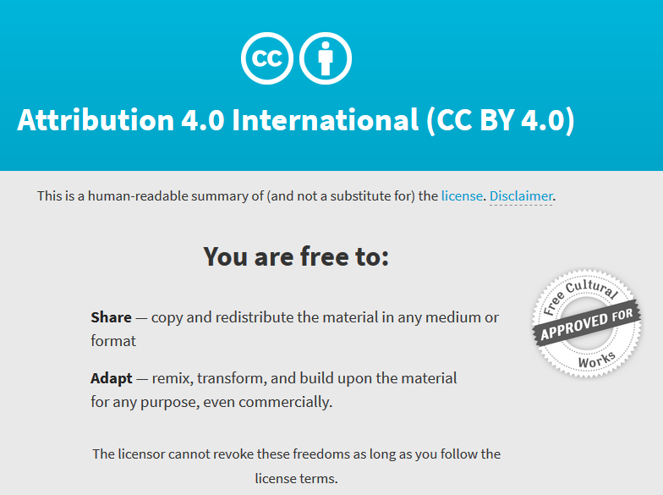
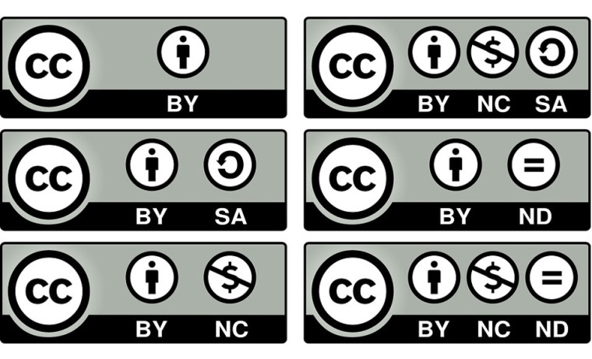

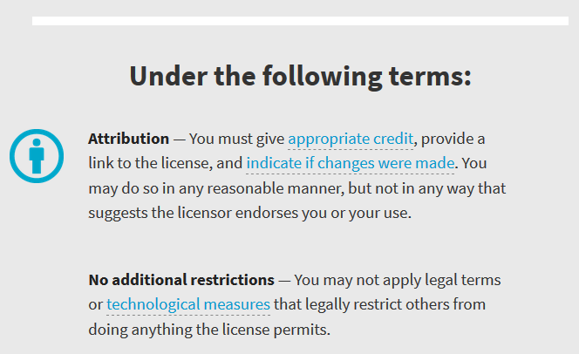
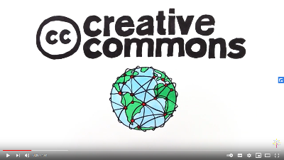
Creative commons Licences
To know more, a short video.
Click here →
Notes:
https://creativecommons.org/licenses/by/2.0/

Slide 41
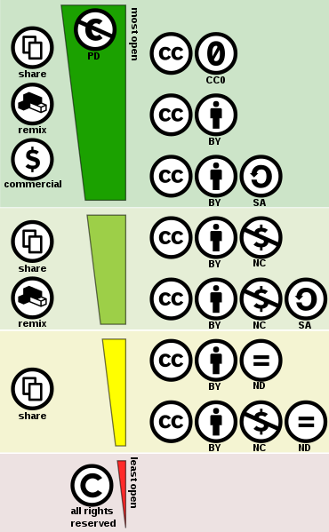
What does it mean?
41
Notes:
Pour vos lignes de code
Si possible pour vos figures
Utile pour le blogging scientifique

Slide 42
Name the author
42
Notes:
Pour vos lignes de code
Si possible pour vos figures
Utile pour le blogging scientifique

Slide 43
Share it in the same terms : CC-BY-SA
43
Notes:
Pour vos lignes de code
Si possible pour vos figures
Utile pour le blogging scientifique

Slide 44
44
Notes:
Pour vos lignes de code
Si possible pour vos figures
Utile pour le blogging scientifique

Slide 45
No commercial use
45
Notes:
Pour vos lignes de code
Si possible pour vos figures
Utile pour le blogging scientifique

Slide 46
No modification
46
Notes:
Pour vos lignes de code
Si possible pour vos figures
Utile pour le blogging scientifique

Slide 47

Register for our upcoming events: https://4euplus.eu/4EU-273.html
Next sessions:
“Data Management Plans - one tool with many applications” | 10 January 2022, 10:00 - 11:30
“Predatory publishers and identity fraud - how to identify dubious providers” | 27 January 2022, 15:00 - 16:30
“Publications Strategies for Monographs in Humanities and Social Sciences” | 7 February 2022, 10:00 - 11:30
7 further sessions after February 2022
47
Notes:
https://4euplus.eu/4EU-273.html

Slide 48
Thank you!

