Slide 1
Approaches for mass spectrometry quality control
Wout Bittremieux

Slide 2







Quality control
Target: peppermint icicles
Result: peppermint … euh ... erm

Slide 3
Do you already use quality control tools?

Slide 4
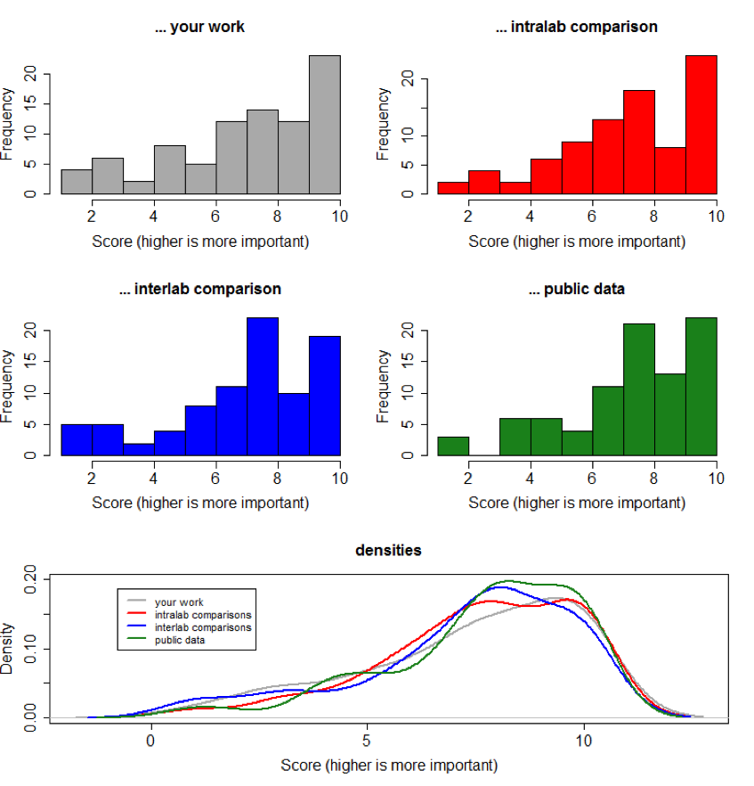
How important is quality control for … ?

Slide 5
Quality control data
proteins
peptides
LC column
MS scans
mass spectrometer
MS/MS scans

Slide 6
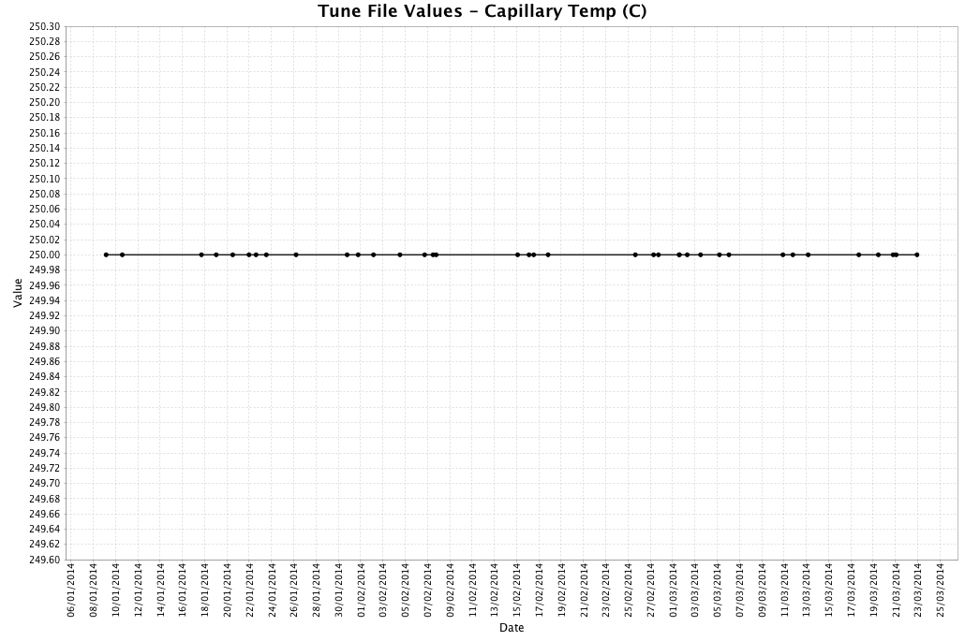
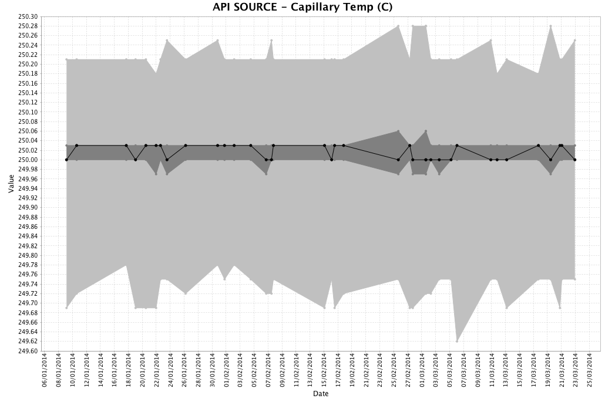
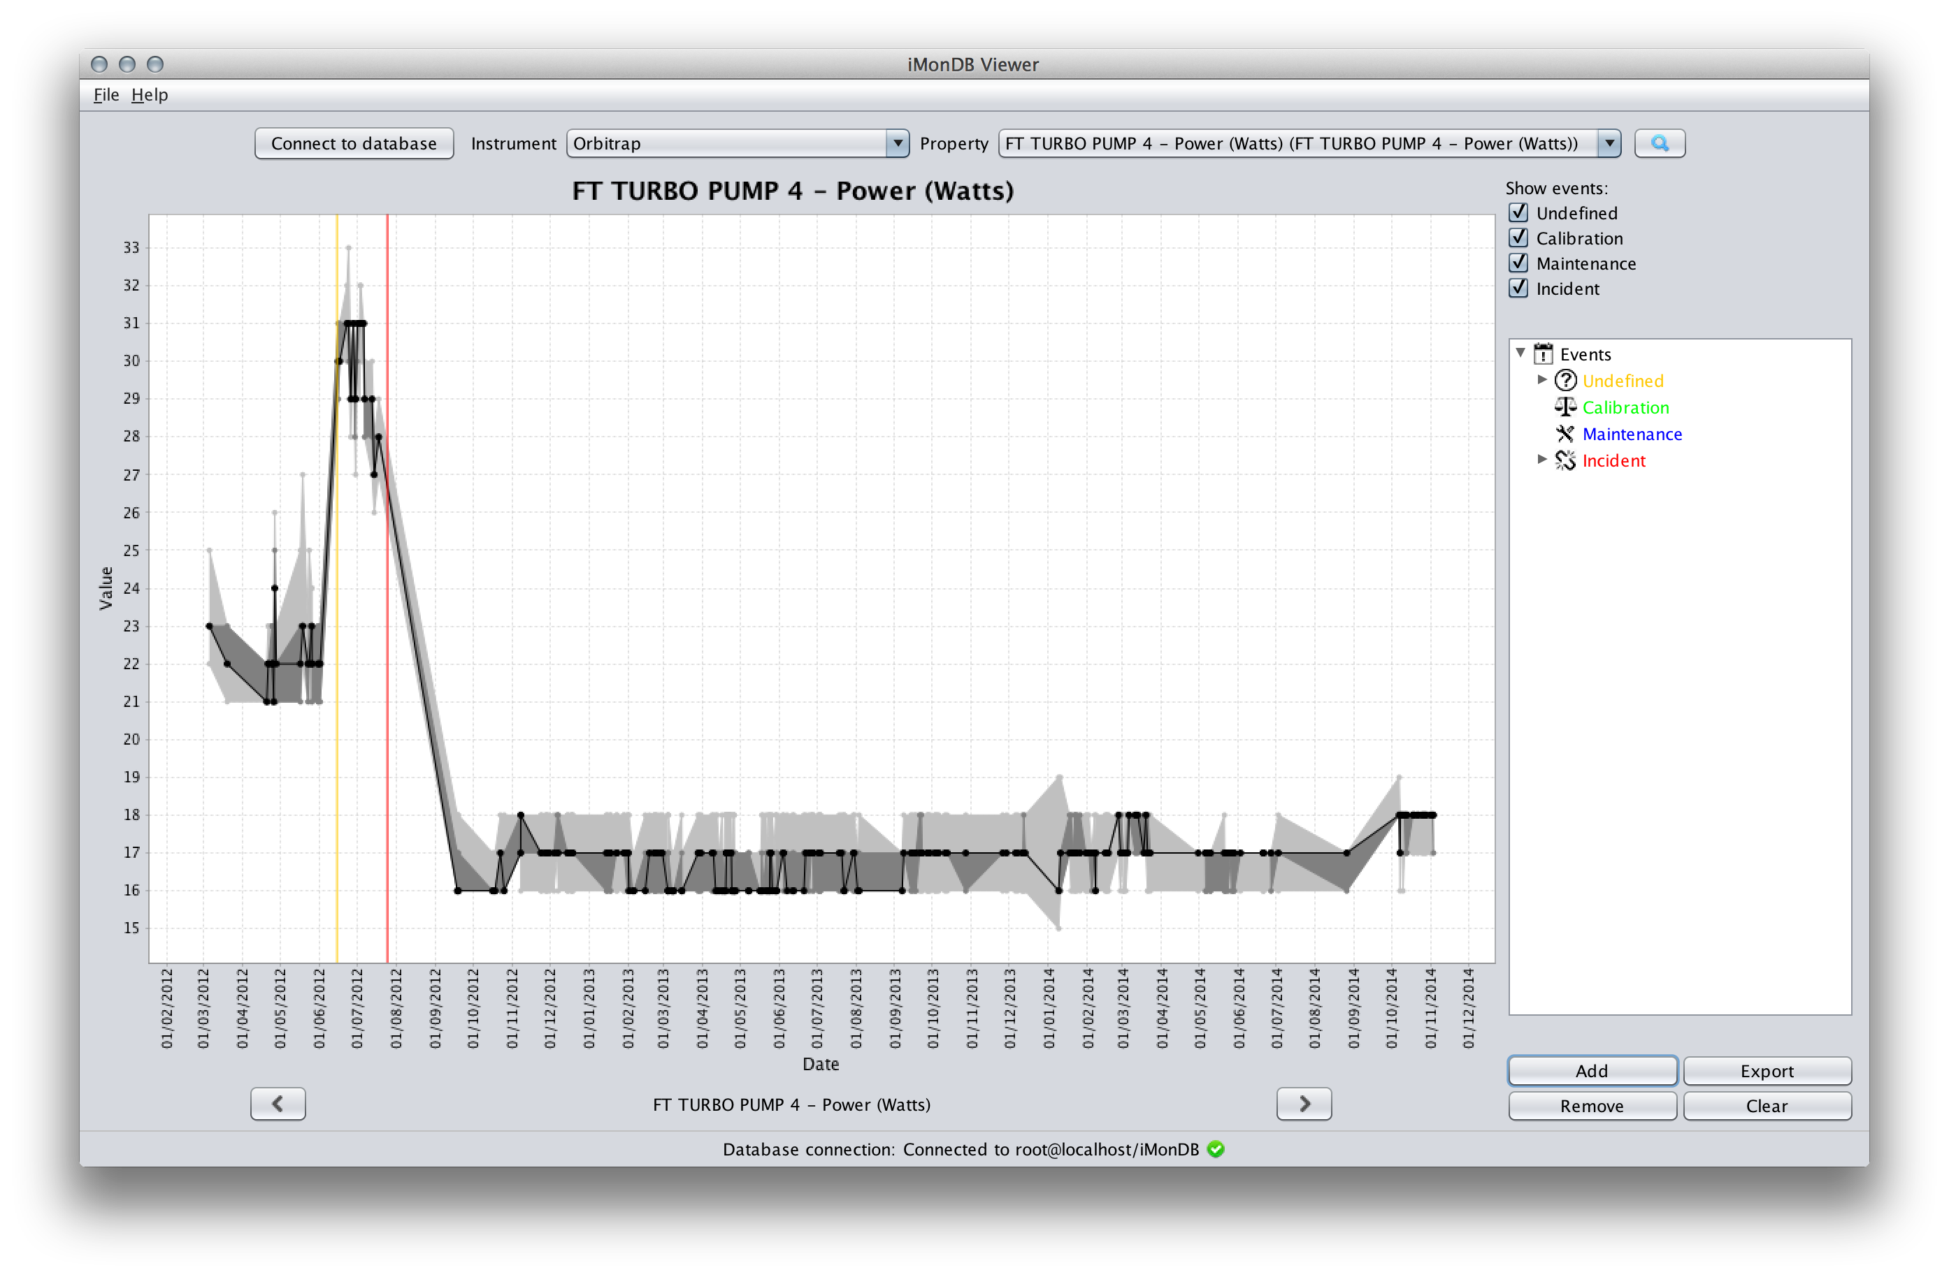
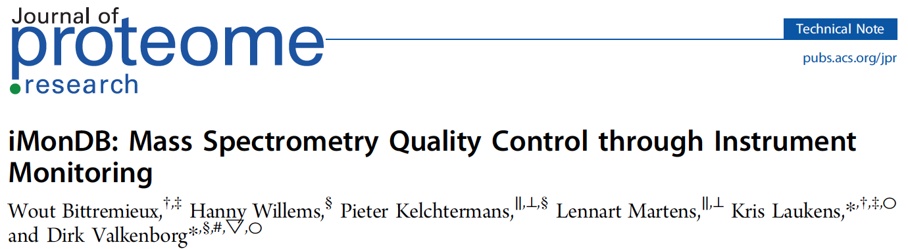
Instrument monitoring

Slide 7
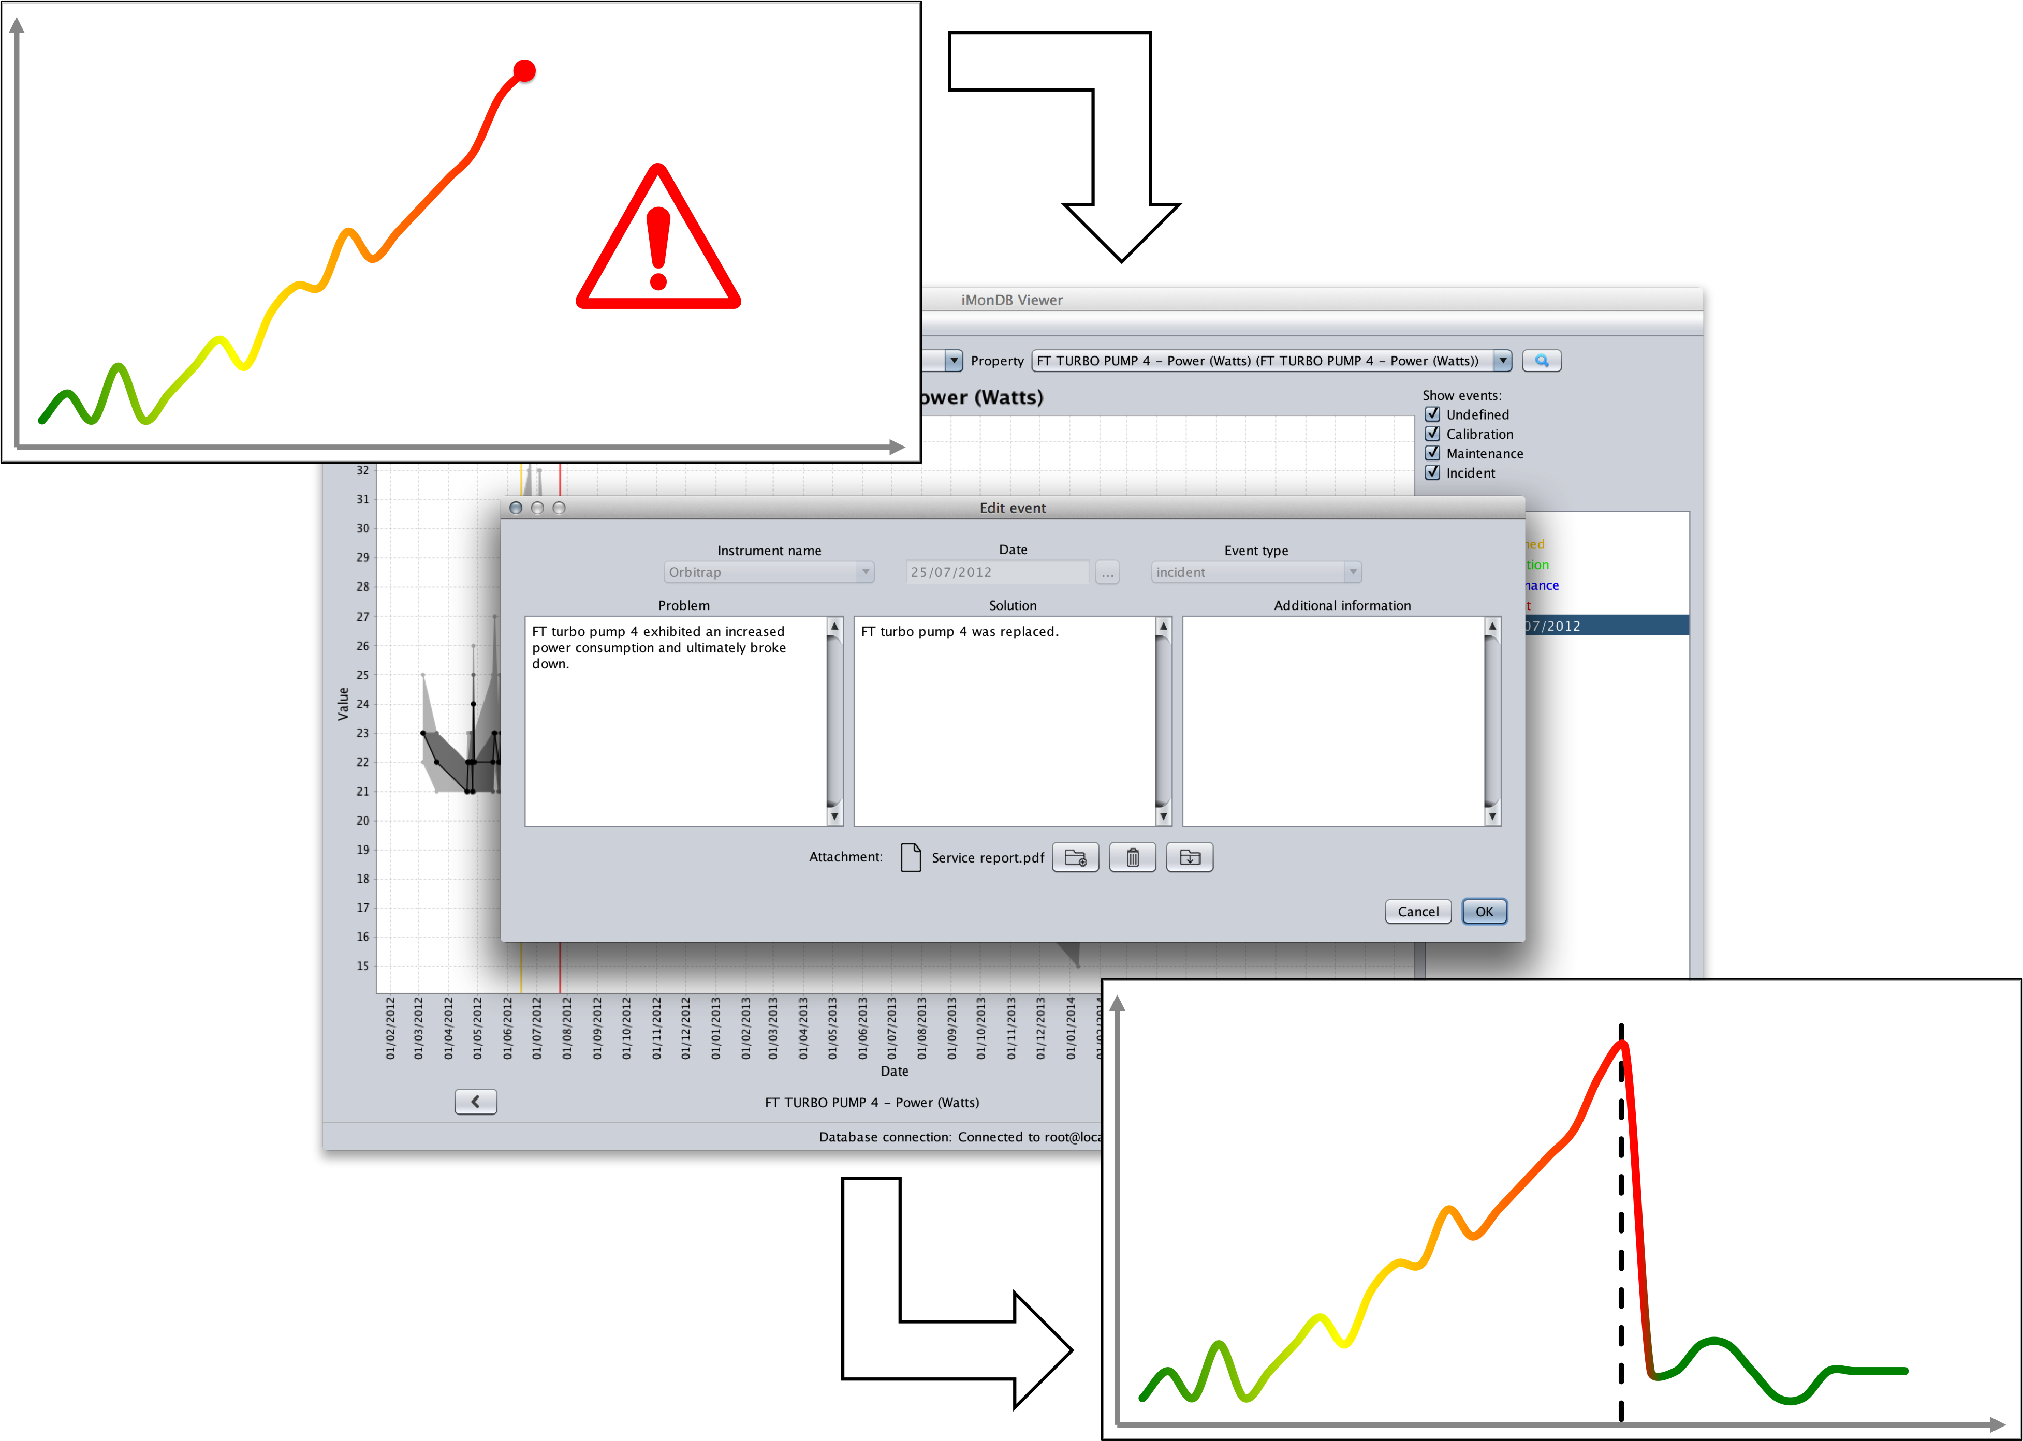
Instrument monitoring

Slide 8
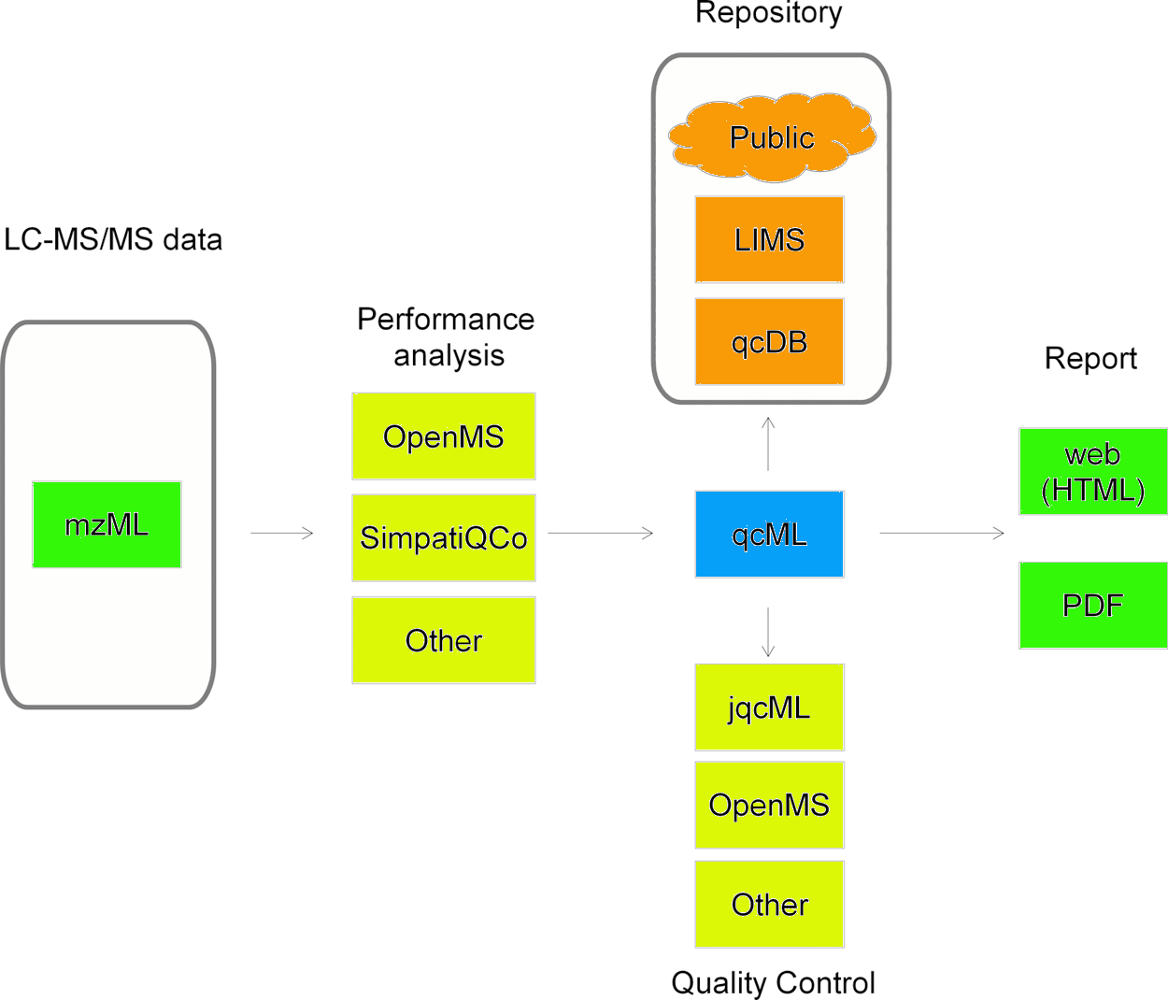
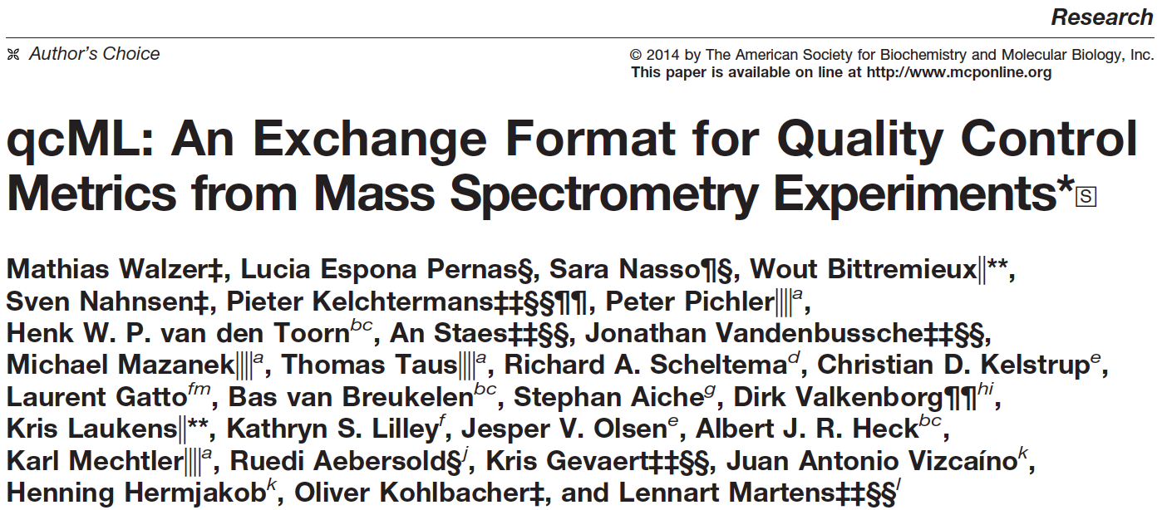
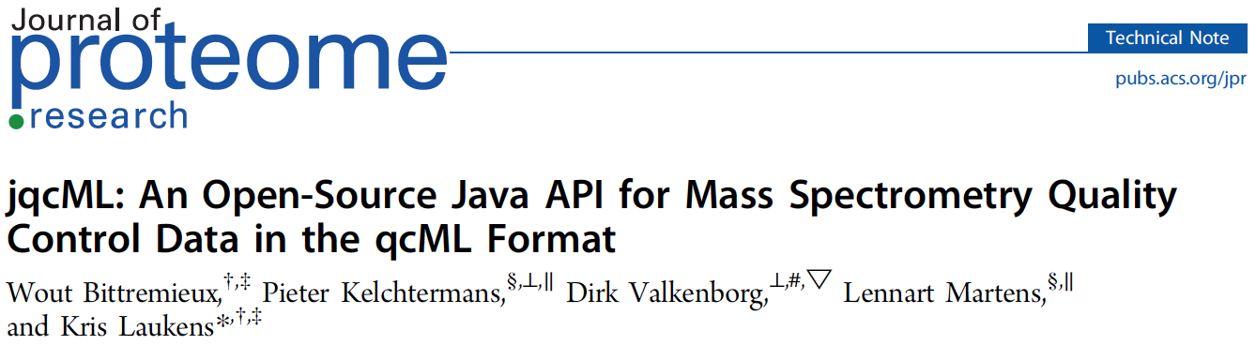
Data exchange

Slide 9
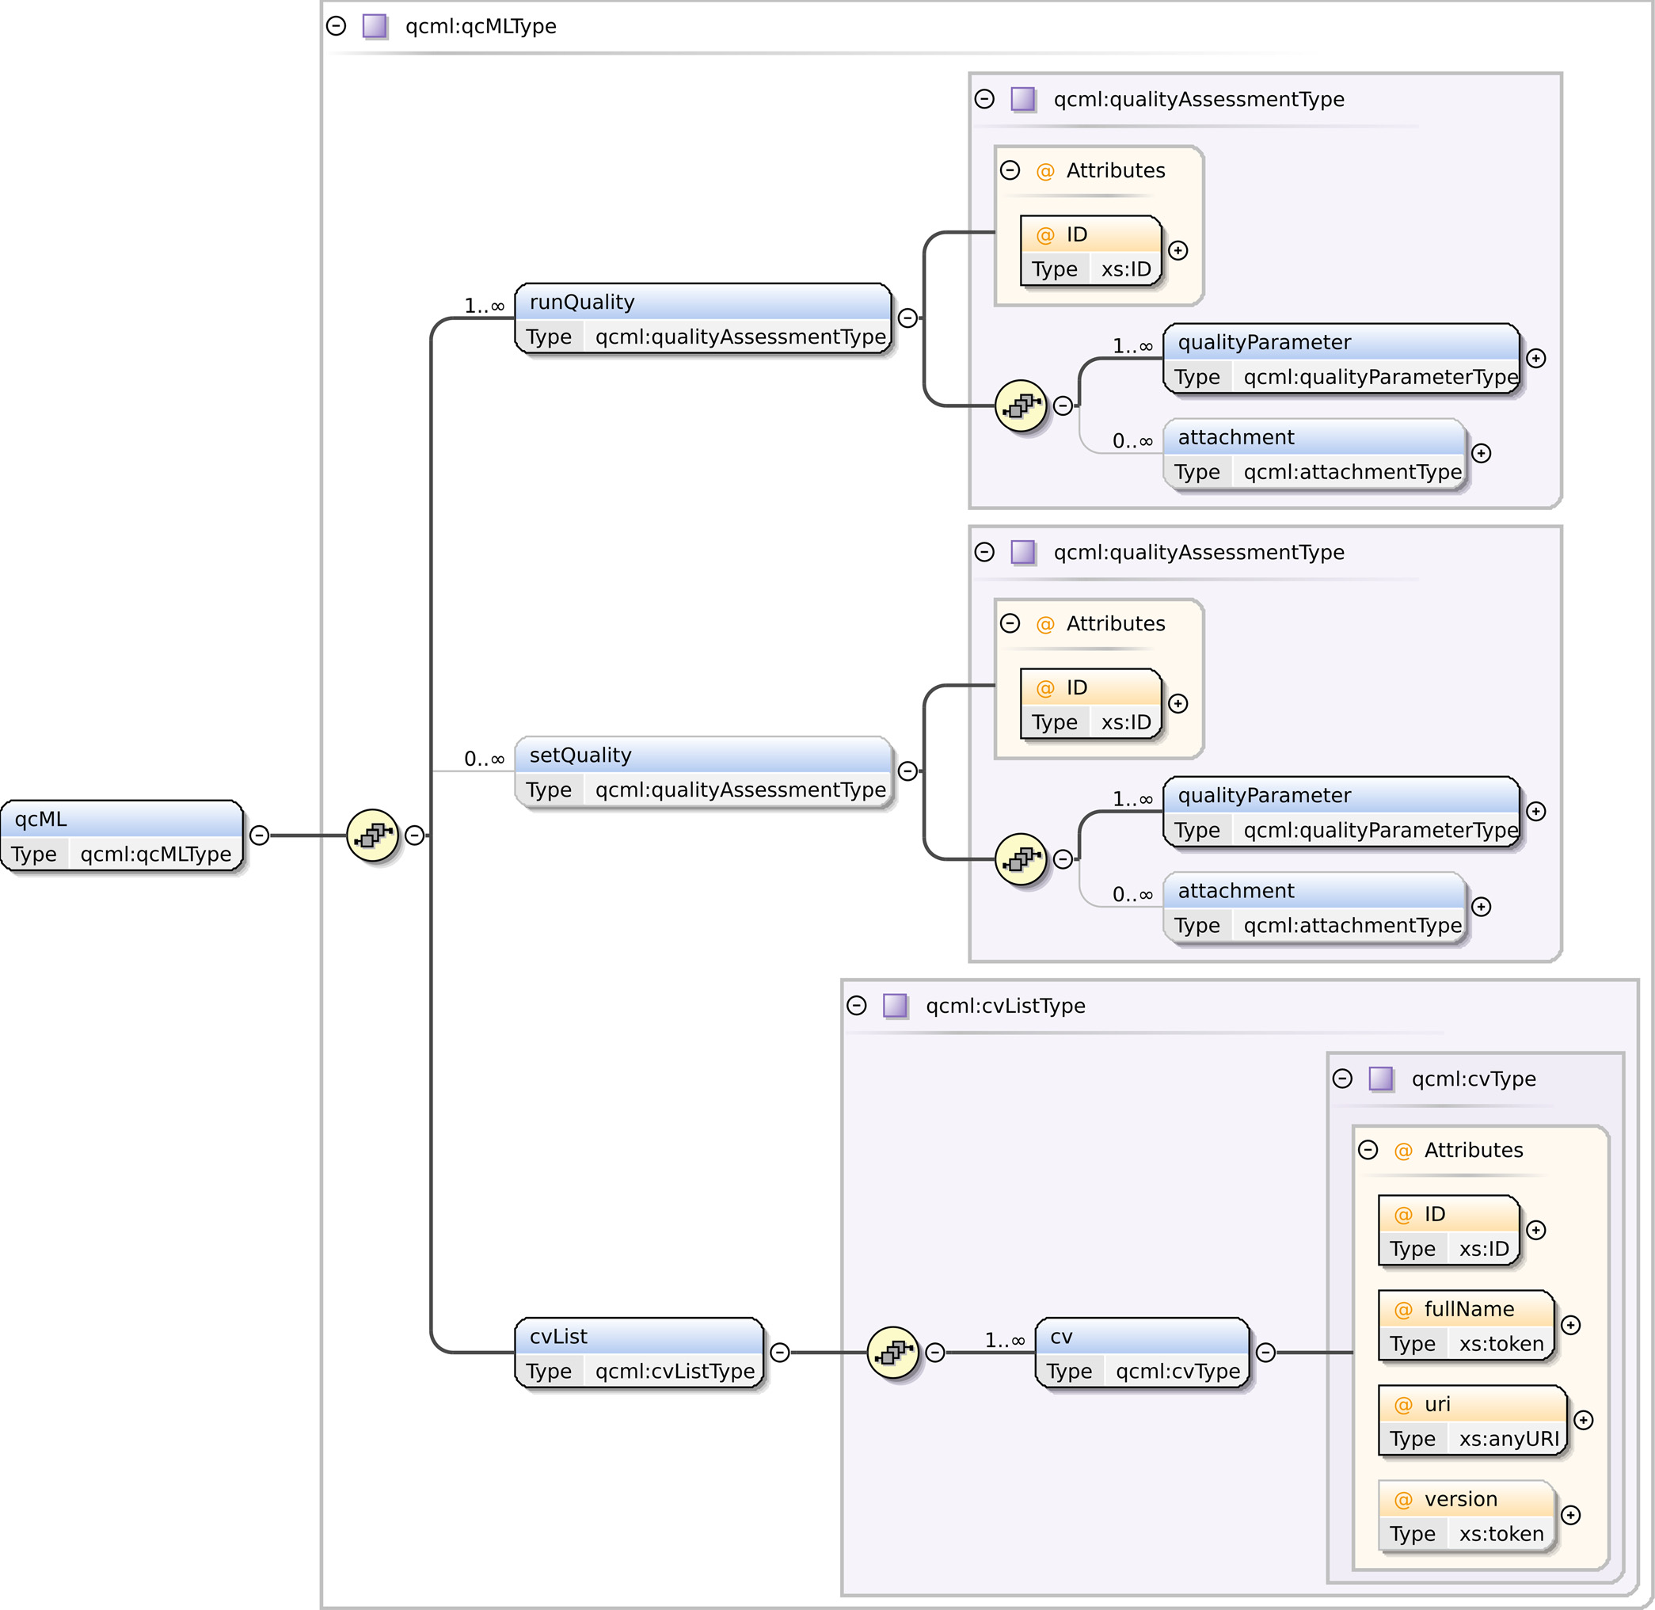
Data exchange

Slide 10

Low-quality experiment detection

Slide 11
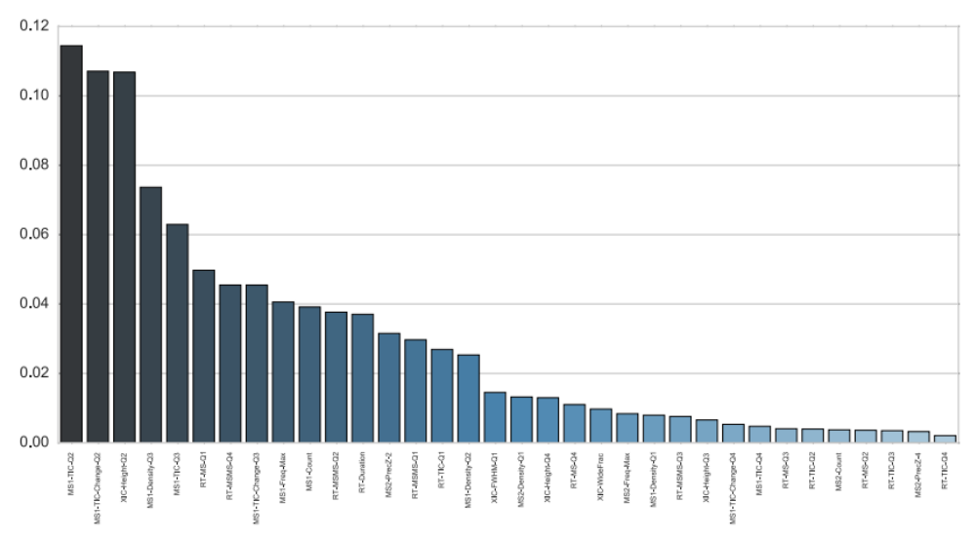
Low-quality experiment detection

Slide 12
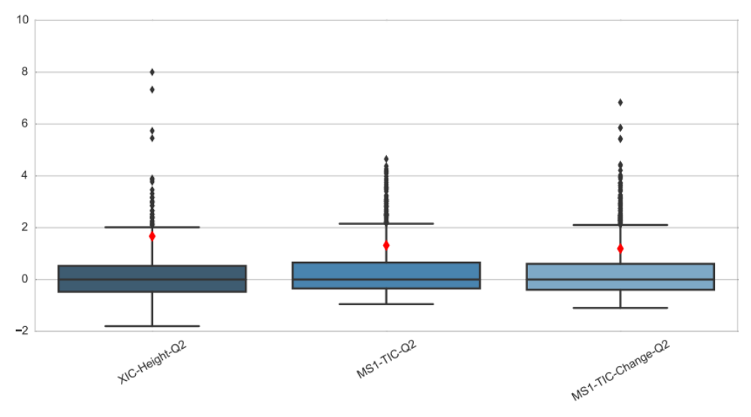
Low-quality experiment detection

Slide 13
Conclusion
Quality control at multiple levels
Instrument monitoring: low-level QC metrics
qcML: standard exchange format & storage
Outlier detection: identify and interpret low-quality experiments

Slide 14



Slide 15

Acknowledgments

