Slide 1
Data-Driven Museums
Alice Daish
Data Scientist
@alice_data
March 2017
Ideas in Practice Symposium

Slide 2
Hardware
Data
Software
@alice_data

Slide 3
Data Silos
@alice_data

Slide 4
Unmanaged data
?
?
?
?
?

Slide 5

Undervalued data
@alice_data

Slide 6
Data opportunity
@alice_data

Slide 7
Questions
Problems
@alice_data

Slide 8
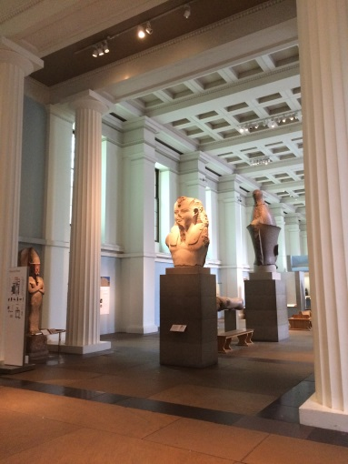
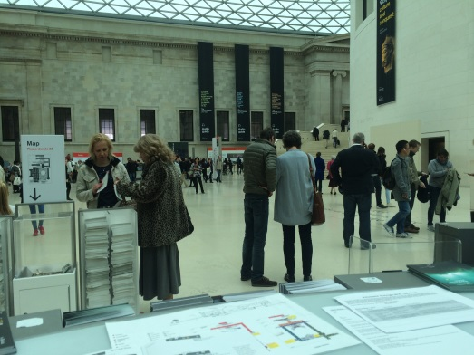

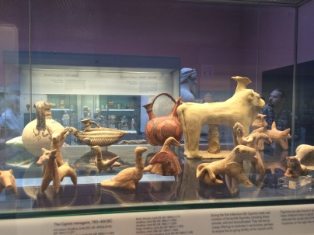
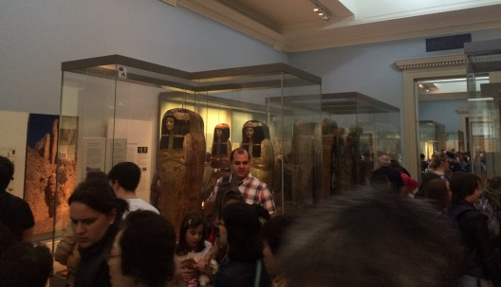
@alice_data

Slide 9







@alice_data

Slide 10
Here to help us …
Questions
Data
Problems
@alice_data

Slide 11
…to the rescue
Questions
Data
D
Problems
@alice_data

Slide 12
Questions
Data
Answers
D
Problems
@alice_data

Slide 13
Questions
Data
Answers
D
Decision
Problems
@alice_data

Slide 14
Questions
Data
Answers
D
Decision
Problems
Actions
@alice_data

Slide 15
Questions
Data
Answers
D
Decision
Problems
Actions
More Q’s
@alice_data

Slide 16
However…

Slide 17
Questions
Data
Answers
Decision
Problems
Actions
More Q’s
@alice_data

Slide 18
Questions
Data
Answers
Decision
Problems
Actions
More Q’s

Slide 19
D
@alice_data

Slide 20


@alice_data

Slide 21
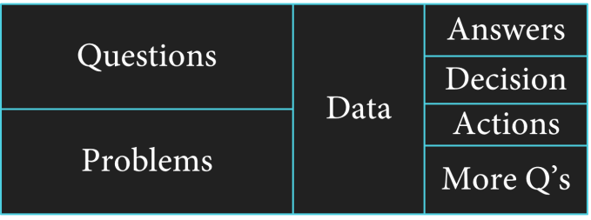
@alice_data

Slide 22
Data-driven

Slide 23
Data-Driven
@alice_data

Slide 24


Data-Driven
Data in the hands of decision makers
@alice_data

Slide 25
Data-Driven
Data in the hands of decision makers
@alice_data

Slide 26


Data-Driven
Data in the hands of decision makers
De-siloed, accessible, centralised data
@alice_data

Slide 27
Data Science at
The British Museum

Slide 28

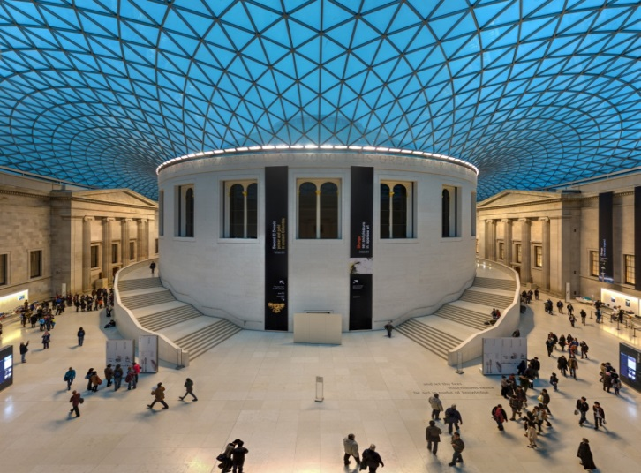
Set up
Opened 1759 to all 'studious and curious persons‘
1st National Public Museum in the World
Today
One of the most visited museum in the world
8 million objects
2 million years of human history
@alice_data

Slide 29




Starting point
Didn’t have … Did have…
No list of data sources
No data access
No databases
No data warehouse
R
Data Scientist
Big Data: Senior Product Manager
What does “big data” mean to the museum?
@alice_data

Slide 30

Finding data

Slide 31
@alice_data

Slide 32
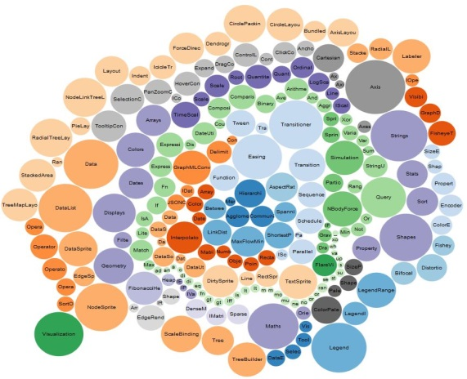


Bubble Envy
@alice_data
D3 Bubble Chart: https://bl.ocks.org/mbostock/4063269

Slide 33
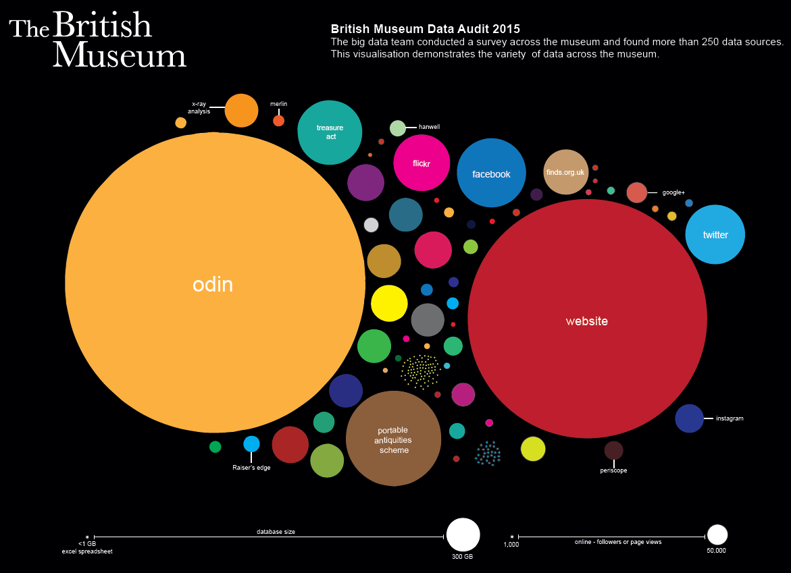
@alice_data
@alice_data
Package: bubbles

Slide 34
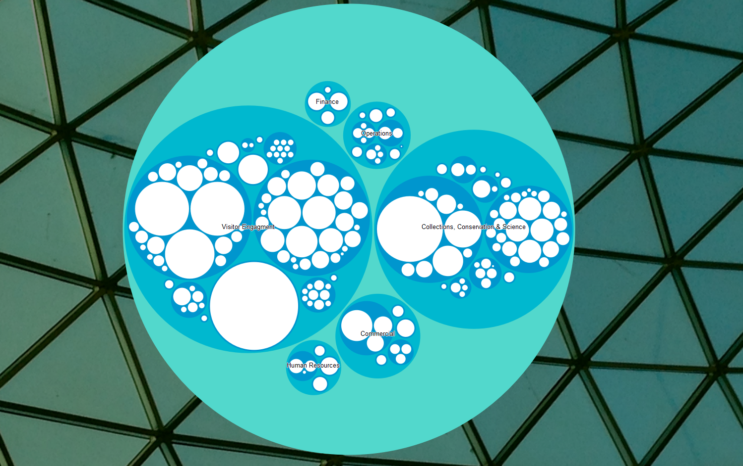
D3
(Data-Driven Documents)
@alice_data

Slide 35
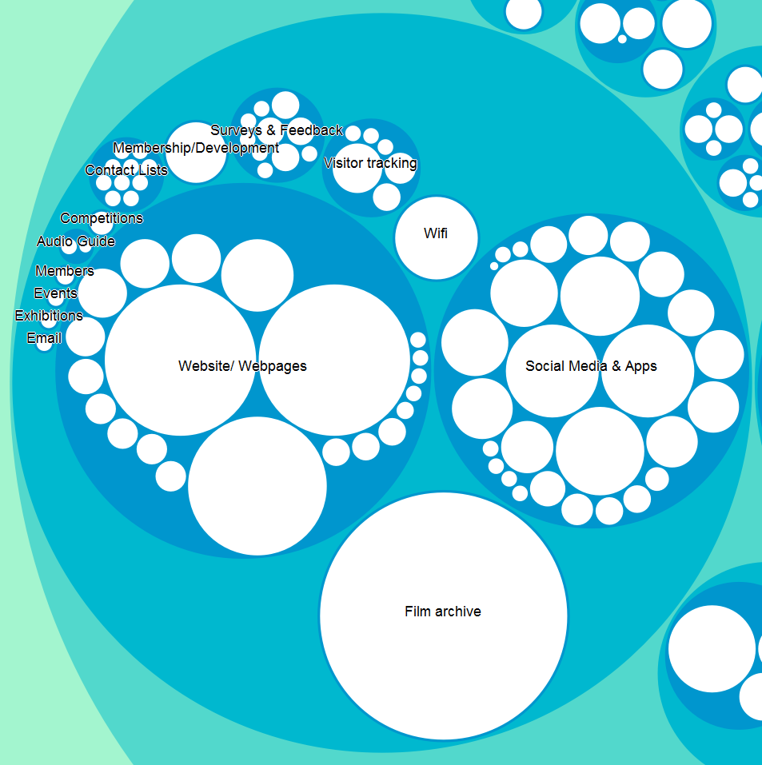
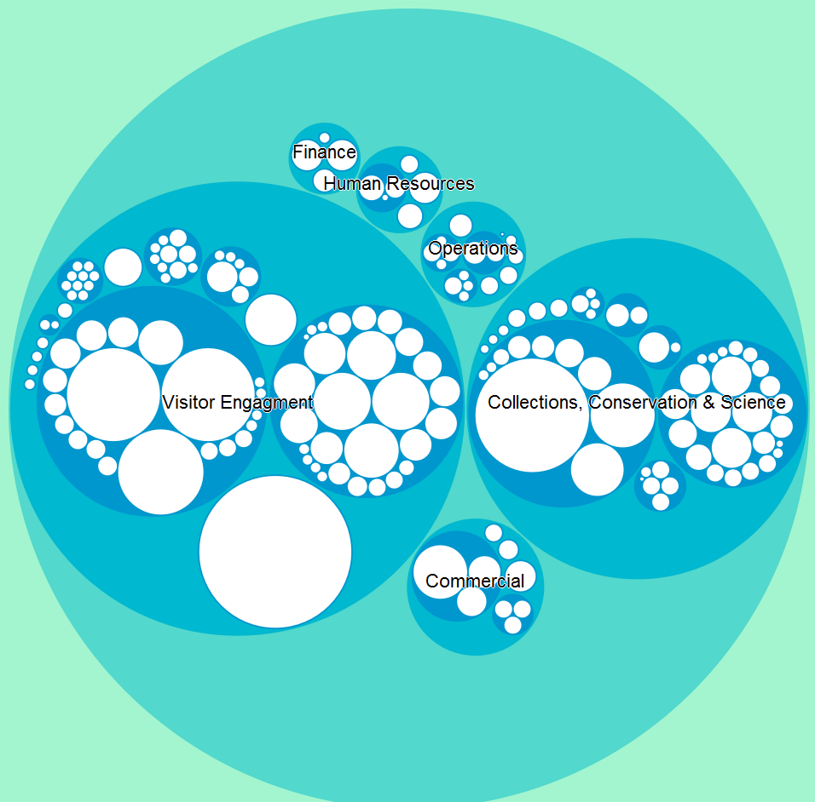
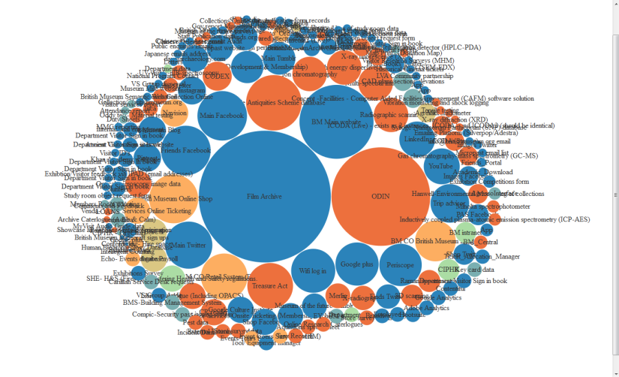
D3
(Data-Driven Documents)
@alice_data

Slide 36

Valuing data
@alice_data

Slide 37


@alice_data
Symbol - Noun Project: Dara Ullrich, DE

Slide 38
Business Problems = Data Opportunities
We don’t know who our visitors are?
Online = > 9 million
Offline = 6.8 million
We don’t know what they do in the museum?
And we don’t know the opportunities to generate revenue?
@alice_data

Slide 39
Business Problems = Data Opportunities
We don’t know who our visitors are?
Online = > 9 million
Offline = 6.8 million
We don’t know what they do in the museum?
And we don’t know the opportunities to generate revenue?
“silos” and “wrangling”
data viz
visitor movement
predictive modelling
@alice_data

Slide 40



email
“silos” and “wrangling”
Multiple visitor data platforms
CSV exports from external platforms
No SQL
online shop
wi-fi
@alice_data
Packages: data.table, dplyr

Slide 41
email
100’s of columns
“silos” and “wrangling”
Multiple visitor data platforms
CSV exports from external platforms
No SQL
online shop
print format exports
nested by timeslots
wi-fi
Split first and second name
@alice_data
Packages: data.table, dplyr

Slide 42
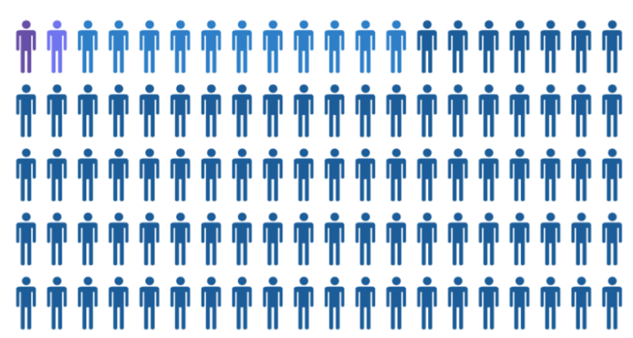
No SQL = data.table
How many visitors are on multiple platforms?
Assess the visitor data siloing
Why?
To improve engagement and access of the museum we need to examine our visitor data.
@alice_data
Packages: data.table, dplyr

Slide 43
Top 500 website search
June 2015-16
Packages : RSiteCatalyst (Adobe Analytics), WordCloud
@alice_data
Alice Daish. (2016). R KeyWord Search WordCloud: First Release. Zenodo. 10.5281/zenodo.56283

Slide 44

Top 500 website search
June 2015-16
Packages : RSiteCatalyst (Adobe Analytics), WordCloud
@alice_data
Alice Daish. (2016). R KeyWord Search WordCloud: First Release. Zenodo. 10.5281/zenodo.56283

Slide 45
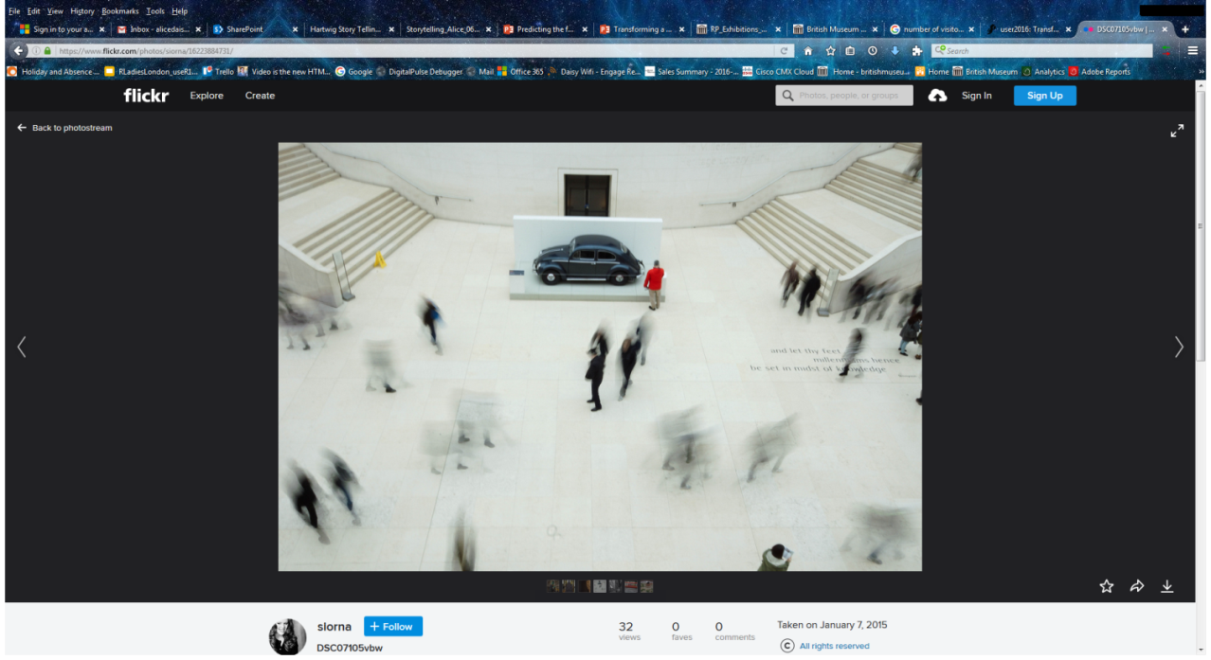
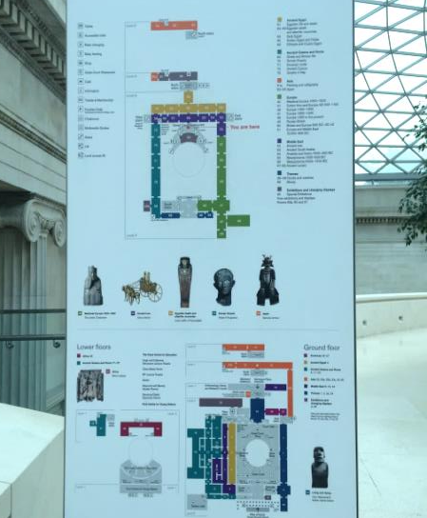
Visitor Movement
62 galleries, 3 floors, largest covered public square in Europe with 6.8 million visitors per year.
@alice_data
Packages : httr, jsonlite

Slide 46
Visitor Movement
Wi-Fi presence used to sample visitor numbers
1st to use R to connect to CISCO Presence API
@alice_data
Packages : httr, jsonlite

Slide 47
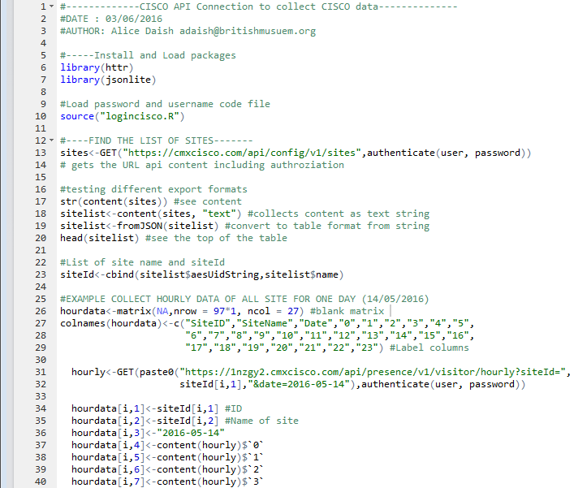
Visitor Movement
Wi-Fi presence used to sample visitor numbers
1st to use R to connect to CISCO Presence API
@alice_data
Packages : httr, jsonlite

Slide 48
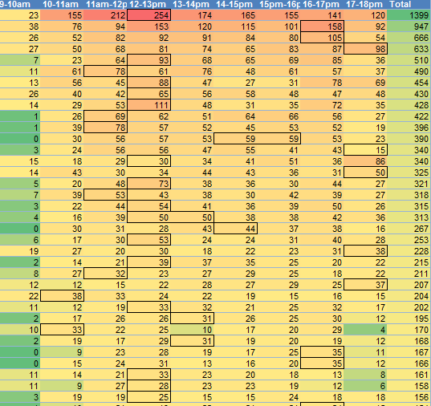
Visitor Movement
Wi-Fi presence used to sample visitor numbers
1st to use R to connect to CISCO Presence API
@alice_data
Packages : httr, jsonlite

Slide 49
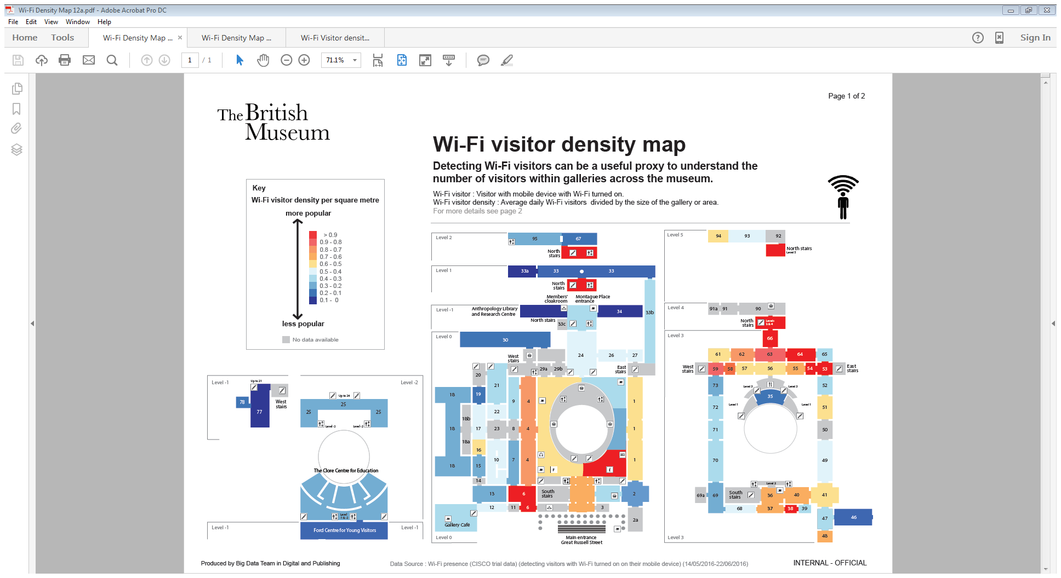
Nothing is perfect
Proxy only
@alice_data

Slide 50
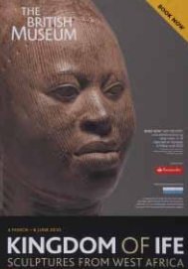
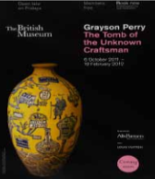
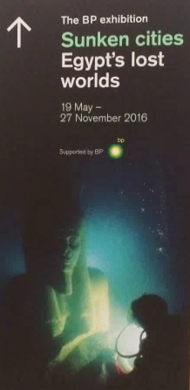
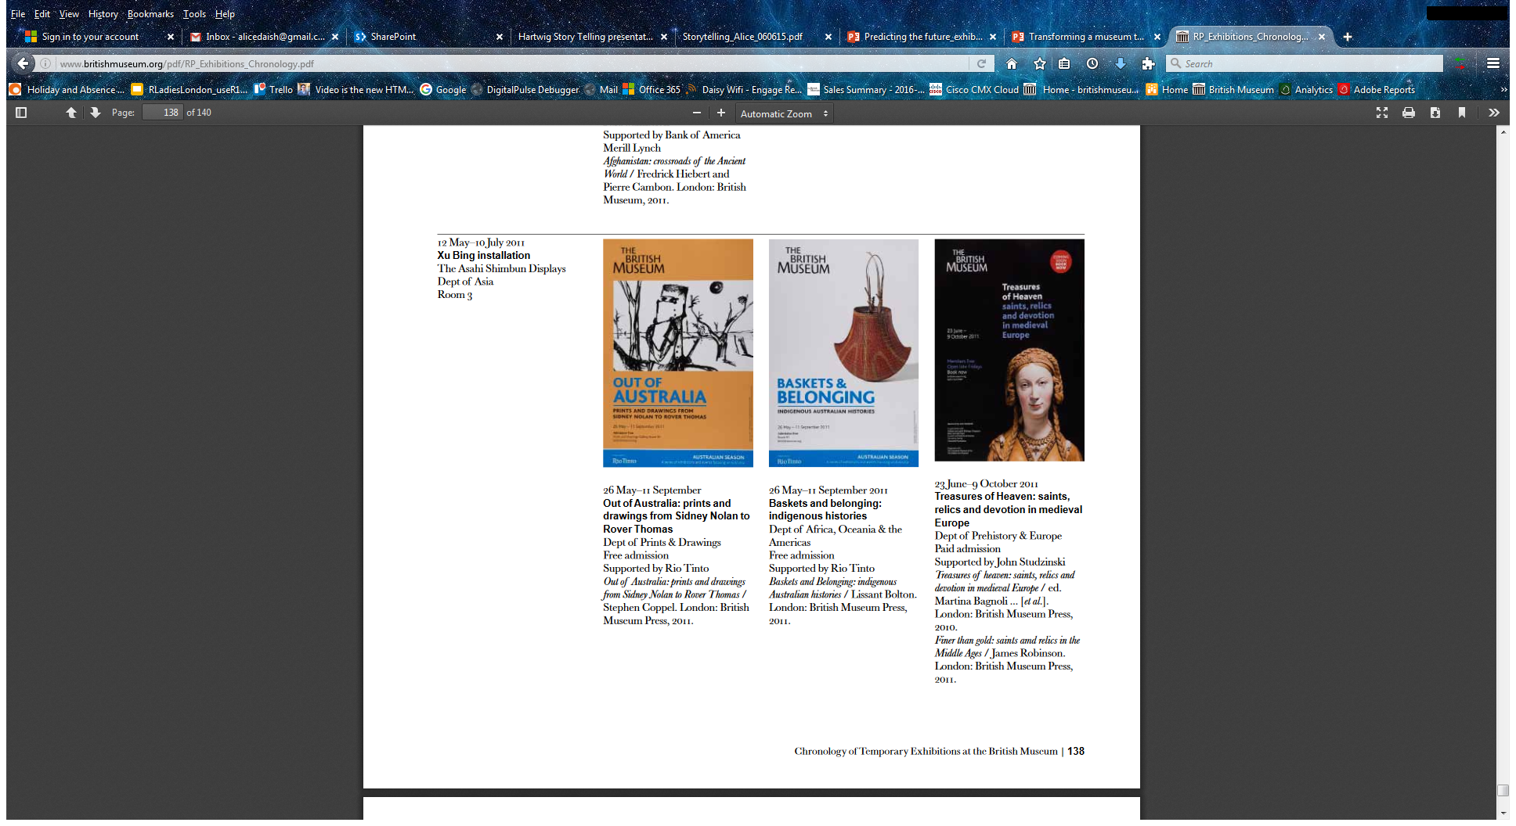
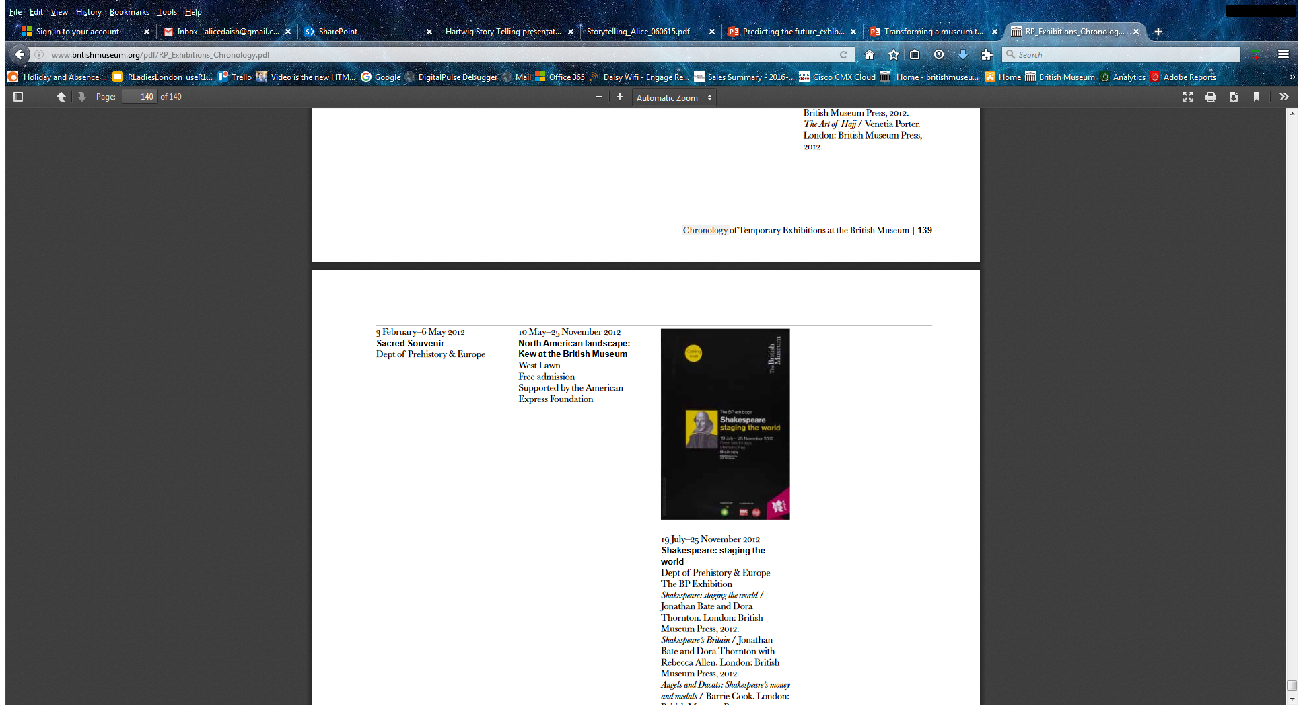
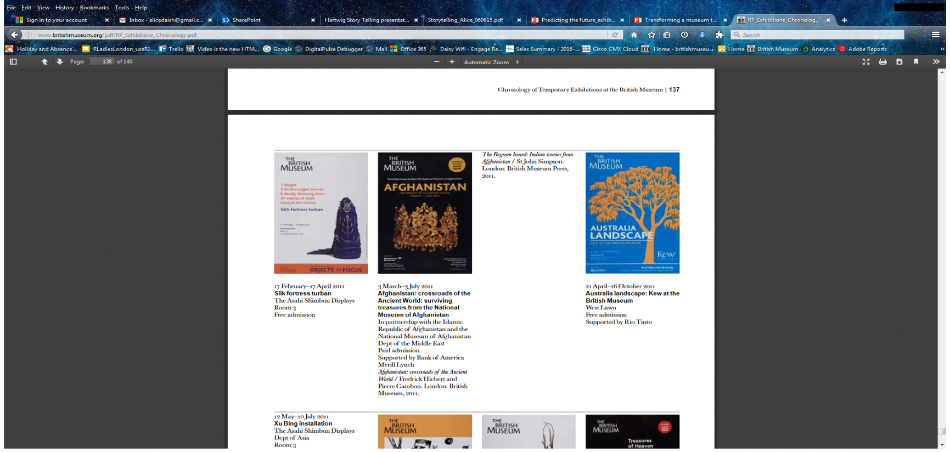
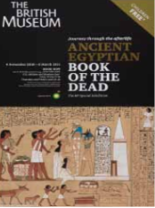
Predictive modelling
Can we predict ticket sales for exhibitions?
mixed effect modelling
data wrangling
modelling
prediction
@alice_data
Packages : lme4, lubridate, dplyr, data.table, ggplot2, ggthemes

Slide 51
Predictive modelling
First initial model created
Predicted first exhibition sales Development continues …
@alice_data
Packages : lme4, lubridate, dplyr, data.table, ggplot2, ggthemes

Slide 52


De-siloed accessible data
@alice_data

Slide 53
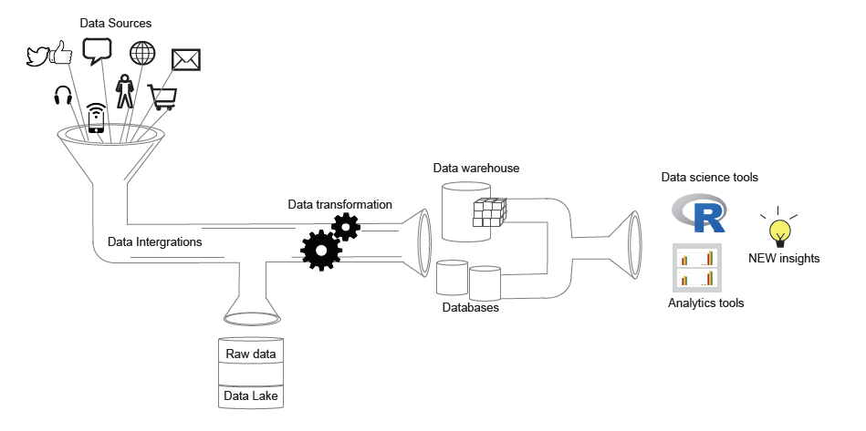
Data Pipeline
@alice_data

Slide 54
Dashboards
Monitoring
Reporting
Analysis
Analysis
Analysis
Visualisation
@alice_data

Slide 55




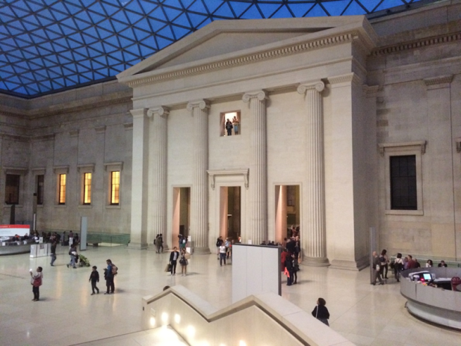
What next…
Data-Driven
Support staff empowerment
Data in the hands of decision makers
De-siloed accessible centralised data
Data-driven decision making primarily for product and content development and optimization
Scoping opportunities for revenue generation
BUT Who knows?
Internet of things
e.g. Toilet door locks, Boilers, Visitor Flow Signs
Machine Learning
e.g. Predicting Visitor Numbers, Optimization, New Collection Discoveries

Slide 56
Transformation advice
@alice_data

Slide 57
Problems to becoming data-driven
@alice_data

Slide 58

Problems to becoming data-driven
Siloed and inaccessible data
@alice_data

Slide 59
Problems to becoming data-driven
Siloed and inaccessible data
@alice_data

Slide 60
Problems to becoming data-driven
Siloed and inaccessible data
Decision maker unwilling and distrusting of data
@alice_data

Slide 61
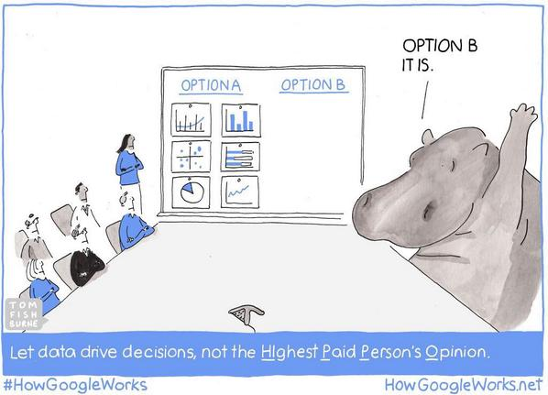

Slide 62
Data culture
Data advocacy
Transforming any organisation to be data-driven is about changing behaviours and habits.
Data value needs to be discovered and shared. By giving voices to data champions and advocates.
@alice_data

Slide 63

support
High level support
Quick Wins
Find early adopters
Build trust
@alice_data

Slide 64
Technical
Evangelist
Technology orientated and use data frequently within their roles.
Supports data roles and adoption across the business
Data Ambassador
Data is highly important to their role but not necessarily their main responsibility.
Adopting data techniques and sharing the value and insight data can provide.
Business Data Advocates
Supports data application across business
Champion the use of data in high-level meetings and discussions
@alice_data

Slide 65

team skills
Data Science
Maths & Statistics Knowledge
Computer Science
Domain Expertise
Communication
& Empathy
@alice_data

Slide 66
team skills
Strategic Project Management
Stakeholder Manage- ment
Project Manage-ment
Communication
& Empathy
Business Strategy
@alice_data

Slide 67

upskilling
@alice_data

Slide 68

Data Science Upskilling
Beginner
Intermediate
Advanced
@alice_data

Slide 69
Data Science Upskilling
Beginner
Intermediate
Advanced
Excel main tool
Filter
Basic calculations
@alice_data

Slide 70
Data Science Upskilling
Beginner
Intermediate
Advanced
Excel main tool
Filter
Basic calculations
Excel and BI tool
Pivots
Advanced Calculation
Visualisation
Data Analysis Reporting
@alice_data

Slide 71
Data Science Upskilling
Beginner
Intermediate
Advanced
Excel main tool
Filter
Basic calculations
Excel and BI tool
Pivots
Advanced Calculation
Visualisation
Data Analysis Reporting
Tools including Programming
Data Wrangling/Munging
Visualisation
Data Analysis
Modelling/Machine Learning
@alice_data

Slide 72
Data Science Upskilling
Beginner
Intermediate
Advanced
Excel main tool
Filter
Basic calculations
Excel and BI tool
Pivots
Advanced Calculation
Visualisation
Data Analysis Reporting
Tools including Programming
Data Wrangling/Munging
Visualisation
Data Analysis
Modelling/Machine Learning
Excel
@alice_data

Slide 73
Data Science Upskilling
Beginner
Intermediate
Advanced
Excel main tool
Filter
Basic calculations
Excel and BI tool
Pivots
Advanced Calculation
Visualisation
Data Analysis Reporting
Tools including Programming
Data Wrangling/Munging
Visualisation
Data Analysis
Modelling/Machine Learning
Excel
BI tools/dashboard
@alice_data

Slide 74
Data Science Upskilling
Beginner
Intermediate
Advanced
Excel main tool
Filter
Basic calculations
Excel and BI tool
Pivots
Advanced Calculation
Visualisation
Data Analysis Reporting
Tools including Programming
Data Wrangling/Munging
Visualisation
Data Analysis
Modelling/Machine Learning
Excel
BI tools/dashboard
Programming : R/Python
@alice_data

Slide 75

listen & empathy
Listen to your stakeholders
Help them formulate
De-complicate keep it simple
@alice_data

Slide 76
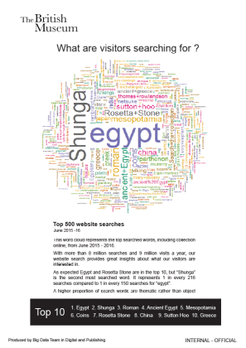
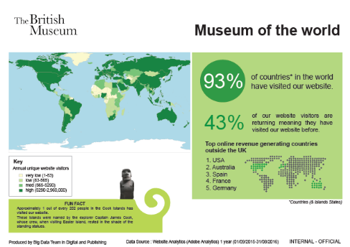

communicate
Comms series “Did you know”
Outreach
Encourage data ambassador
@alice_data

Slide 77
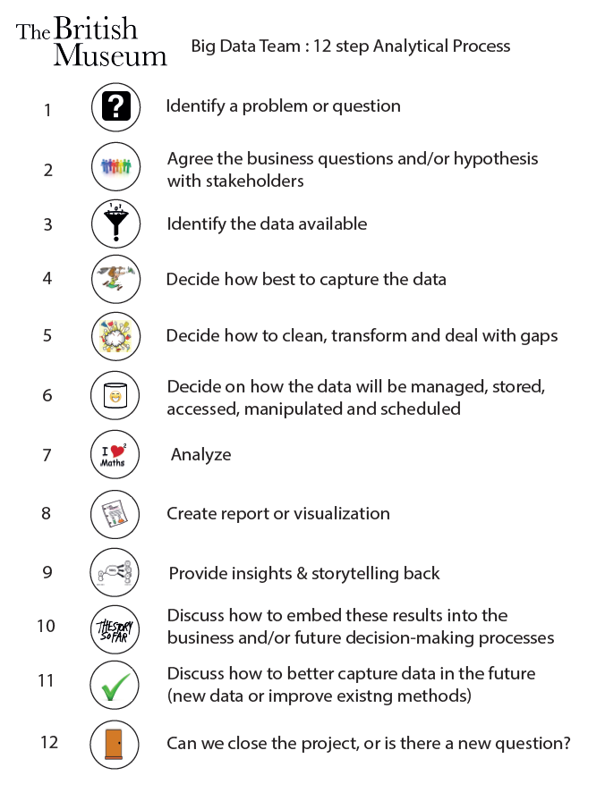

process
@alice_data

Slide 78

Vision for the future

Slide 79
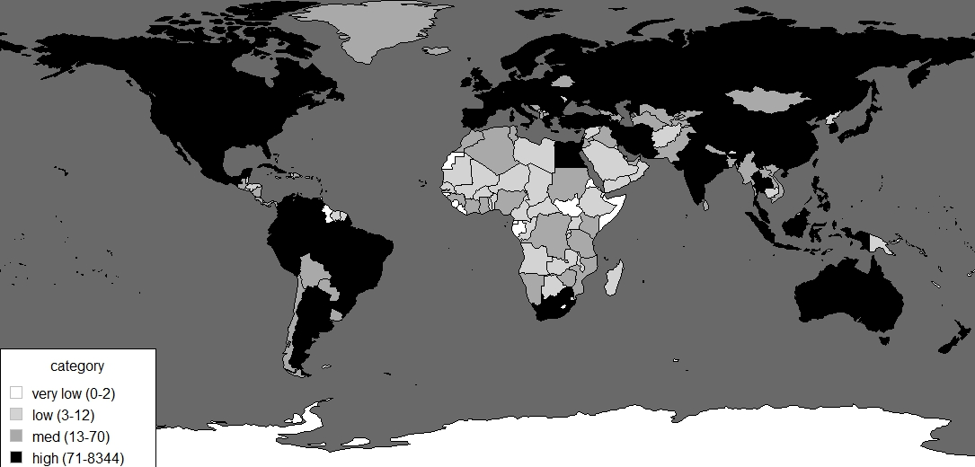
museums potential
55,000 museums 180 countries
Alice Daish (2016). RGlobalMuseumMap: First Release.. Zenodo. 10.5281/zenodo.56366
Original Data Source: Museums of the World (2015) Berlin, Boston: De Gruyter Saur. Retrieved 5, Jun 2016, from http://ww.degruyter.com/view/product/448539

Slide 80
Business Problems
=
Data opportunity
Visitor Engagement
Objects
Operations
Buildings
Retail & ecommerce
Exhibitions
HR
Finance

Slide 81

Thank you & Questions
adaish@britishmuseum.org
@alice_data
Many thanks to museum departments for their support and data access, Siorna Ashby, the big data team and my best friend R.
Symbol - Noun Project: Dara Ullrich, DE

