Slide 1




21 July 2020
Unlocking Data to Tell the Story of Education in Africa: Webinar Summary & Synthesis

Slide 2
About this document
Recommended citation. | Adam, T., Agyapong, S., Asare, S., Heady, L., Macharia, W., Mjomba, R., Mugo, J., Mukiria, F., Munday, G. (2020) Unlocking Data to Tell the Story of Education in Africa: Webinar Summary & Synthesis. Available at: Available under Creative Commons Attribution 4.0 International, https://creativecommons.org/licenses/by/4.0/.
Licence. | Creative Commons Attribution 4.0 International https://creativecommons.org/licenses/by/4.0/. You — dear readers — are free to share (copy and redistribute the material in any medium or format) and adapt (remix, transform, and build upon the material) for any purpose, even commercially. You must give appropriate credit, provide a link to the license, and indicate if changes were made. You may do so in any reasonable manner, but not in any way that suggests the licensor endorses you or your use.
Creative Commons Acknowledge-ment | N/A
Identifiers | 2405685:S9MFQ8KB;10.5281/zenodo.4279156
Internal use. | g/p/1ZDlDzl061FVELgzlxCtJrdkl6MicygY4

Slide 3
ESSA and the REAL Centre at Cambridge University mapped available data sets across education based on research published in the African Education Research Database built as collaboration between ESSA and the REAL Centre at Cambridge University. The mapping covered early childhood education, primary and secondary and into tertiary.
Based on this mapping, we brought together a small group of actors with an interest in increasing data access and use for education in Africa on Tuesday 21st July, 2020. Participants included holders of education data sets, funders of education research and experts in opening and sharing data from other fields.
The aim of this virtual meeting was to understand how we can make progress, focusing on the following questions:
• What are the biggest barriers to sharing more data?
• What is currently being done to overcome these barriers? What more could be done?
• What can we learn from how other sectors have addressed this problem?
• What are effective approaches to increase the use of this data?
• How to work across education as a whole and where to focus on specific elements of the system?
The output from this webinar meeting will feed into an action plan to increase data availability and use in education across sub-Saharan Africa.
Notes:
Make sure the name is on the screen

Slide 4
Overview
Core partners
5
Presentation by Obadah Diab
15
Core team
6
Where should we aim to get to?
17
Welcome in numbers
7
What are the next steps to get there?
25
Meeting objectives
8
Who else do we need?
34
Welcome by John Mugo
9
Key highlights from facilitators
37
Introduction by Lucy Heady
10
Post-webinar reflections
44
Presentation by Samuel Asare
11
Thematic working groups
45
Pre-webinar survey reflections
13
Next steps
46

Slide 5
Core team
Taskeen Adam, EdTech Hub
Samuel Agyapong, ESSA
Samuel Asare, ESSA
Lucy Heady, ESSA
Wairimu Macharia, ESSA
Renaldah Mjomba, ZiZi Afrique
John Mugo, ZiZi Afrique
Faith Mukiria, ZiZi Afrique
Gemma Munday, ESSA
Notes:
Make sure the name is on the screen

Slide 6



Webinar in numbers
49 attendees
4 main speakers
10+ countries
4 regions
Notes:
Make sure the name is on the screen

Slide 7
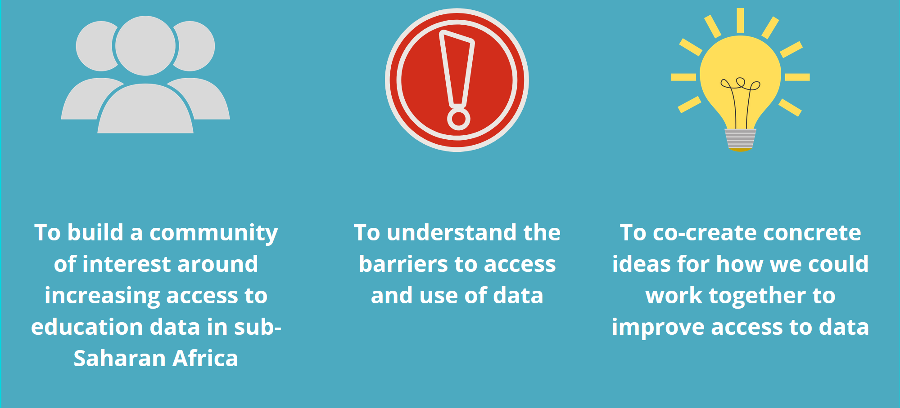
Meeting objectives

Slide 8
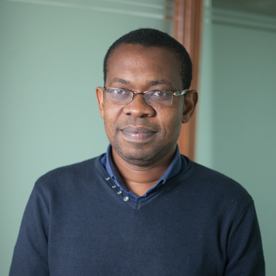
Welcome
We welcome every member to this Webinar, and value the attention you have given to this discussion on unlocking data for Africa’s education.
Africa’s education continues to face many challenges, but also, many of the solutions and answers lie still in unused datasets, and untold stories.
We welcome the participants to this discussion, that may be a great beginning of unearthing solutions and telling stories. When we work together, learning outcomes can be better, and achieved faster.
Dr John Mugo is the Executive Director of Zizi Afrique Foundation. Based in Nairobi, John has over 15 years post-PhD experience in generating large-scale data, and advocating for evidence-led policy change in education. Currently, John is leading the Assessment of Life Skills and Values in East Africa (ALiVE), a regional initiative that will produce large-scale evidence to catalyze systemic focus on the critical competences. Previously, John headed the Uwezo assessment in East Africa, and also taught at Kenyatta University in Kenya.

Slide 9

Introduction
We are all here today because we see progress in education held back by a lack of access to data.
Access to existing data is just one part of a big problem, but it is an important one: and we know it is one that affects African researchers disproportionately.
Poor access not only prevents useful analysis that could inform policy now, but it is also a barrier to building a new generation of African education experts and analysts in universities, statistical offices, NGOs and ministries. A generation that is needed for sustainable, evidence-driven change.
The COVID-19 pandemic makes our need for data only more extreme. Data is harder to collect and has never been needed more. Such a precious resource must be used to its full potential.
Lucy is the CEO at ESSA. She has over 15 years of experience in generating and using evidence to improve education, both in the UK and internationally. Her previous roles were at Nesta, the UK’s innovation foundation, as the Impact Director and at the Children's Investment Fund Foundation leading on assessment of evidence and managing evaluations for the education portfolio.

Slide 10
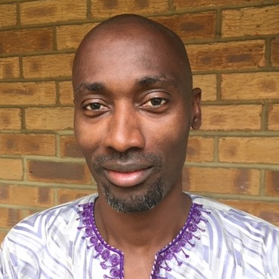
Open Data Use in the African Education Research Database
The conversation around data sharing or access has been going on for some time and the project to map education data is meant to contribution to this conversation.
The objectives of the project were:
  Map existing education data sets in SSS to increase its visibility and use.
  Advocated for open access policy and practice in the region.
Findings included:
  Low numbers of data sets.
  TVET and early childhood education have lowest numbers of data sets with primary and secondary education having the highest.
  Data sets from academics are least accessible and used.
Dr Samuel Asare is a higher education researcher and currently consulting for ESSA on the African Education Research Database, a joint project with REAL centre at the University of Cambridge. Prior to this, he held a postdoctoral position at the REAL centre. His research focuses on teaching and learning, especially factors that drive students to invest time and effort in their learning. His recent studies have looked at equity in research partnerships and agendas.

Slide 11
Q & A on African Education Research Database
Samuel was asked a number of questions after his presentation. The questions were thematically categorised and his answers are presented below.
01
What is data defined as?
According to Samuel, data refers to information collected through research which is stored as numbers or words and can be analysed multiple times.
02
Why was qualitative data excluded?
The exclusion of qualitative data was because of its high tendency to create confidentiality concerns.
03
Why was North Africa excluded from the analysis?
North Africa is crucial in the development of the region, however the scope of the project was to specifically focus on SSA.
04
Who are the end users of the data sets?
The data sets from the project will have a wider range of users including researchers, students, and policymakers.
Notes:
Data is often scattered and not centralised
Data is outdated
Lack of funds to
collect data
train people to handle data (data literacy)
specialists to analyse data
Lack of quality assurance
Data may not be cleaned or presentable
Data may not be accurate and representative
Data may not be checked for sensitivity and privacy concerns
Administrative data is hard to collect
Data is hard to disaggregate
Narrow the gap between program implementation and research.

Slide 12
Pre-webinar survey reflections
Before the webinar, participants were sent a pre-webinar survey asking them what issues they face regarding open data on education. The answers were thematically grouped into three categories.
Data accessibility and analysis
Data utilisation
Data capacities
Finding and sharing data
Data quality and interoperability
Relevance and packaging
Nurturing evidence use cultures
Capacities for quality and scale
Capacities for analysis and packaging
Notes:
Data is often scattered and not centralised
Data is outdated
Lack of funds to
collect data
train people to handle data (data literacy)
specialists to analyse data
Lack of quality assurance
Data may not be cleaned or presentable
Data may not be accurate and representative
Data may not be checked for sensitivity and privacy concerns
Administrative data is hard to collect
Data is hard to disaggregate
Narrow the gap between program implementation and research.

Slide 13
Pre-webinar survey reflections
In the pre-webinar survey, participants were asked ‘How can your organisation contribute?’. These were some of the responses:
Conduct training on analysis, access, publication UIDs and other interoperability issues
Map data use and availability more comprehensively
Define benchmarks for increasing confidence in independent data
Lobby governments and engage in continuous stakeholder engagement
Create a data repository
Define good practice norms for sharing data
Notes:
Data is often scattered and not centralised
Data is outdated
Lack of funds to
collect data
train people to handle data (data literacy)
specialists to analyse data
Lack of quality assurance
Data may not be cleaned or presentable
Data may not be accurate and representative
Data may not be checked for sensitivity and privacy concerns
Administrative data is hard to collect
Data is hard to disaggregate
Narrow the gap between program implementation and research.

Slide 14

Humanitarian Data Exchange
The mission of the HDX Centre is to increase the use and impact of data in humanitarian response.
HDX has over 100,000+ users per month and over 19K+ datasets have been shared from 1200+ sources.
The challenges facing HDX include willingness in data sharing, timeliness of data and messiness of data.
Some use cases of the HDX platform include mapping of global school closures due to COVID-19 (UNESCO), mapping of Ebola outbreaks in West Africa etc.
Effective practices when it comes to data sharing and outreach include increasing access to open, interoperable and timely data critical for understanding various issues and the best strategies for responding in different contexts.
The challenges they have faces can be overcome through support and cultivation of relationships with data owners.
Obadah Diab is a Research Analyst working with the United Nations OCHA Centre for Humanitarian Data. Over the past year, he has been involved in multiple projects that aim to increase access to data on education in emergencies. Obadah graduated from Georgetown University School of Foreign Service in 2018 where he majored in International Economics.

Slide 15
Breakout Sessions
Participants were separated into groups, and each group was tasked to respond to three questions. In the first two questions, the responses were grouped into three similar themes that emerged.
Q1.
Where should we aim to get to?
Q2.
What are the next steps to get there?
Q3.
Who else do we need?
Understanding the data ecosystem
Processes and procedures
Stakeholder Engagement
Understanding the data ecosystem
Processes and procedures
Stakeholder Engagement
Stakeholder engagement

Slide 16
Understanding the data ecosystem
Q1. Where should we aim to get to?

Slide 17
Q1.I
Identifying problems
In discussing where we want to get to, the following problems were identified.
Data is often scattered, decentralised, and difficult to disaggregate
There is lack of funds to collect data, promote data literacy, and obtain
specialists to analyse data
Lack of quality assurance
Data may not be cleaned or presentable
Data may not be accurate and representative
Data may not be checked for sensitivity and privacy concerns
Data is outdated and not available when needed
There is difficulty collecting certain types of data, e.g., administrative data
Notes:
Data is often scattered and not centralised
Data is outdated
Lack of funds to
collect data
train people to handle data (data literacy)
specialists to analyse data
Lack of quality assurance
Data may not be cleaned or presentable
Data may not be accurate and representative
Data may not be checked for sensitivity and privacy concerns
Administrative data is hard to collect
Data is hard to disaggregate
Narrow the gap between program implementation and research.

Slide 18
Q1.I
Defining data and quality
Before deciding where we want to go to, we need to properly take stock of where we are.
Define what education data is
Identify our baseline
Identify stakeholders
Identify data uses
We need to define/identify what useful, quality data for education research is.
We need to define the supply and demand of data i.e.
What types of data exist?
What types of data do we want/need to collect?
We need to identify
who data owners are
who data users are, e.g., researchers, governments, education implementers, journalists
We need to identify:
What is/will the data being used for?
Where are there gaps in education data?

Slide 19
II. Processes and procedures
Q1. Where should we aim to get to?

Slide 20
Q1.II
Data collection standards and procedures
Participants proposed that to get to where we want to, we should:
01
Create and improve procedures and standards of data and data collection.
We need to have a set of key indicators to guide data collection.
Data needs to be cleaned and in the correct format.
02
For example, criteria for
  Relevance and accuracy
  Timeliness
  Accessibility/cost of dissemination of data
  Interoperability and comparability.
Develop criteria to evaluate if data is fit for purpose
03
Make data available in a timely manner
Data need to be available when
  it is needed, e.g., in response to a crises
  it is relevant, e.g., to help make informed decisions
04
Change norms of data usage and standards
Educational data should be automatically open, unless it needs to be restricted.
Data should be used to promote mutual accountability
05
Decide conditions for when it is best to keep data restricted
Data may need to be restricted
  for ethical reasons
  for safeguarding reasons

Slide 21
Q1.II
Accessibility
Three angles of accessibility were identified to allow for the most effective dissemination of data to users
e.g., openly licensed
Legally accessible
Accessibility
Accessibly formatted
Understandable to non-technical audiences
e.g., editable and reusable without proprietary software
e.g., using visualisation tools
Notes:
We need to make education data
Available (legal)
Accessible (formats)
Understandable to non-technical audiences (communication and dissemination)
E.g. visuals

Slide 22
III. Stakeholder engagement
Q1. Where should we aim to get to?

Slide 23
Q1.III
Visions for open education data
Participants shared specific visions of where we should get to for successful open education data:
Higher education
Promote open data sharing in higher education. They are currently driven by publication numbers. Data sharing could also become a metric.
Ministries of Education Improve capacity of ministries to manage and share education data e.g. through EMIS
Industry
Harness the bidirectional relationship between market demands and insights from data.
Data dissemination
A functional, online, interactive data repository specifically for education data sets in sub-Saharan Africa.
Stakeholder engagement
A network of stakeholders committed to data sharing across sub-Saharan Africa.

Slide 24
Understanding the data ecosystem
Q2. What are the next steps to get there?

Slide 25
Q2.I
Analyse the ‘education data’ ecosystem
In discussing the next steps, it was realised that the first step is to analyse where we are now.
Identify and address the bottlenecks on the ground.
Identify why there is inertia and/or lack of interest to moving towards open data.
Understand the gaps in education data better and where education data is needed.
Identify the financial barriers such as costs of data collection or preparation.
Learn from institutions that have made data open (e.g., Uwezo or the Young Lives Project).

Slide 26
II. Processes and procedures
Q2. What are the next steps to get there?

Slide 27
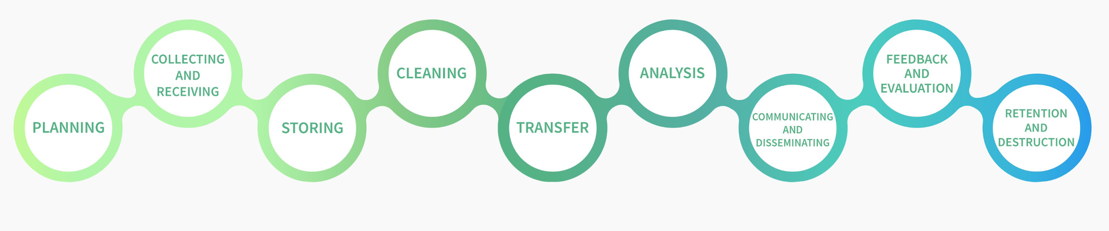
Q2.II
Create processes, standards and frameworks
Participants identified that we need to develop processes, standards, frameworks and policies to guide open data collection and utilisation.
Map the data life cycle for education data and outline standardisation processes
Stratify and categorise data to make it appropriate for and useable by different types of users.
Create legal and policy framework that guides data collection and data sharing
Image by HDX: https://data.humdata.org/

Slide 28
III. Stakeholder engagement
Q2. What are the next steps to get there?

Slide 29
Q2.III
Promote skills development
Building capacity of data owners, collectors, handlers, analysers and users was identified.
Build skills and capacity in data collection
Conduct workshops on how to collect data
Develop data guides on how to handle data
Share effective practices to data collection
Provide guidelines on how to standardise datasets

Slide 30
Q2.III
Advocacy
An important next step is to advocate and raise awareness with different stakeholder groups.
Advocate with various stakeholders about the uses and benefits of open data
Raise awareness about the need for sharing data with researchers, policy makers, etc
Share examples of when data was shared openly and the successes it led to (e.g., apps like Citymapper emerging from open data)
Nurture a culture of research to: inform policy and programmes, be demand driven, and have a deeper understanding of the use of data

Slide 31
Q2.III
Facilitate stakeholder engagement
Throughout the webinar, it was highlighted that there is a need to bring different actors together. Suggestions relating to stakeholder engagement included:
Establish an education data group with the various stakeholders to
discuss issues of data accessibility and sharing
foster collaboration
Include varied perspectives and gain buy-in from the onset
Facilitate communication between those who are generating and those who are using the data.
Build links to and learn from other groups/organisations working with other data sets e.g. datasets in health.
Encourage engagement, utilisation and interrogation of the data by researchers and policymakers as this will lead to improved data quality.
Building stakeholder engagement

Slide 32
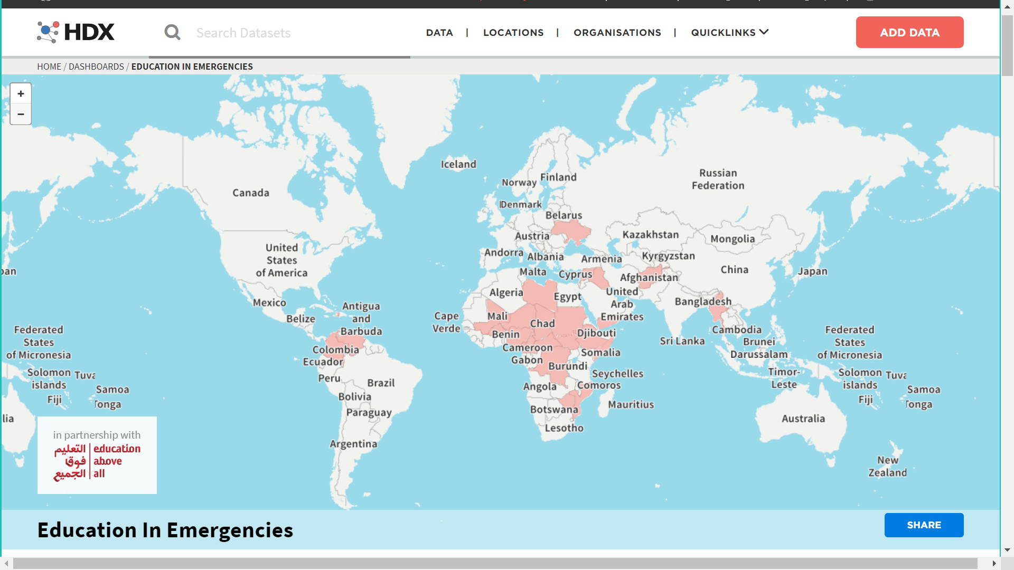
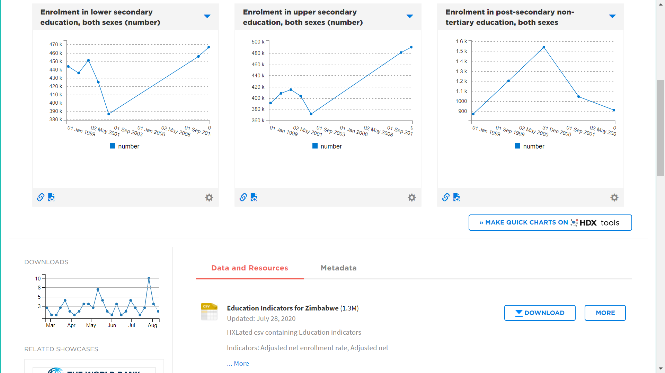
Build a data portal
Creation of a data portal will promote communication and information dissemination. The data portal by HDX (below) provides a good example of how to collate data and present it well.

Slide 33
I. Stakeholder engagement
Q3. Who else do we need?

Slide 34
Types of stakeholders
Six types of stakeholders who play different roles in the data management process were identified:
Data owners/funders
e.g. an INGO
Data producers
e.g. a research team
Data collectors
e.g. enumerators
Data consumers
e.g. policymakers
Data communicators
e.g. data portal creators
Data analysers
e.g. statisticians

Slide 35
Breakdown of key stakeholders
Many key stakeholders were listed by participants. Due to many of them playing multiple roles (or different roles in different contexts) they are not grouped into the six categories.
Funders
Higher Education Institutions
National governments
Econometricians
NGOs/INGOs
Research students
Ministries of education
Statisticians
Civil society organisations
Researchers
Policymakers
Data collectors
Data communications agencies/ Media
Academics
Districts offices
Enumerators & Translators
Private sector
Academic journals/ Publishers
Bureaus of statistics
Data brokers/
intermediaries
Scholarship providers
Education implementers

Slide 36
Key highlights from facilitators

Slide 37
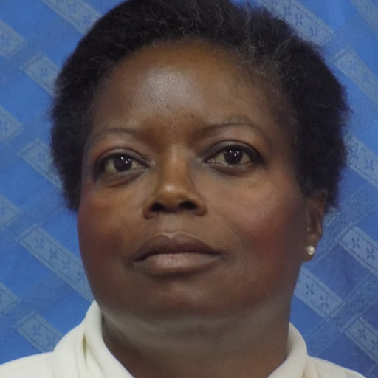
We need to reach out to [the data] users and ensuring we are engaging all key stakeholders including teachers.
There should be greater consideration of use of the data even before data collection to ensure we are capturing the right information. If this is done correctly, it can improve learning and teaching.
Mrs. Esme Kadzamira
University of Malawi
Chancellor College, School of Education

Slide 38

There should be increased equality in data availability and access. How can we incentivise/encourage data sharing for those who don’t necessarily see the benefit in opening up their data?
Dr. Hugues Moussy
Head of Research & Development
UNESCO

Slide 39
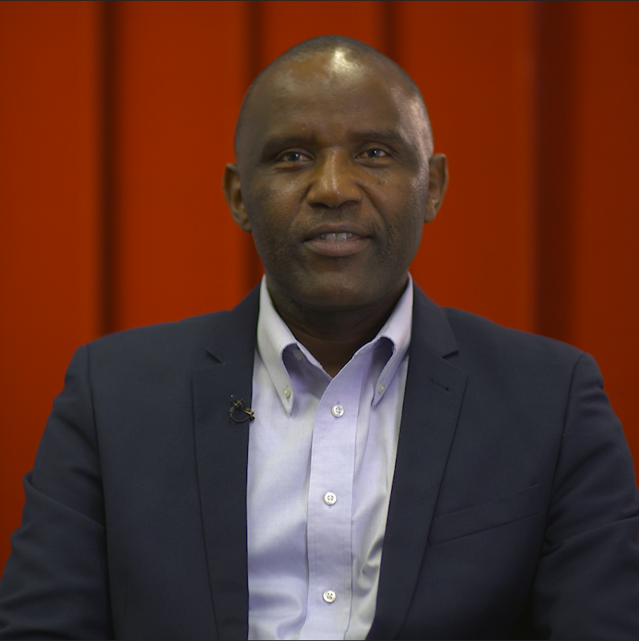
Open data in the education sector should be the default and not the exception to make access easier for all. Increasing access to education data will allow for greater utilisation for decision making. This is a process that will take time, concerted effort and collaboration.
Dr. Moses Ngware
Senior Research Scientist
African Population and Health Research Center (APHRC)

Slide 40
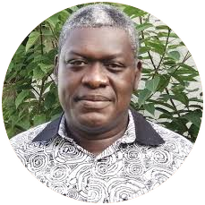
We should aim to have an online repository of education data with different levels of access for users.
We should also work with the wider ecosystem of education data stakeholders/collectors.
Dr. Jean Francois Kobiane
Associate Professor of Demography
Institut Supérieur des Sciences de la Population (ISSP), University Joseph Ki-Zerbo, Ouagadougou

Slide 41
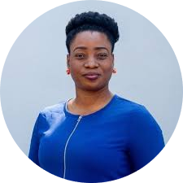
We should put in place Applied Research centres to help solve the existing problems in the education sector and strengthen their capacities in making use of that data to improve education in Africa. This will help to bridge the gap between research and policy.
Dr. Mo Adefeso-Olateju
Managing Director
Education Partnership Centre

Slide 42

Let us maintain this momentum and energy to build better data infrastructure for Africa.
Dr. Björn Haßler
Director of Research
EdTech Hub

Slide 43
Post-webinar survey
These are some of the responses based on our post-webinar survey
The event was very informative and well organised!
Very pleased with the diversity of the stakeholders.
The break out sessions were very well structured and facilitated.
Good time management. Time allocated was just enough to tease out the critical issues.
Great presentations from the speakers: Dr. Samuel Asare and Obadah Diab.
Allocate more time for Q&A and breakout sessions to go deeper into the issues.

Slide 44
Thematic working groups
At the end of the webinar, three thematic working groups were set up going forward.
Data accessibility and analysis • Finding and sharing data • Data quality and interoperability | Data utilization • Relevance and packaging • Nurturing evidence use cultures | Data capacities • Capacities for scale and quality • Capacities for analysis and packaging
Obadah Diab (OCHA Centre for Humanitarian Data) Sosthene Guei (TRECC/JF) Taskeen (Edtech Hub) Pauline Rose Philippe Gafishi (PARIS21) David Maxwell Bessah(Ghana Statistical Service) Samuel Agyapong (ESSA) Maurice Mutisya Peter Wanjohi (Kenya National Bureau of Statistics) Purity Ngina Jamie Proctor Esme Kadzamira Samuel Asare (ESSA) Jean-Francois Joyce Malombe | Margaret Irving (GPE) Julie Belanger (EPG) Modupe Adefeso-Olateju - The Education Partnership (TEP) Centre Sosthene Guei (TRECC/JF) David Maxwell Bessah (Ghana Statistical Service) Jonas Bausch (Decent Jobs for Youth - ILO) Zizi Afrique Kerubo Okioga Dana Schmidt Chi-Chi Undie (Population Council) Hugues Moussy Data interoperability platforms (JET Education Services and merSETA - South Africa) Björn (EdTech Hub) Joyce Malombe | Obadah Diab (OCHA Centre for Humanitarian Data) Nodumo Dhlamini (Association of African Universities) Kerubo Okioga Peter Wanjohi (Kenya National Bureau of Statistics) Björn (EdTech Hub) Jean-Francois Joyce Malombe

Slide 45
Next Steps
This meeting has informed the construction of a collaborative initiative that focuses on: Data accessibility, Data Use, and Data capacities. Report to be shared not later than Friday August 21st, 2020.
The sign-up of interests will be followed up by smaller, more-focused sessions, between August and September 2020
Follow-up meetings to be held with HDX, to explore potential role in catalyzing accessibility to education data
Zizi Afrique and Education Sub-Saharan Africa commit to drive the initial phase of this collaborative, until something comes out of it
A meeting planned for Thursday September 24th, 2020 will make things more concrete, and clarify interests and partnerships with the potential friends who signed up

Slide 46
Attendees/Organisations
Obadah Diab - Humanitarian Data Exchange (HDX)
Opeyemi Oluleye - TEP Centre
Pauline Rose - University of Cambridge
Peter Wanjohi - KNBS
Philippe Gafishi - OECD
Purity Ngina - Zizi Afrique
Renaldah Mboje - Zizi Afrique
Roberta Bassett - World Bank
Samuel Agyapong – ESSA
Samuel Asare - ESSA
Sara Ruto - Pal Network
Sosthène Guei - TRECC Program
Taskeen Adam - EdTech Hub
Wairimu Macharia - ESSA
Wangui Nyaga - Banyan
Abdulkadir Amin Awes - KNBS
Adeline Addy - AAU
Angela Arnott - GESCI
Björn Haßler - EdTech Hub
Chi-Chi Undie - Population Council
Dana Schmidt - Echidna Giving
David Bessah - Statistics Ghana
Delali Amuzu - University of Ghana
Dennis Nyakundi - Pal Network
Esme Kadzamira - University of Malawi
Faith Mukiria - Zizi Afrique
Fredrick Osheku - TEP Centre
Gemma Munday - ESSA
Godfrey Otieno – KNBS
Hannah Itcovitz - The Broker Online
Hugues Moussy - UNESCO
Jack Rossiter - CG Dev
James Ciera - Twaweza
James Keevy - JET
James Otieno Jowi - EAC HQ
Jamie Proctor - (DFID)
Jean-François KOBIANE - ISSP
John Mugo - Zizi Afrique
Jonas Bausch - ILO
Joyce Malombe - WP Fund
Julie Belanger - Ark Online
Kerubo Okioga - Porticus
Lucy Heady - ESSA
Margaret Irving - Global Partnership
Mary Goretti Nakabugo - Uwezo Uganda
Modupe Adefeso-Olateju - TEP Centre
Moses Ngware - APHRC
Mutisya Maurice - APHRC
Nodumo DHLAMINI - AAU
Notes:
Make sure the name is on the screen

