Slide 1

Questionable research practices and the role of replication studies in ecology
Hannah Fraser
University of Melbourne
@hannahsfraser

Slide 2
Questionable Research Practices
@hannahsfraser

Slide 3
Questionable Research Practice | Ecology Fraser et al 2018 n=494 | Evolution Fraser et al 2018 n=313 | Education Makel et al 2019 n=1488 | Psychology Italy Agnoli et al. 2017 n=277 | Psychology USA John et al. 2012 n=2155
Omitting nonsignificant studies or variables | 64 | 64 | 62 | 48 | 63
Omitting nonsignificant covariates | 45 | 43 | 42
HARKing | 49 | 54 | 46 | 37 | 27
Omitting analyses | 53 | 53 | 67
Rounding p-values | 27 | 18 | 29 | 22 | 22
Data Exclusion ARKing | 24 | 24 | 26 | 40 | 39
Data peeking | 37 | 51 | 29 | 53 | 56
Analysis gaming | 54 | 52 | 50
Hiding methodological problems | 20 | 22 | 24
Cherry-picking
@hannahsfraser
Abbreviation from Makel et al 2019

Slide 4
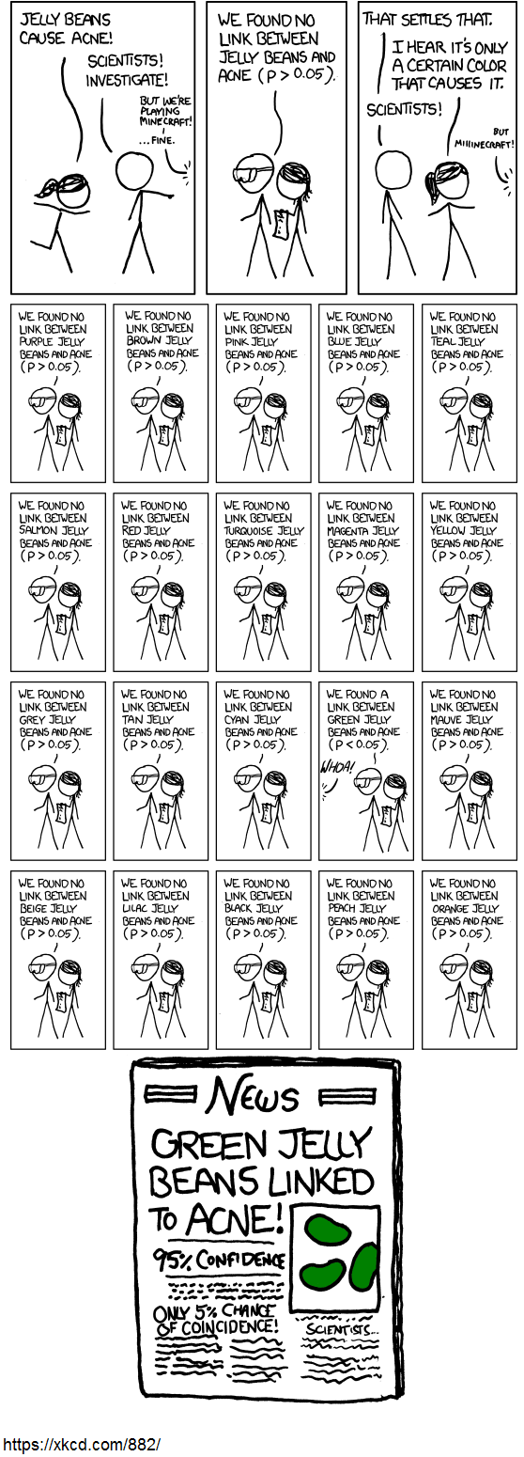
Cherry-picking
What is it?
Selectively reporting the parts of the study that showed statistically significant or otherwise noteworthy results.
Why is it questionable?
Increases the false positive rate
Makes research look more certain than warranted
Modified without permission
@hannahsfraser

Slide 5
Cherry-picking
This seems like an underestimate to me
Questionable Research Practice | Ecology Fraser et al 2018 n=494 | Evolution Fraser et al 2018 n=313 | Education Makel et al 2019 n=1488 | Psychology Italy Agnoli et al. 2017 n=277 | Psychology USA John et al. 2012 n=2155
Omitting nonsignificant studies or variables | 64 | 64 | 62 | 48 | 63
Omitting nonsignificant covariates | 45 | 43 | 42
Omitting analyses | 53 | 53 | 67
This seems like a massive underestimate to me…
@hannahsfraser

Slide 6
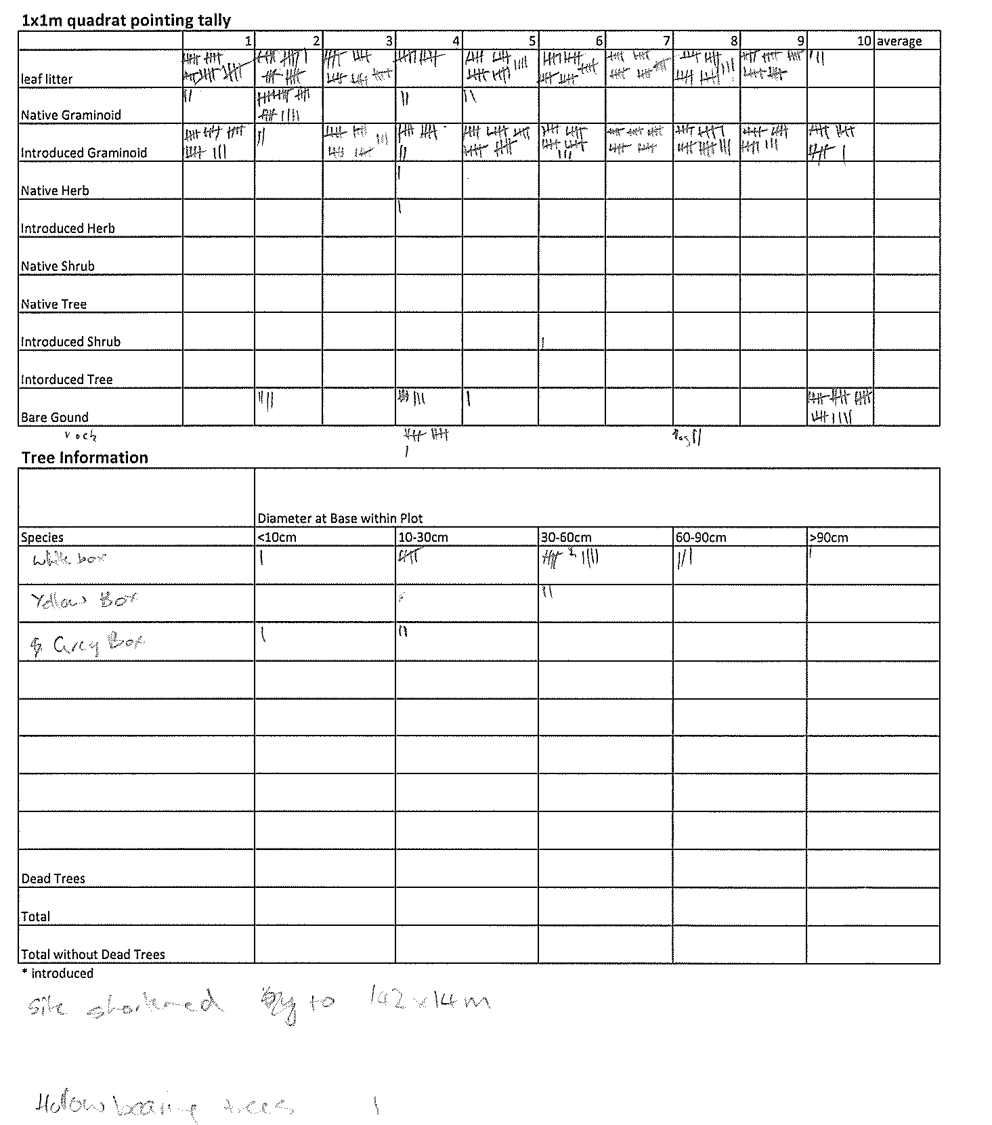
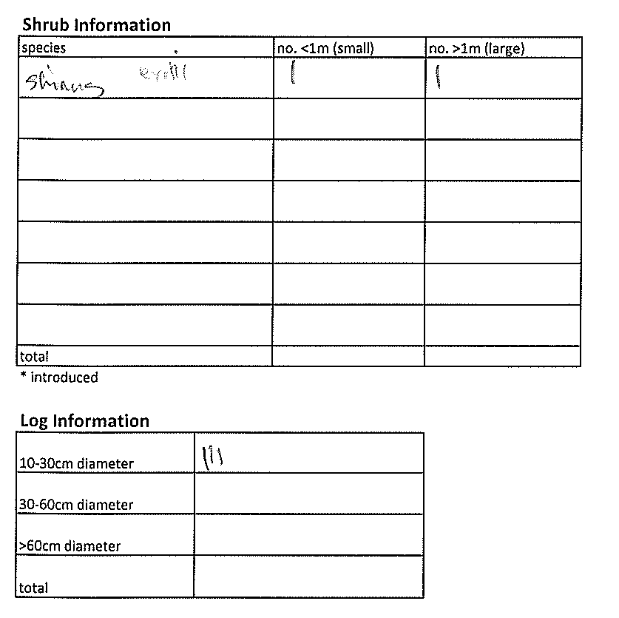
Why?
Many collect data like this
1
2
3
4
5
6
7
8
9
23 (number of shrub species)
10 (number of tree species)
24 25
26
27
28
29
Total number of trees
11 12 13 14 15 16
17 18 19 20 21 22
30 variables on this sheet alone….
Plus 112 bird species
Plus transformations of those variables
Plus ∞ environmental variables from the web
30

Slide 7

Teaching Solutions
Undergraduate Students
Incorporate preregistration into teaching
2 phase assignments
  Preregister a data collection and analysis plan prior to seeing/accessing data
  Submit final report
Graduate students
Insist on a solid research and analysis plan prior to data collection (and assist with this)
Preregister this plan (publicly or just with supervisor)
Support student to include + discuss original plan in the paper (Even if it doesn’t turn out as planned)
@hannahsfraser

Slide 8
Replication Studies
@hannahsfraser

Slide 9
Replication rates across disciplines
Discipline | Studies repeated | % same results
Genetics | 36 | 6
Pre-Clinical Medicine | 136 | 22
Psychology | 148 | 43
Economics | 18 | 61
Social Science | 21 | 62
Experimental Philosophy | 37 | 78
Ecology | ?? | ??
@hannahsfraser

Slide 10
What percentage of studies are replicated (re-done) in ecology?
Studies that identify themselves as replications: 0.023% (Kelly 2019)
Studies others identify as replications (Kelly 2006):
Journal | Direct/Exact replication | Conceptual replication | Quasireplication
Behavioral Ecology and Sociobiology Animal | 0% | 34% | 62%
Animal Behaviour | 0% | 25% | 75%
Behavioral Ecology | 0% | 26% | 73%

Slide 11
Location | Environmental Conditions | Study System | Variables | Purpose: Investigates whether result is…
Same | Same | Same | Same | driven by sampling error, QRPs, mistakes, fraud
D | Similar | Similar | Similar | driven by its specific location within scope of study
Similar | D | Similar | Similar | dependent on the environmental conditions at the time of study within scope of study
Similar | Similar | Similar | D | an artefact of how the question was operationalised within scope of study
S/D | S/D | Similar | S/D | Robust to multiple simultaneous changes in study design within scope of study
Similar | Similar | D | Similar | generalisable to new study systems (‘quasireplication’) within scope of study claims
S/D | S/D | S/D | S/D | generalisable and robust to multiple changes in study design within scope of study claims

Slide 12
Teaching Solution
Undergraduate Students:
Collaborative Replications and Education Project (CREP)
    Conducting replication studies as part of the syllabus
    Tricky with direct replications due to time and logistics
    May be possible if doing replication with pre-existing data
    Benefit: learn thorough reporting, critical evaluation of study design, potentially produce publication
@hannahsfraser

Slide 13
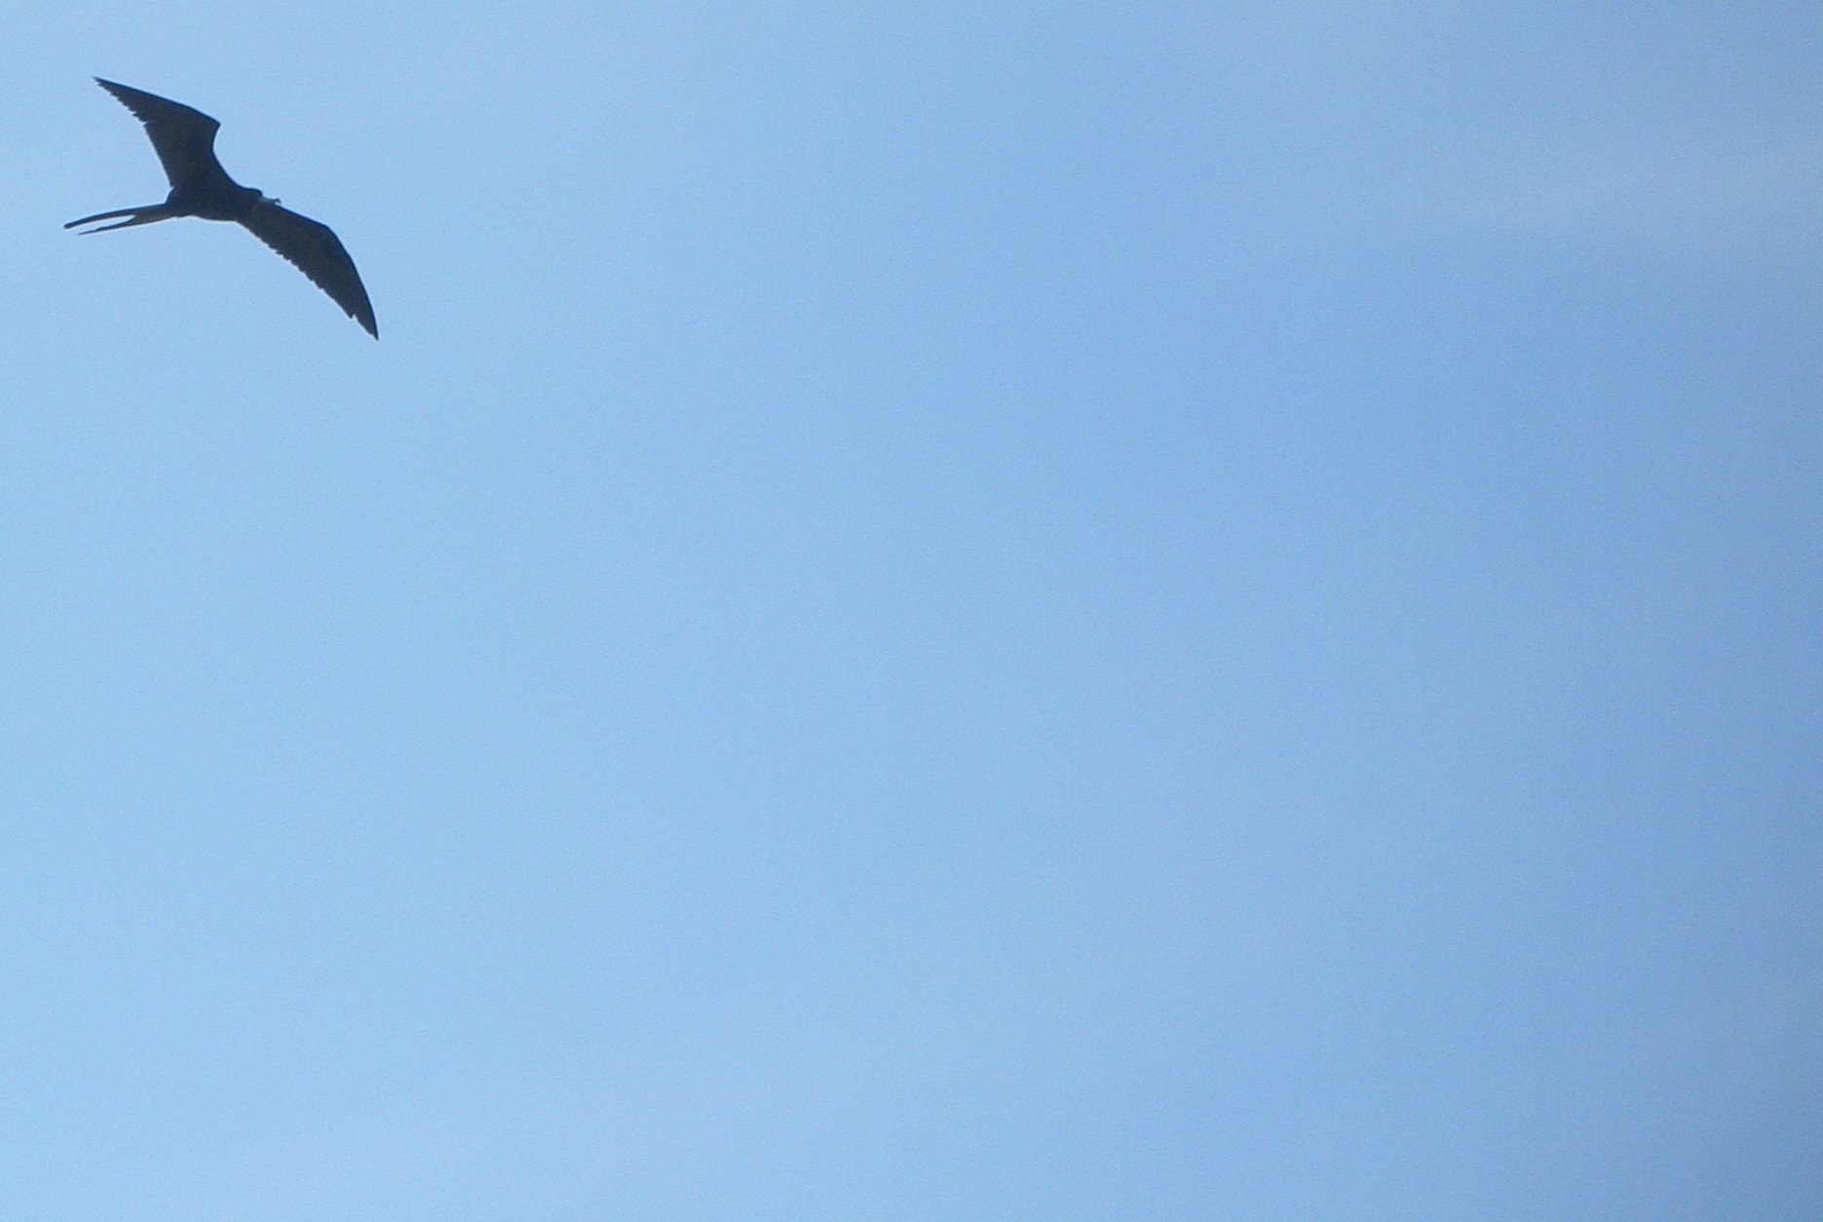
Any questions?
Special thanks to Tim Parker for sharing his thoughts on open science teaching
@hannahsfraser

Slide 14
Questionable Research Practices
Agnoli, F., J. M. Wicherts, C. L. S. Veldkamp, P. Albiero, and R. Cubelli. 2017. Questionable research practices among Italian research psychologists. PLoS ONE 12:1–17.
Fraser, H., T. H. Parker, S. Nakagawa, A. Barnett, and F. Fidler. 2018. Questionable research practices in ecology and evolution. PLoS One 13:e0200303.
John, L. K., G. Loewenstein, & D. Prelec. 2012. Measuring the prevalence of questionable research practices with incentives for truth telling. Psychological Science 23:524–532
Makel, M. C., J. Hodges, B. G. Cook, & J. A. Plucker. 2019. Questionable and open research practices in education research. EdarXiv.
Replication studies:
Fraser, Hannah, A. Barnett, T. H. Parker, & F. Fidler. 2019. The Role of Replication Studies in Ecology. EcoEvoRxiv. October 11. doi:10.32942/osf.io/4cuwp.
Kelly, C. D. 2006. Replicating empirical research in behavioural ecology: how and why it should be done but rarely is. The Quarterly review of biology 80:221–236.
Kelly, C. D. 2019. Rate and success of study replication in ecology and evolution. PeerJ.
Makel, M. C., & J. A. Plucker. 2014. Facts are more important than novelty: replication in the education sciences. Educational Researcher 43:304–316.
Makel, M. C., J. A. Plucker, & B. Hegarty. 2012. Replications in psychology research: how often do they really occur? Perspectives on Psychological Science 7:537–542.
CREP: https://osf.io/wfc6u/
For info on replication rates go to this osf site – curated by David Mellor

