Slide 1






&
m scripts
@agahkarakuzu

Slide 2

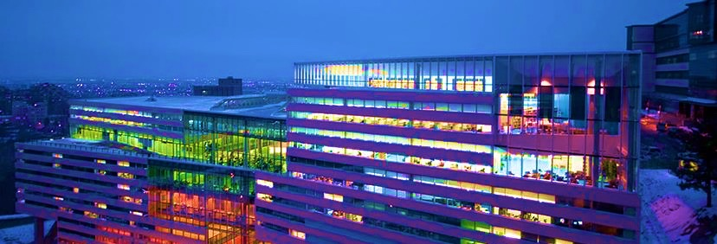

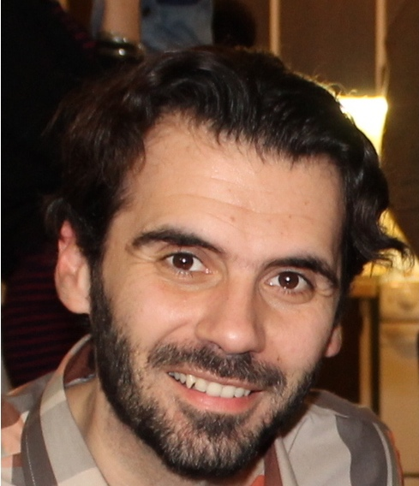





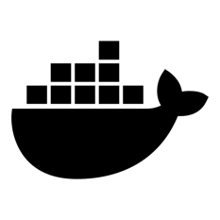

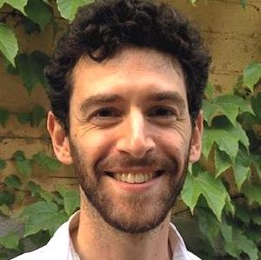

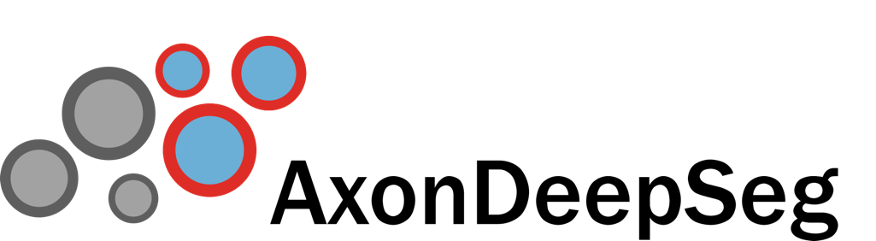
https://qmrlab.org
From acquisition
to publication.
qMRLab
qmrlab
@qmrlab
Nikola Stikov
neuropoly/spinalcordtoolbox
neuropoly/axondeepseg
neuropoly/realtime_shimming
Julien Cohen-Adad

Slide 3

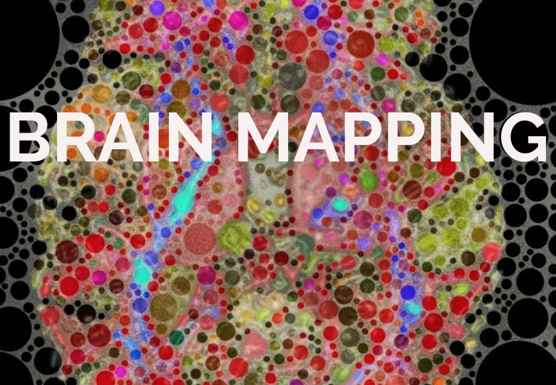


@mrm_highlights
blog.ismrm.org
ohbmbrainmappingblog.com

Slide 4

Some time ago in a neuroimaging
lab far, far away…

Slide 5




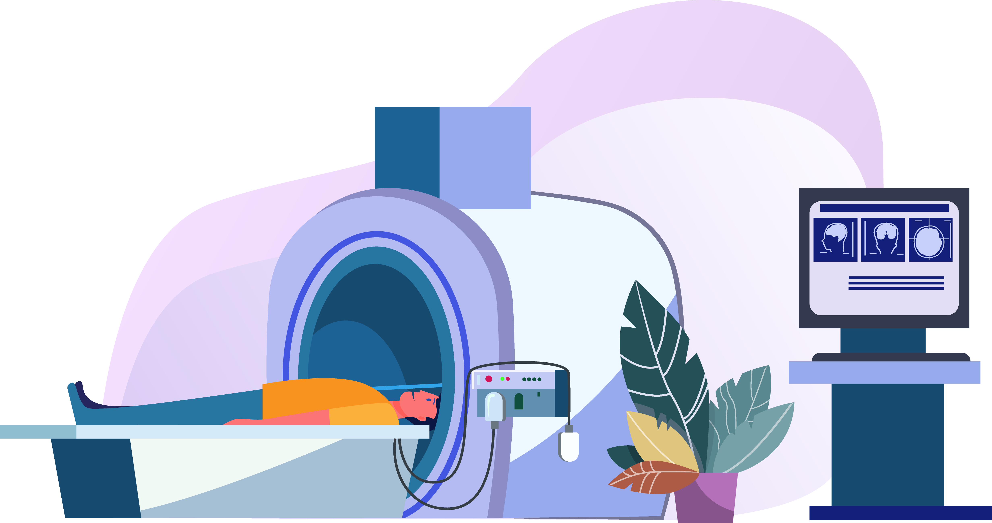
Microstructure informed
structural connectivity
DWI
MTon
MToff
Prof Jennis

Slide 6



I will give you a
pilot data.
I know some
MATLAB
Let’s try …
Jim
Inverse distance weighted interpolation of MTR values on corpus callosum tracts

Slide 7

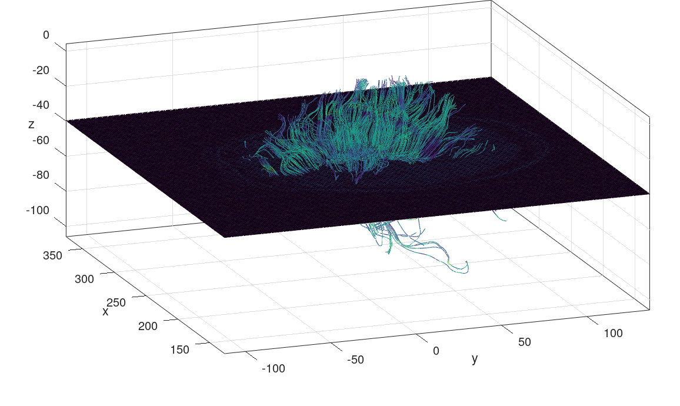
This works, but I have
no idea how…
jim_mtr.m

Slide 9



I want to put those
figures in my grant
proposal but…
Oh Jim, what
have you done?
Of course Jennis!
Eda
Can you refactor
jim_mtr.m?

Slide 10

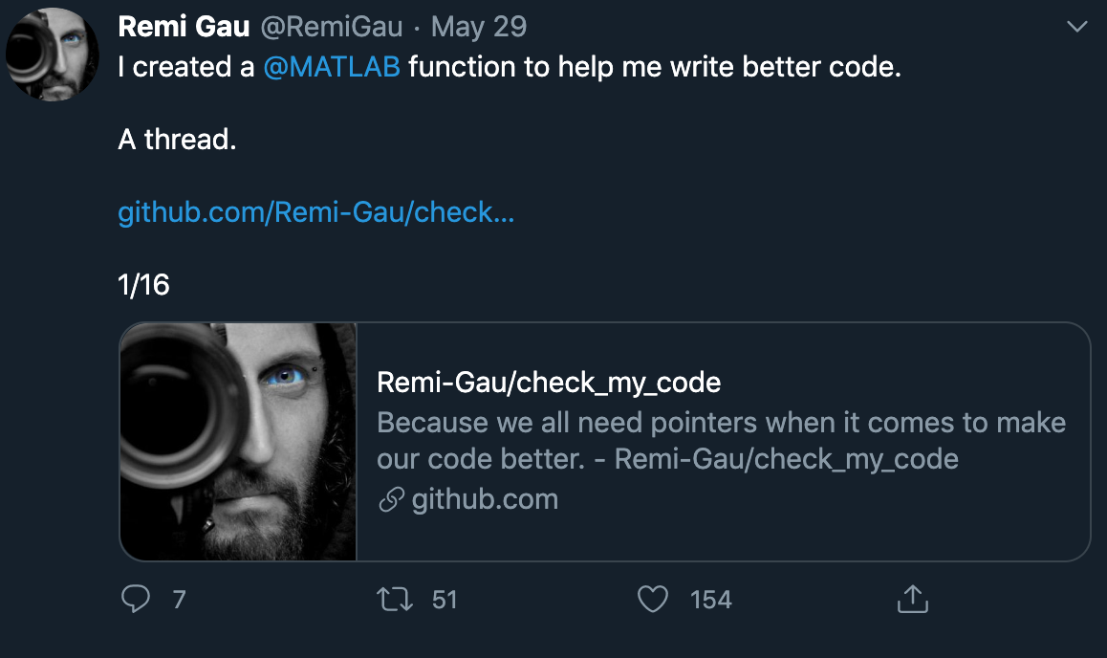
RUN

Slide 11

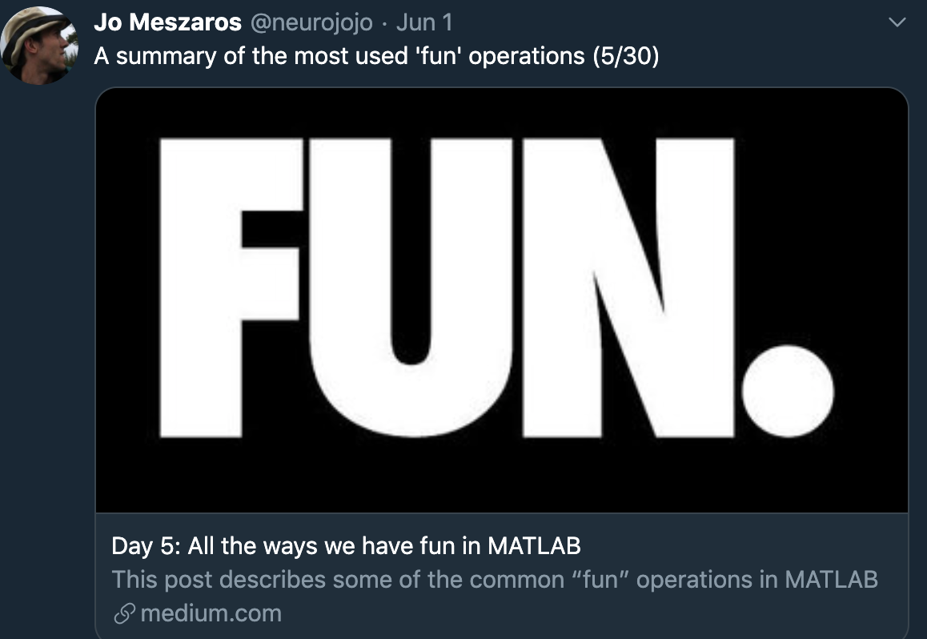

Slide 12


Slide 13
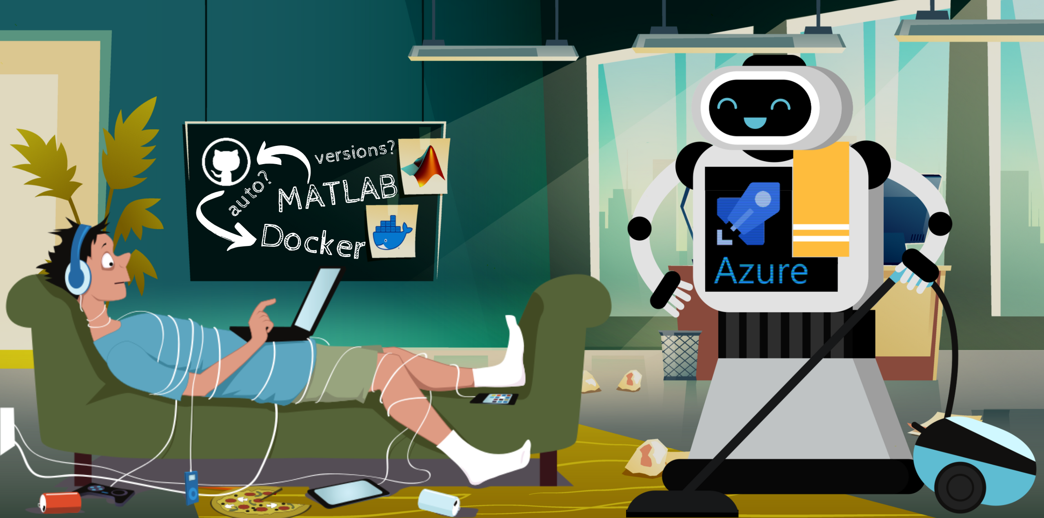
CI & CD using MATLAB
https://qmrlab.org

Slide 14
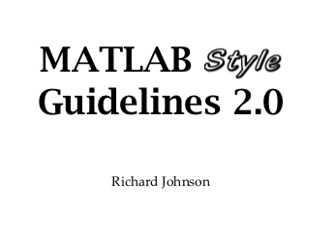

Slide 15




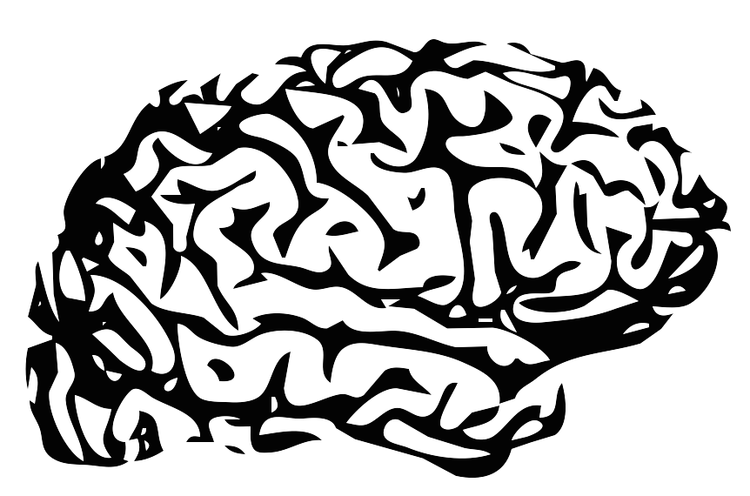


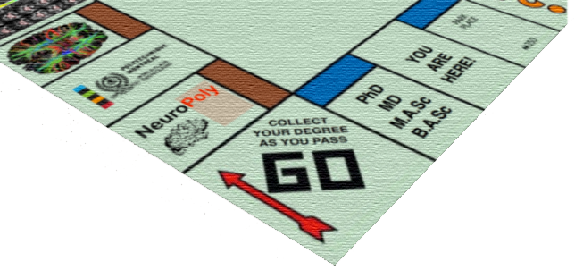



THANKS!
Nikola Stikov (Advisor)
Julien Cohen-Adad
Ilana Leppert
Mathieu Boudreau
Jennifer Campbell
Agah Karakuzu
Tommy Boshkovski (Shared his data <3)
Tanguy Duval
Bruce Pike
Sridar Narayanan
Christine Tardif
Robert Brown
David Rudko
Jean-Francois Cabana
Robert Dougherty
Brian Wandell
agahkarakuzu@gmail.com
@agahkarakuzu
www.neuro.polymtl.ca

Slide 16

Coolvector, pch.vector
https://www.freepik.com/free-vector/landing-page-template-universe_5198525.htm
https://www.freepik.com/pch-vector
https://www.freepik.com/coolvector
Visual artwork used in this presentation is featured on behance.net, slideshare.net and freepik.com.

