Slide 1
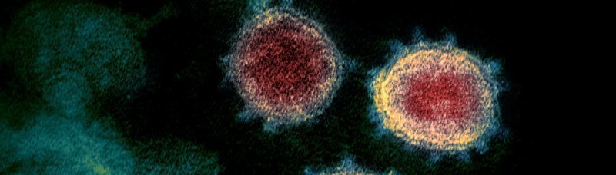





R, Coronavirus, and Pandemic Prevention
Noam Ross
nyhackr, 2020-04-20
noamross
@
Notes:
I'm Noam. I'm an ecologist at EHA.
Research at the confluence of conservation and public health, emerging inf. dis
Field ecologists, public health specialists, to our large + growing m&a team, and software engineering to turn our models into apps, and do large-scale ML for global disease surveillance.

Slide 2
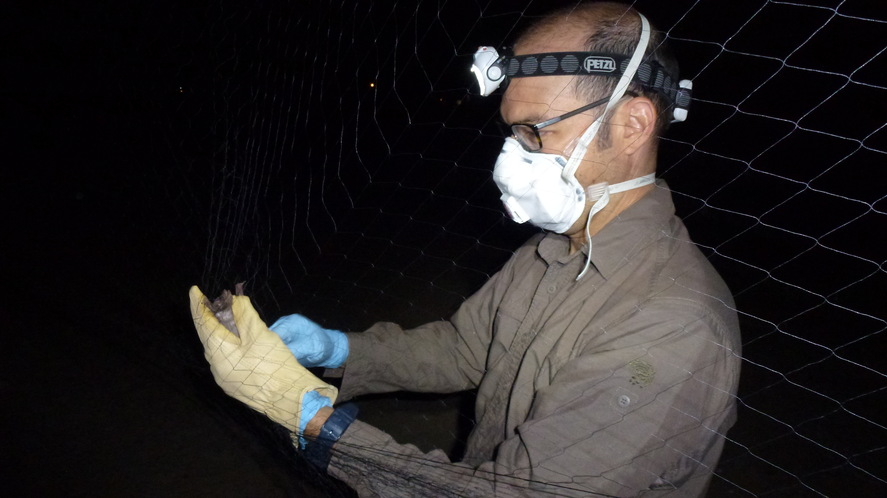
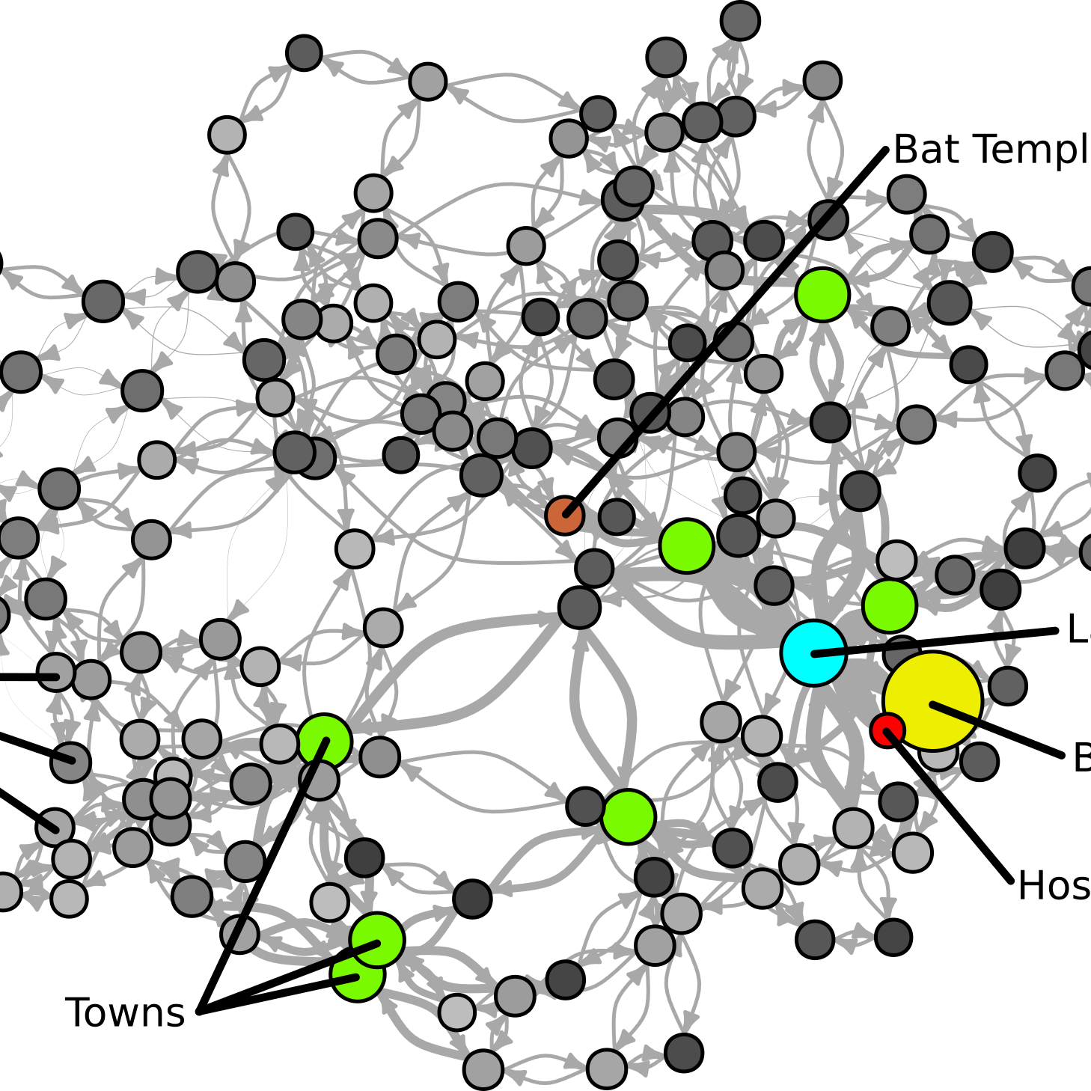
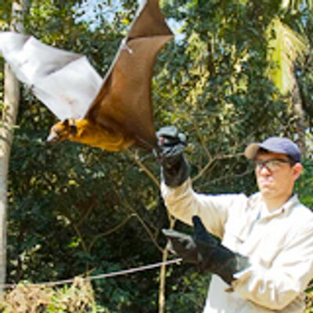
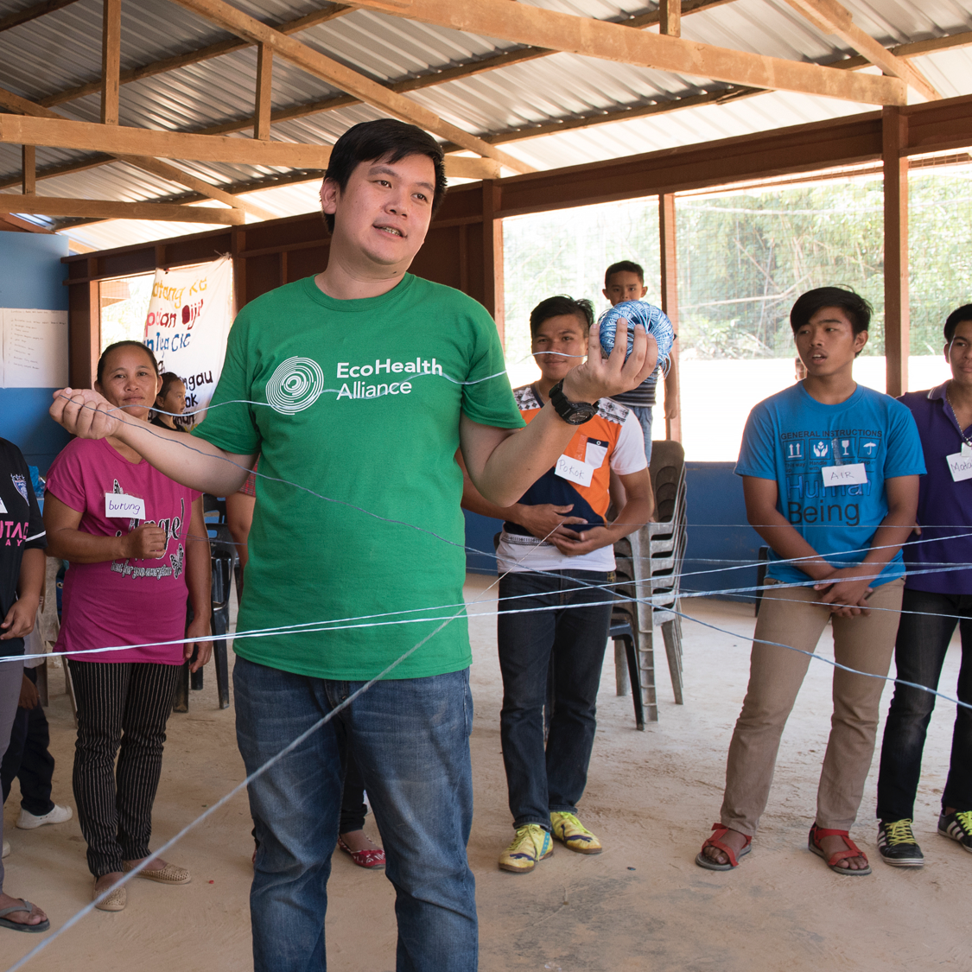
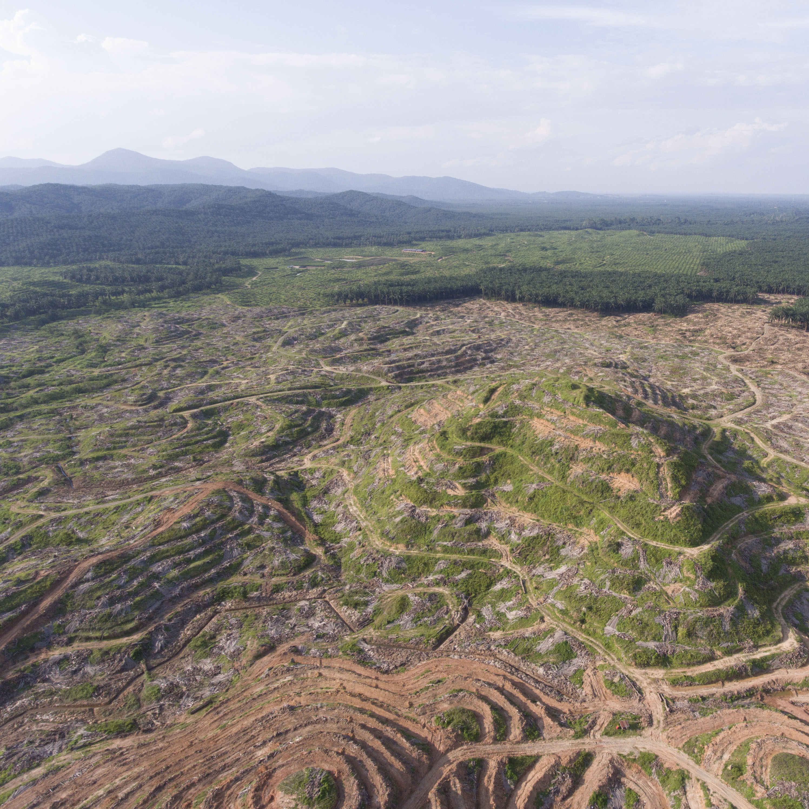
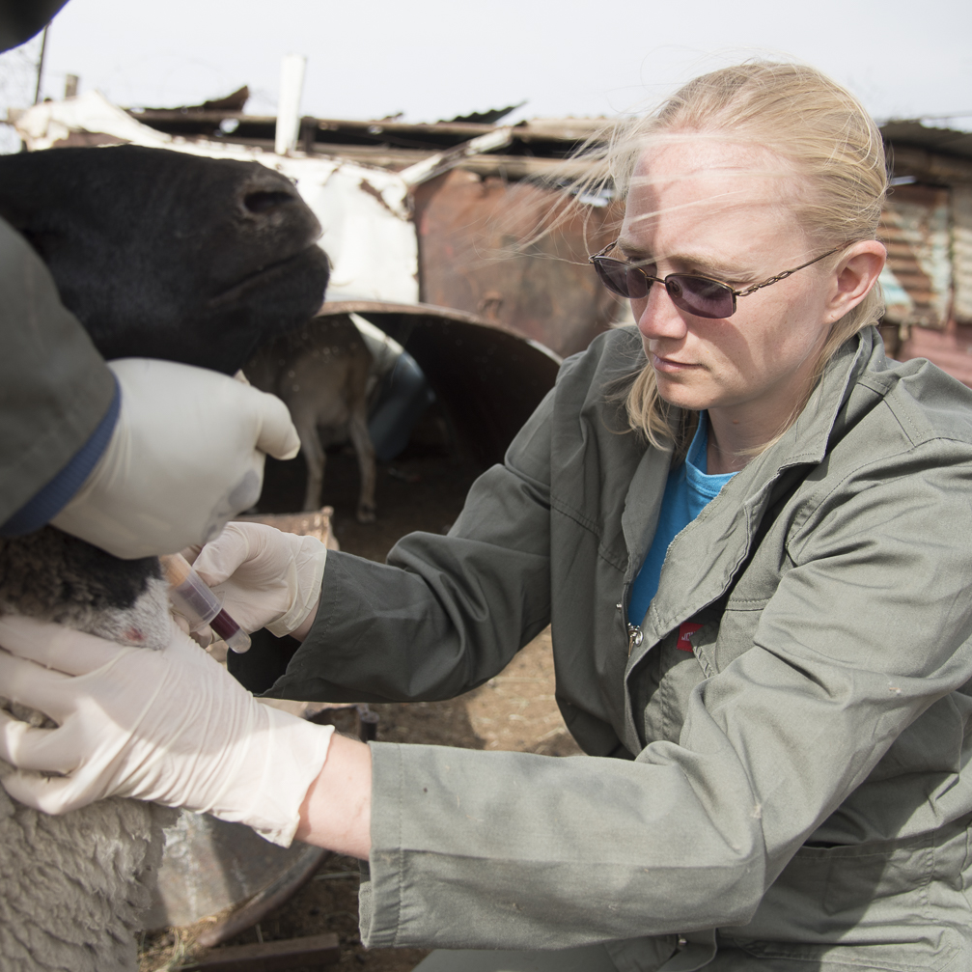
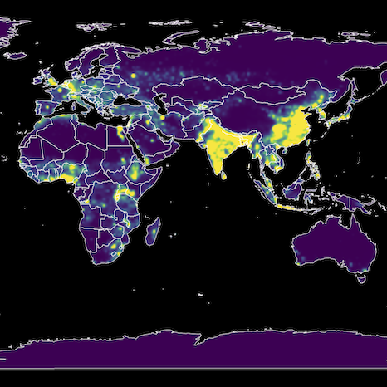


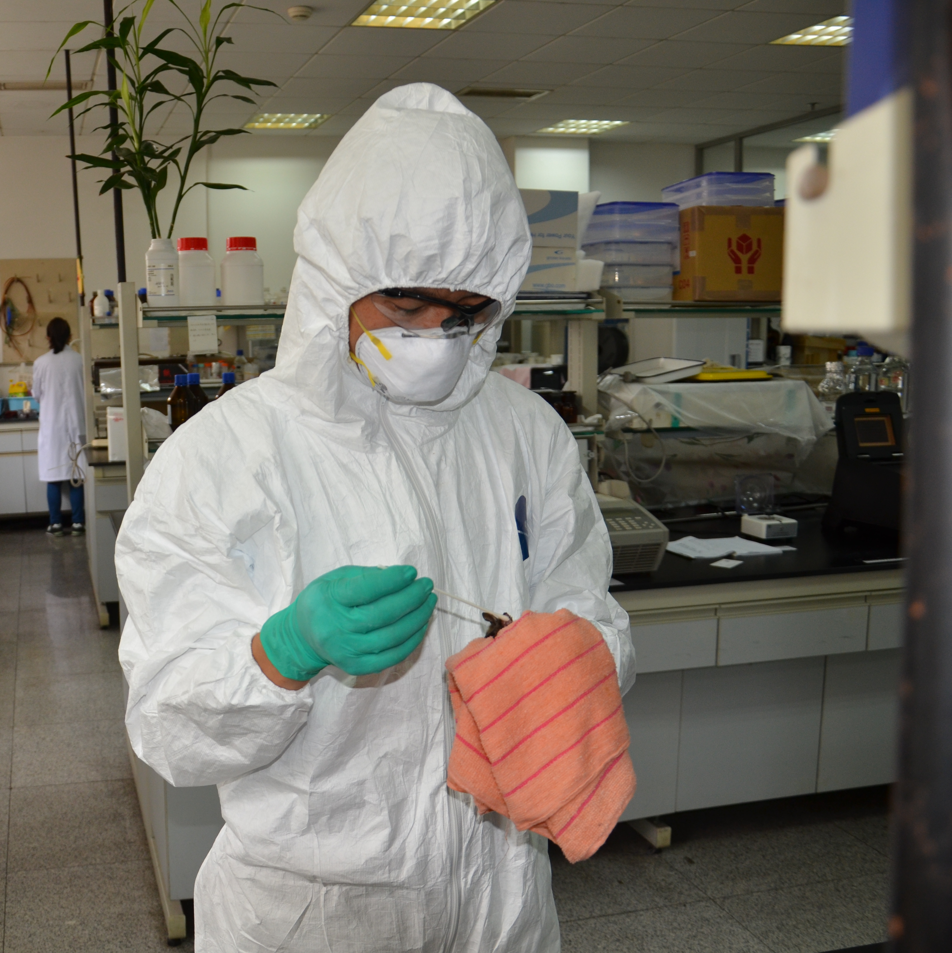
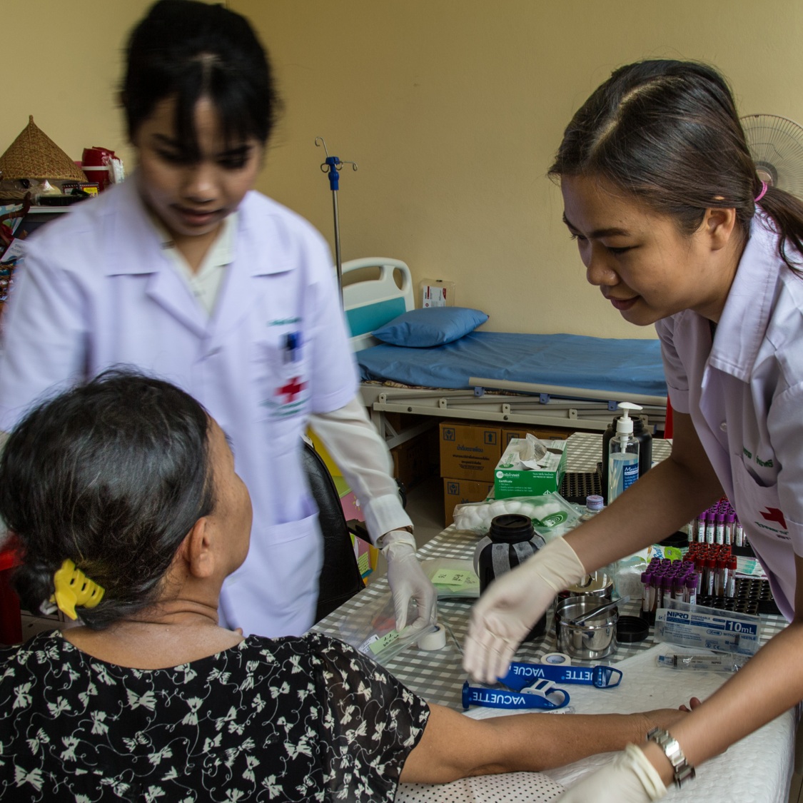
@EcoHealthNYC ecohealthalliance.org

Slide 3
Building technical and community infrastructure for R to support open, reproducible science
@rOpenSci
ropensci.org
Notes:
An organization that...
"Build open-source software, build community" (some themes from JD, Ricardo, Sean + Mike)
Fellowships for those who want to push the limits of tools
Hackathons
Mostly, write, incubate, maintain, lot and lots of packages to connect scientists with data sources and fill holes in reproducibility and data cycle.

Slide 4
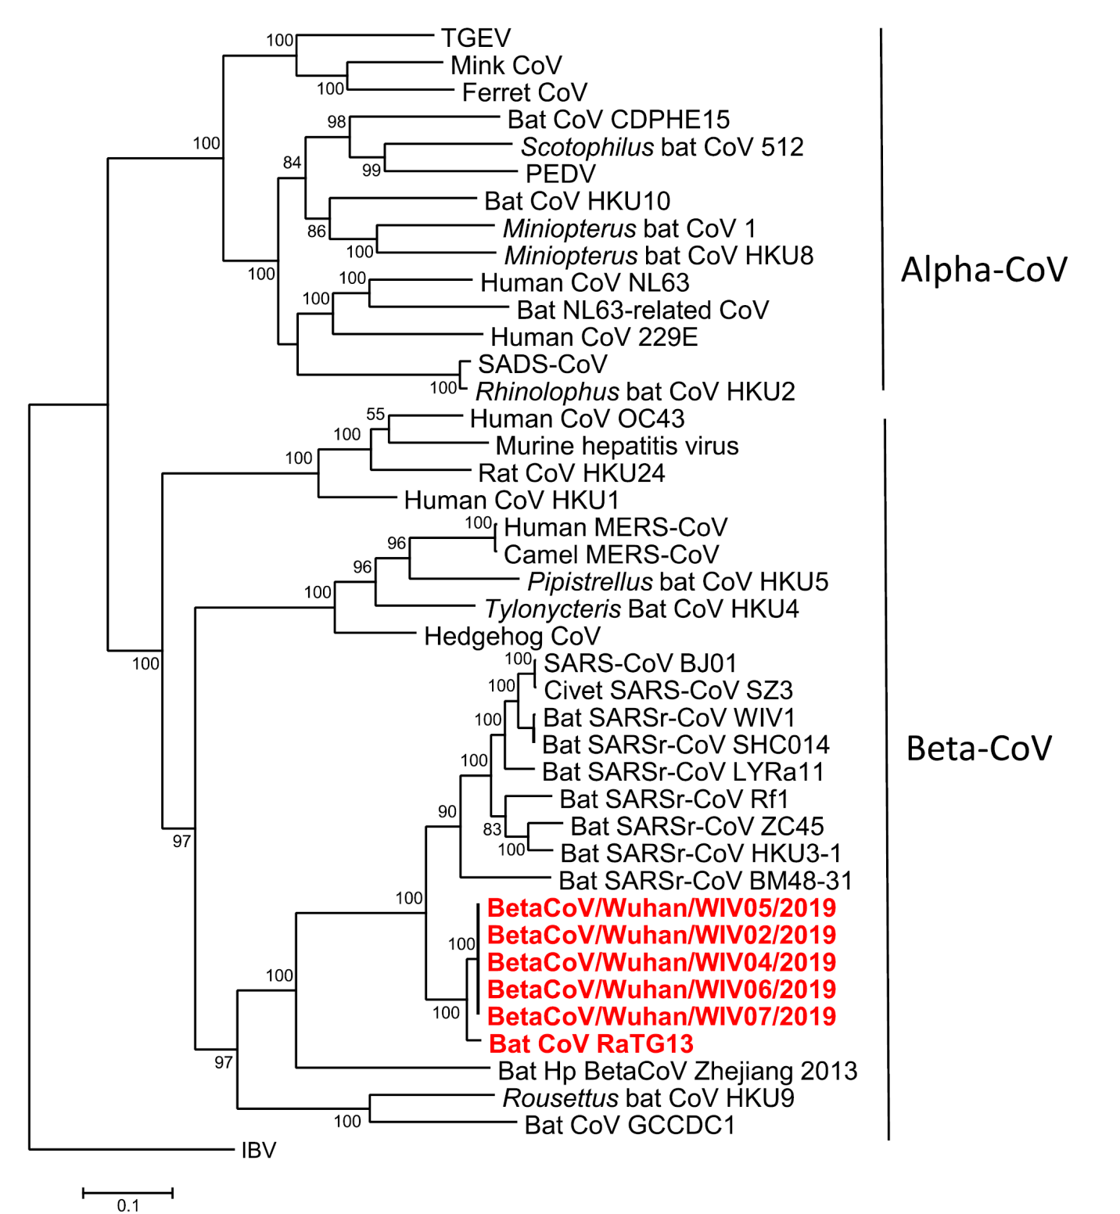
Like SARS, COVID-19 likely began with a bat-origin virus
Zhou et al. Nature 2020

Slide 5


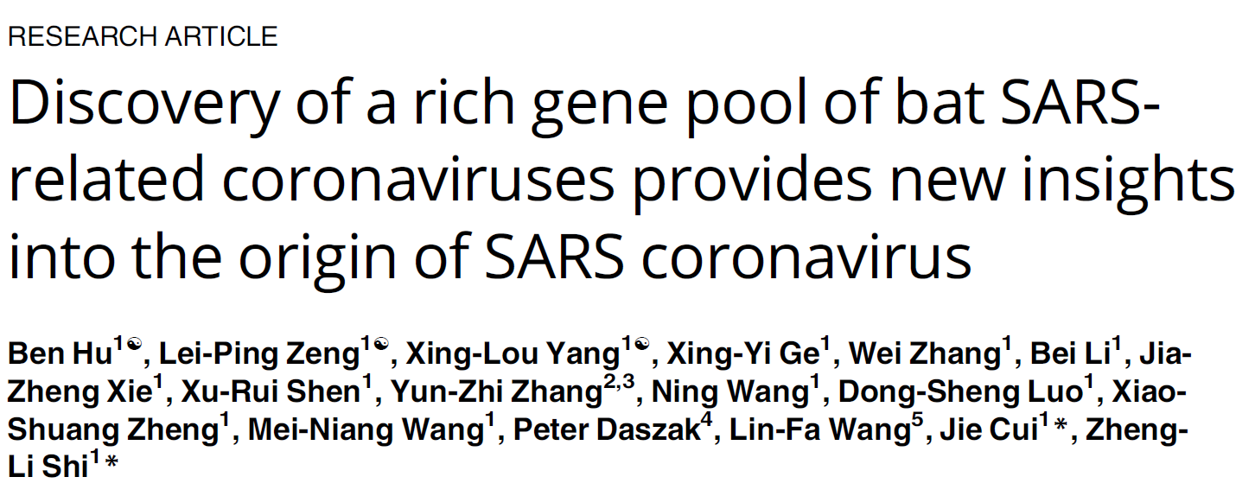
Hu et al. (2017) PLoS Pathogens

Slide 6
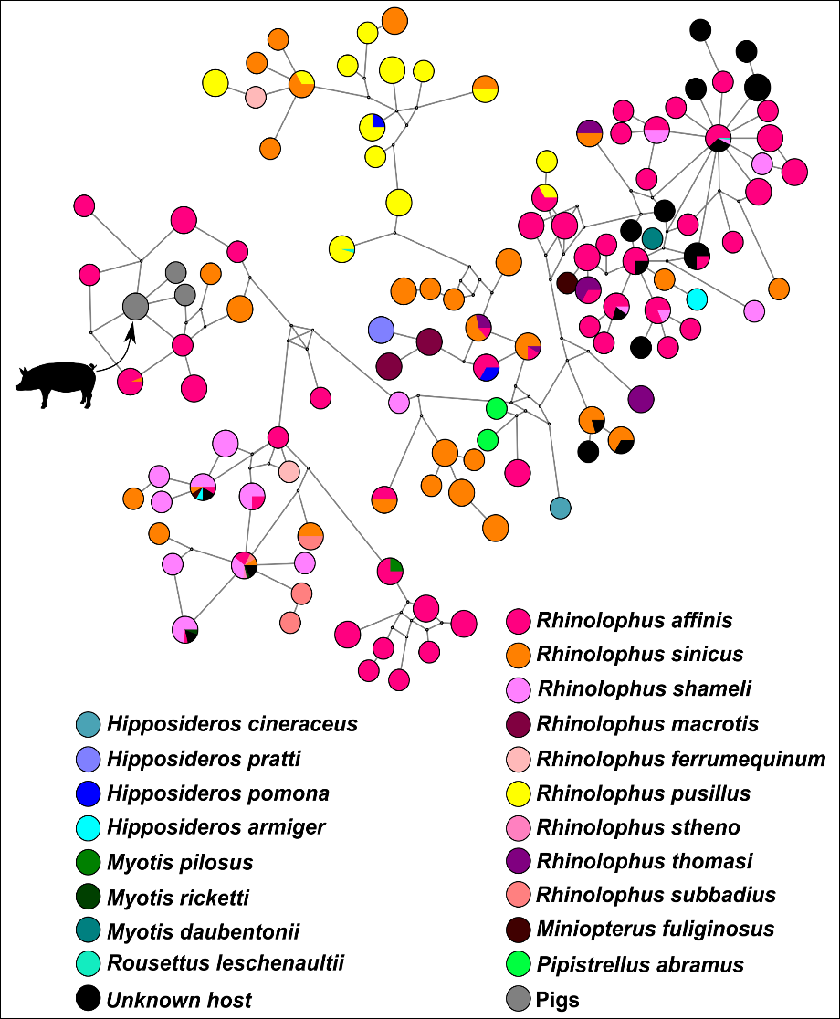
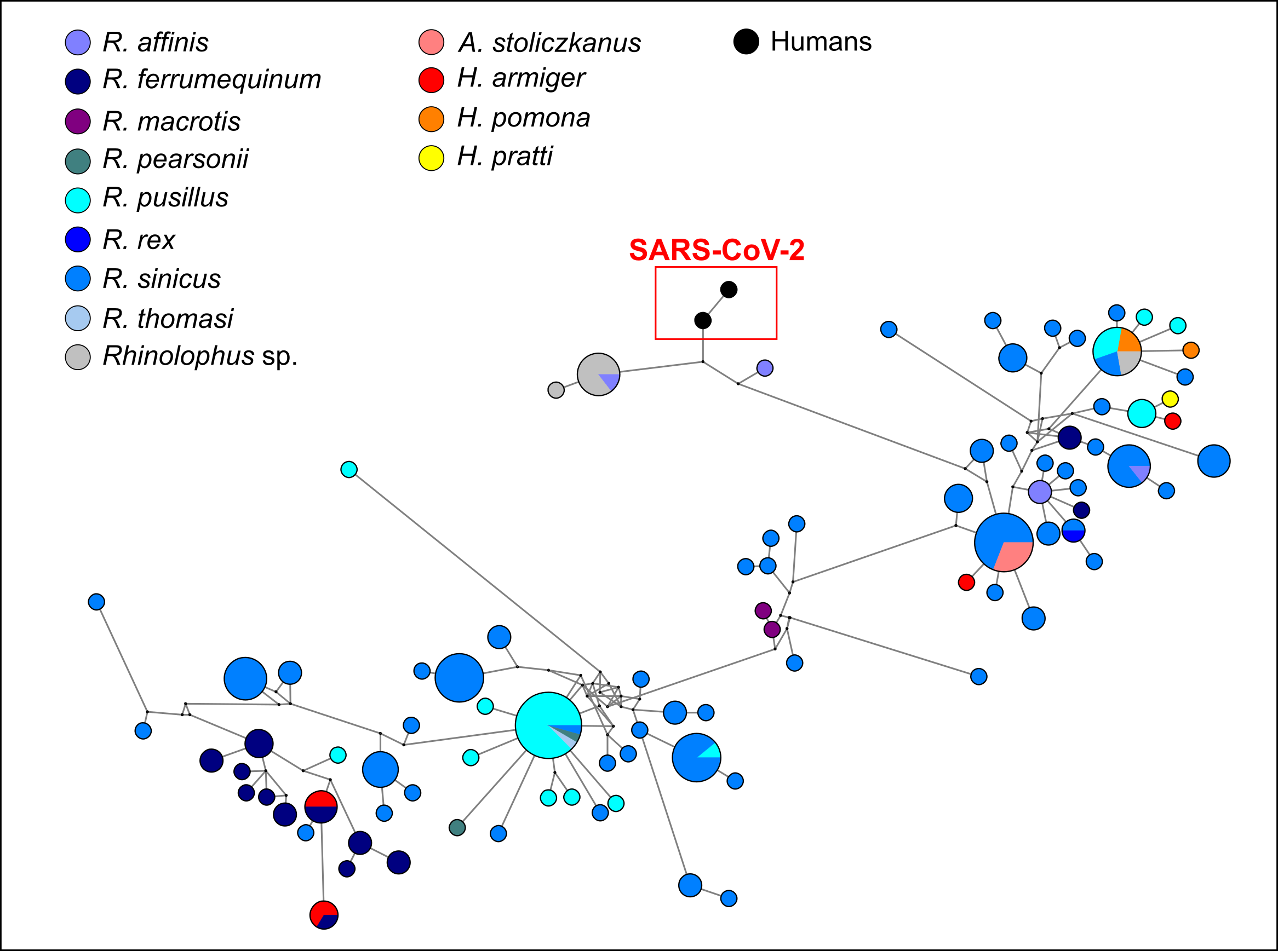
> 500 sequences of novel bat-CoVs discovered in China
Size of circle proportional to the number of samples with identical viral sequences.
405 β – CoVs (SADSr), 361 from China
α – CoVs Clade 2b (SARSr-CoVs)

Slide 7
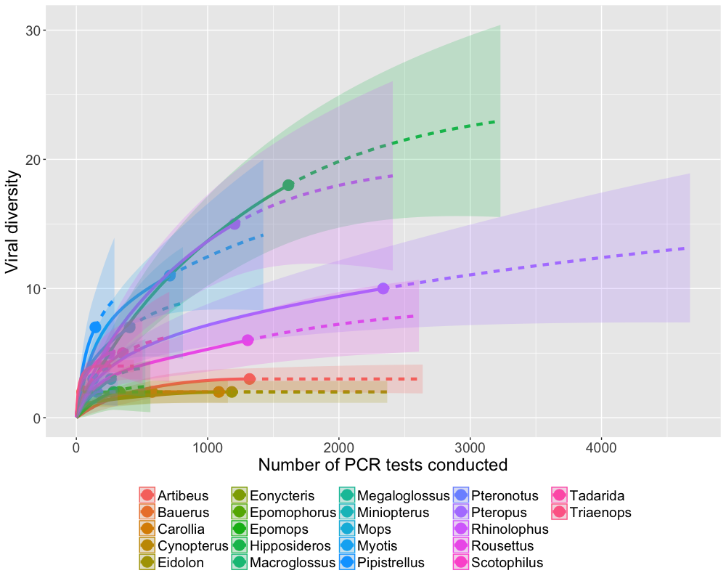
Coronavirus discovery, bats 10 yrs

Slide 8
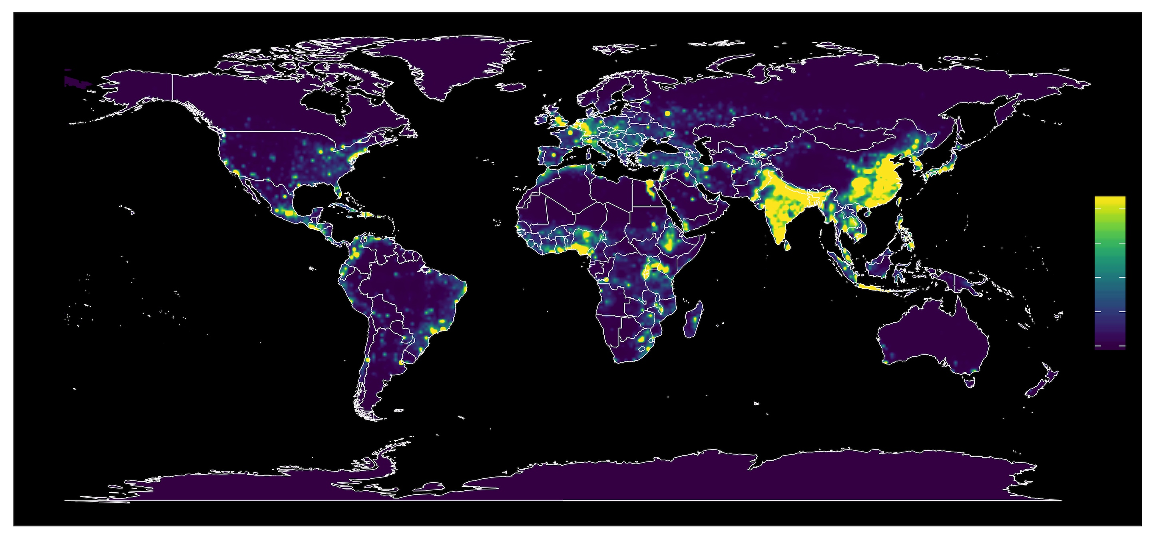
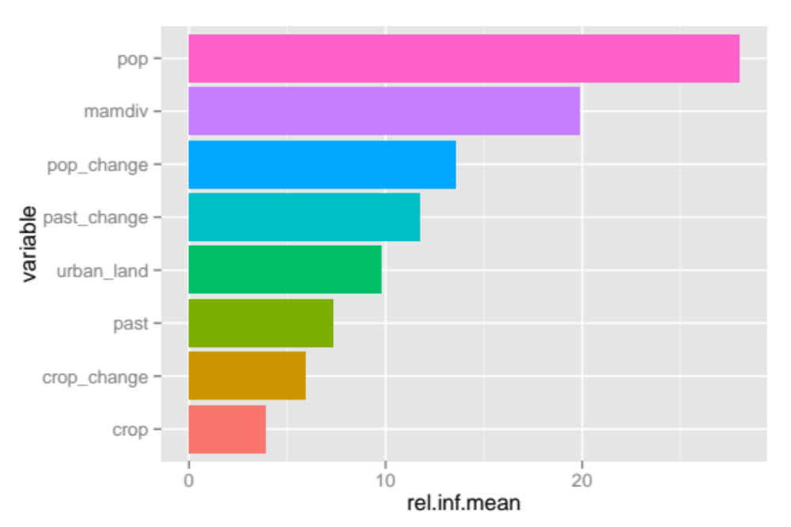
Hotspots 2.0
 | relative influence (%) | std. dev.
population | 27.99 | 2.99
mammal diversity | 19.84 | 3.30
change: pop | 13.54 | 1.54
change: pasture | 11.71 | 1.30
urban extent | 9.77 | 1.62
Allen et al. Nature Comm. 2017

Slide 9
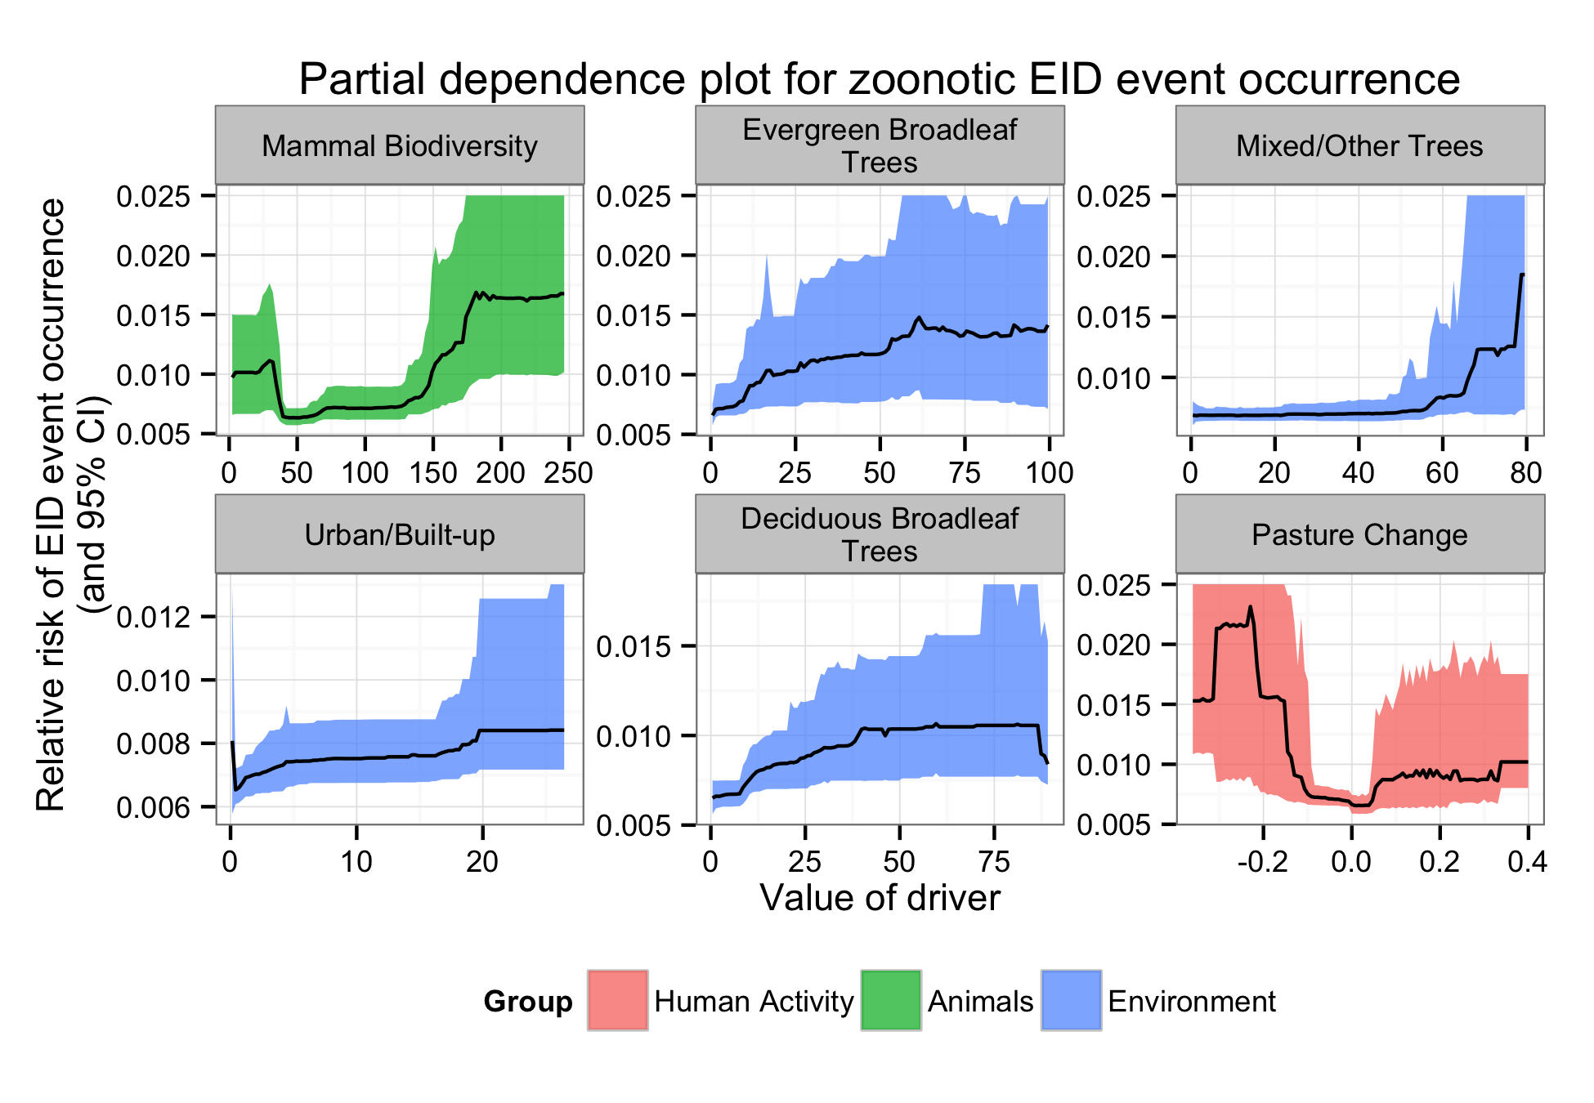
y-axis: relative probability of an EID event in a grid cell with this characteristic
x-axis: min. to max. values of each driver (except ‘Pasture Change’)
Plots show effect relative to human pop. Distribution, factoring out reporting bias.
Model: 2 levels of interaction between drivers,
Notes:
This partial dependence plot shows the effect of the predictors on the outcome for the six most influential variables.
The line represents the best estimate; the shaded section shows the 95% confidence interval for the line.
The x axes represent the minimum to maximum values of each driver (Predictors).
Mammal diversity: number of species whose ranges overlap the grid cell.
Blue variables (Environment): percentage of grid cell covered.
Pasture change: change in amount of grid cell used for pasture between one decade and the next.
The y axes represent the relative probability of an EID event occurring in a grid cell with this characteristic (Outcome variable).
These plots average out the effects of other drivers, but the actual model takes into account two levels of interaction between drivers.
They also display the effect—at our best estimate—relative to the human population distribution, factoring out our reporting bias layer.
You can see that the confidence intervals are pretty wide.
The dataset of EID events is pretty noisy in this regard, but there are some overall trends apparent.
Of particular note: biodiversity. This suggests, along with evergreen broadleaf trees (i.e. rainforest) that disease emergence events are more likely to happen to people living in areas with high biodiversity and a lot of forest, for example. These data also suggest—albeit only suggest—that perturbation, both from increasing and decreasing cropland, can increase the probability of a disease emergence event.

Slide 10
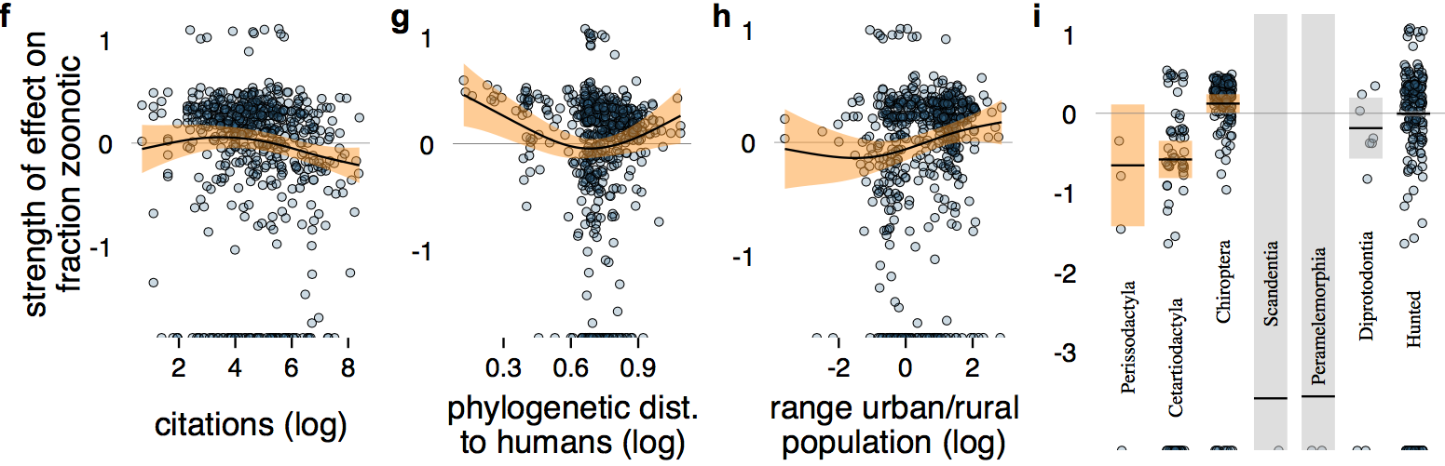
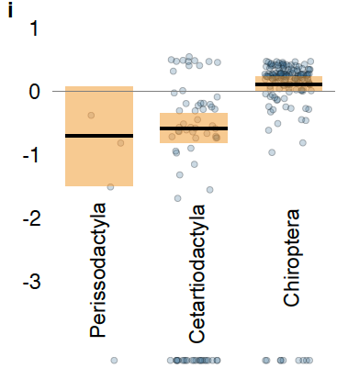
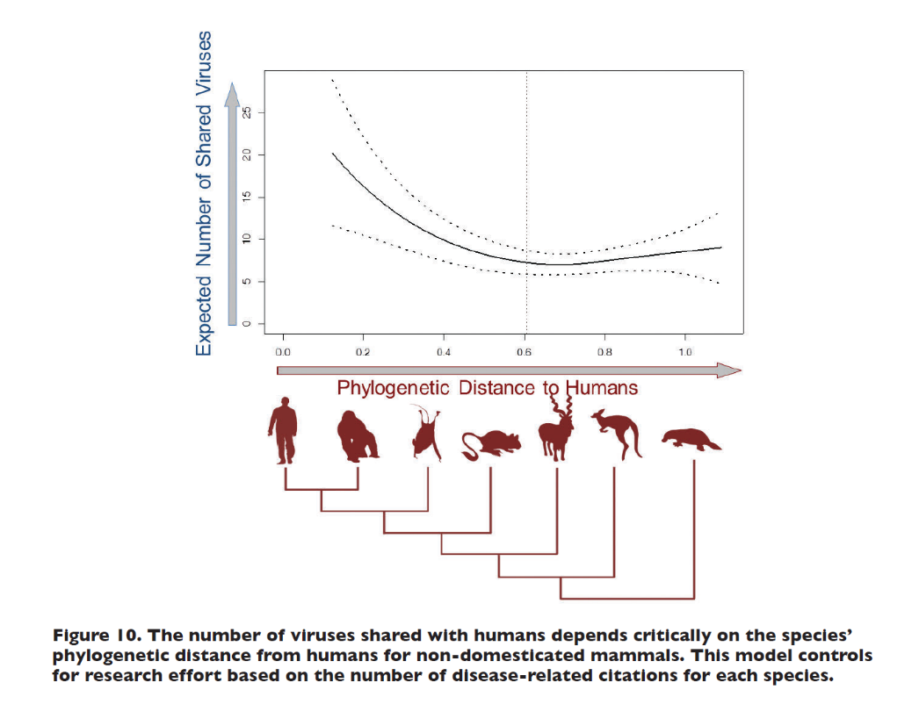

Predictors of the proportion of zoonotic viruses that a species carries
Olival et al. 2017, Nature
Notes:
When we run these data through complex mathematical models to analyze each factor separately, and correcting for the underlying biases (e.g. that most surveillance work has historically been done on large species that are easily captured), we find that bats are the most important hosts of zoonotic viruses, and therefore the host most likely to have the next emerging virus.

Slide 11
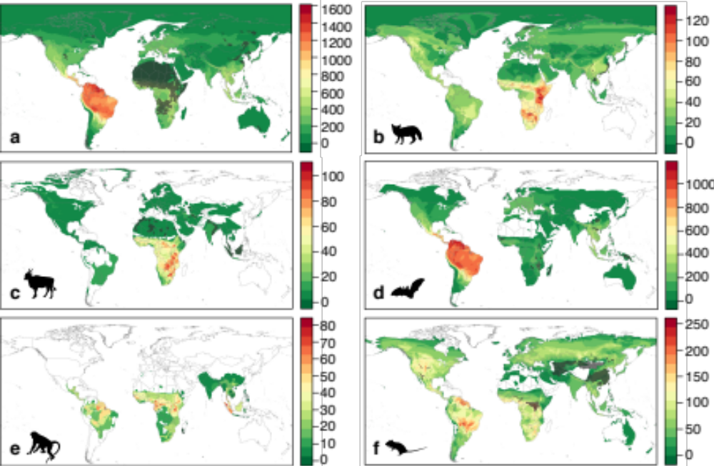
Missing Zoonoses - Mammals
Olival et al. 2017 Nature

Slide 12
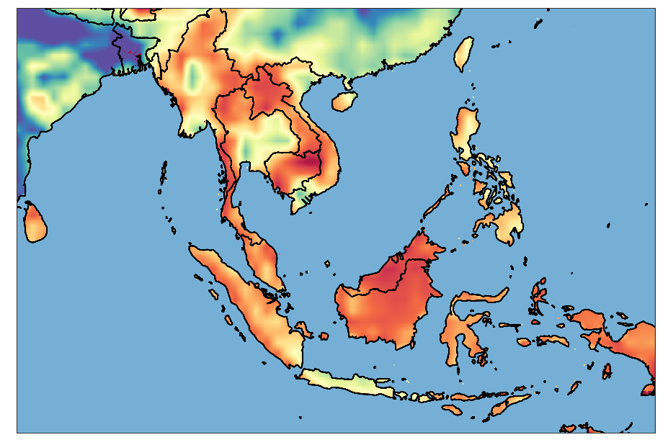
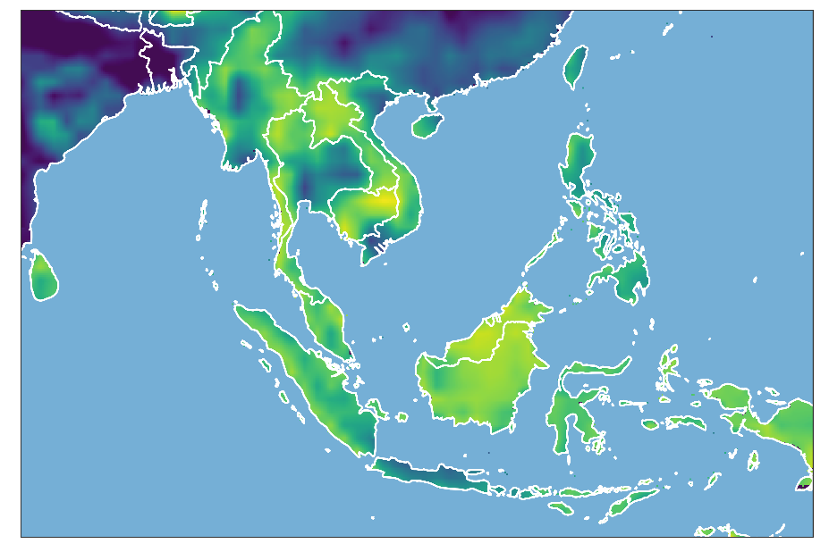
Bat coronavirus risk is regional, not restricted to China
= Site in SW Yunnan where up to 3% of people had antibodies to bat-coronaviruses
Across Southeast Asia:
1 – 7 million people exposed to bat-coronaviruses every year
Notes:
This pandemic won’t be the last if we don’t learn lessons and focus on spillover from the source –bats.

Slide 13
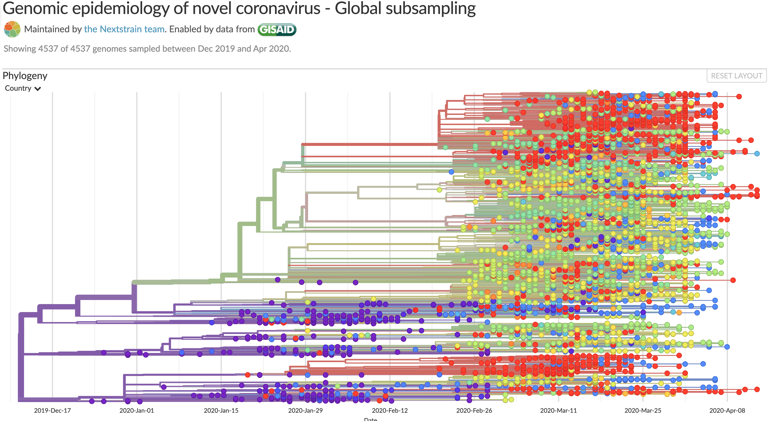

Slide 14
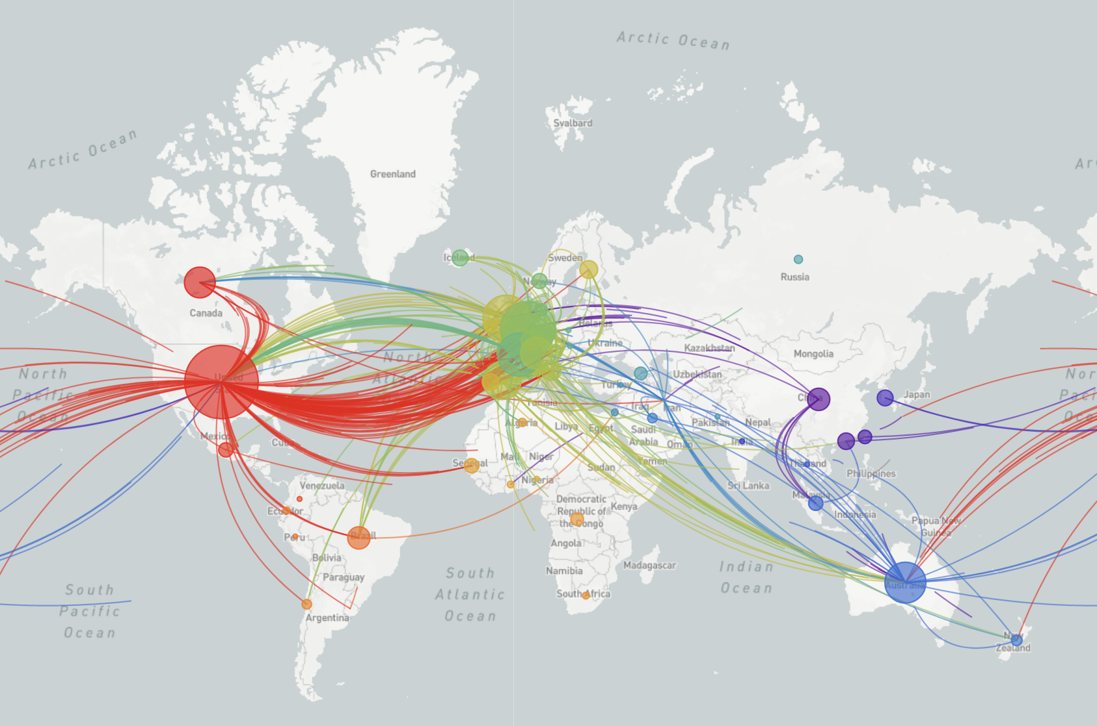

Slide 15
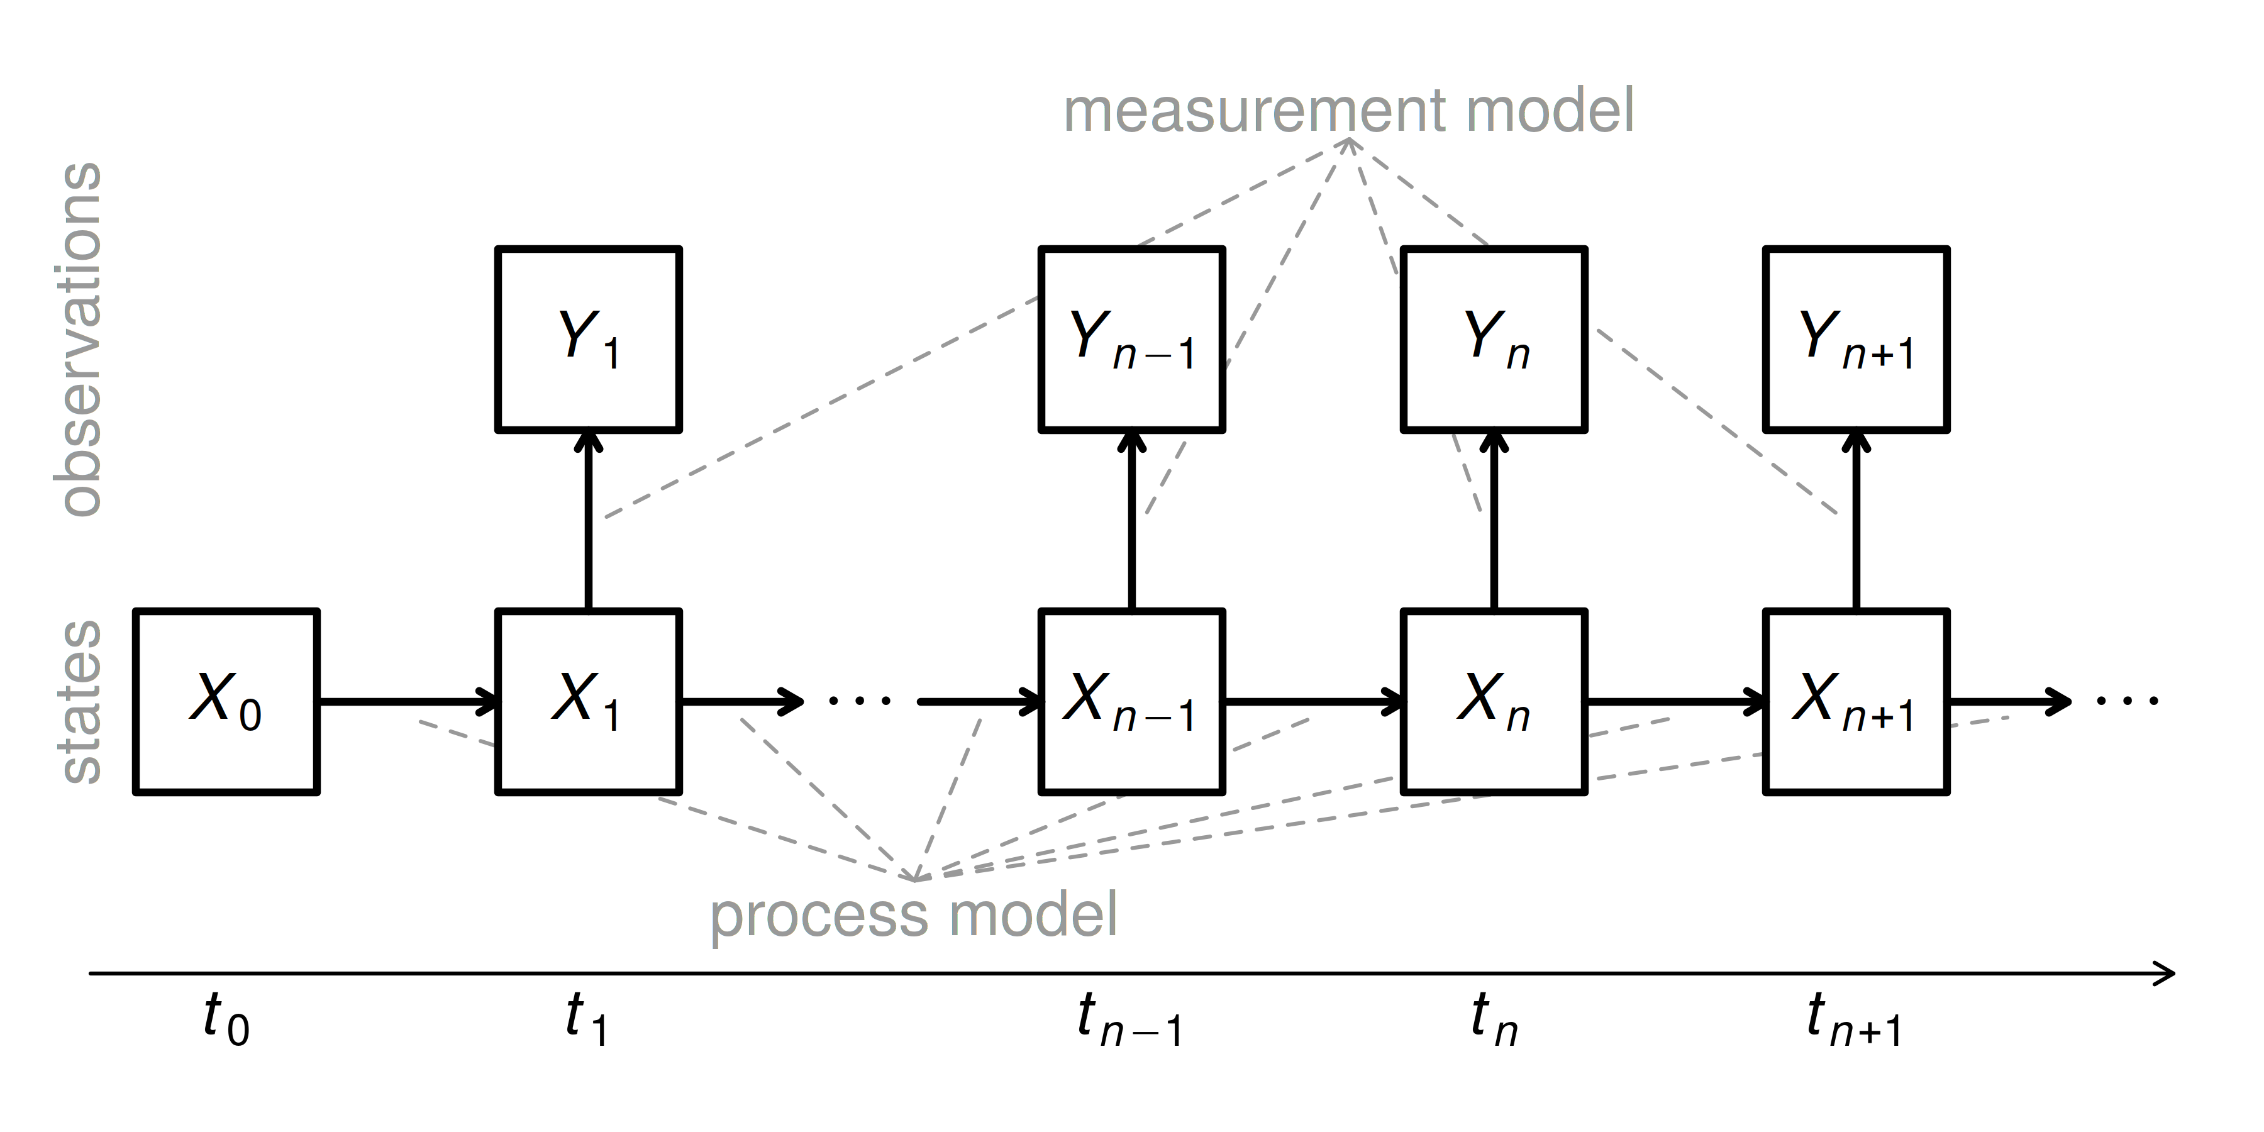

Slide 16
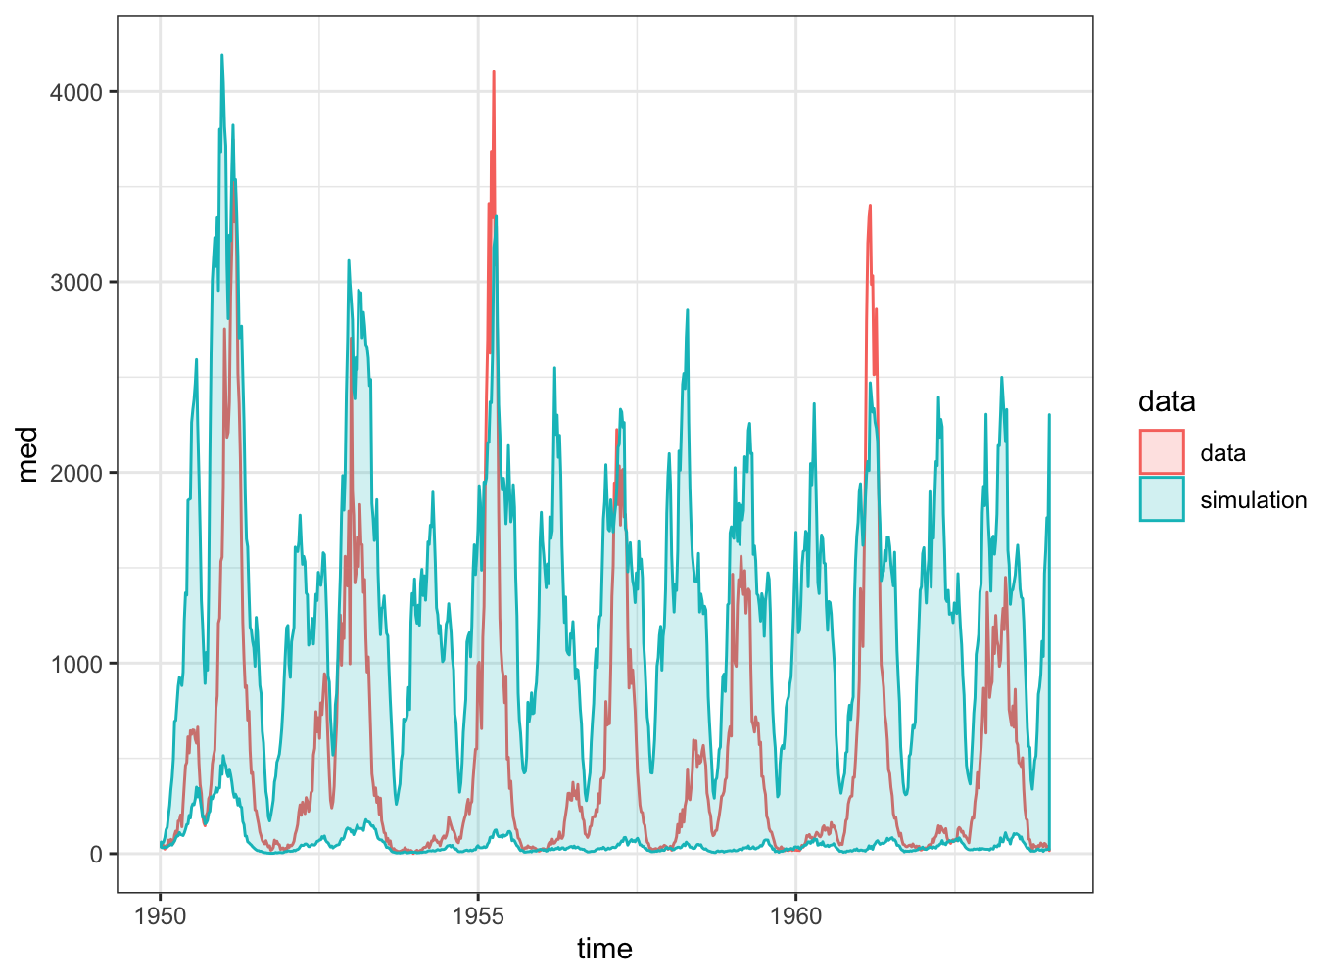
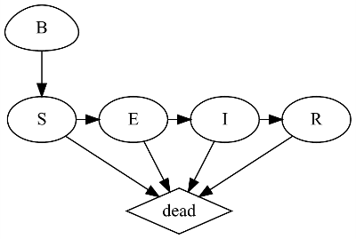

Slide 17
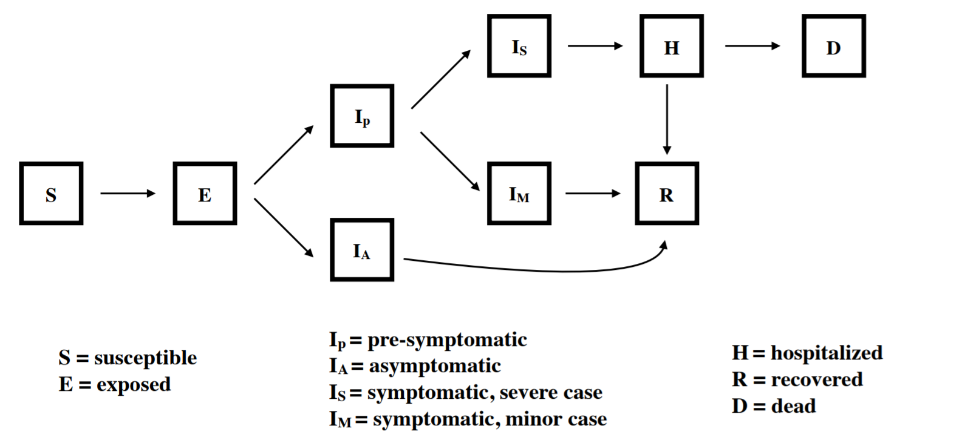

Slide 18
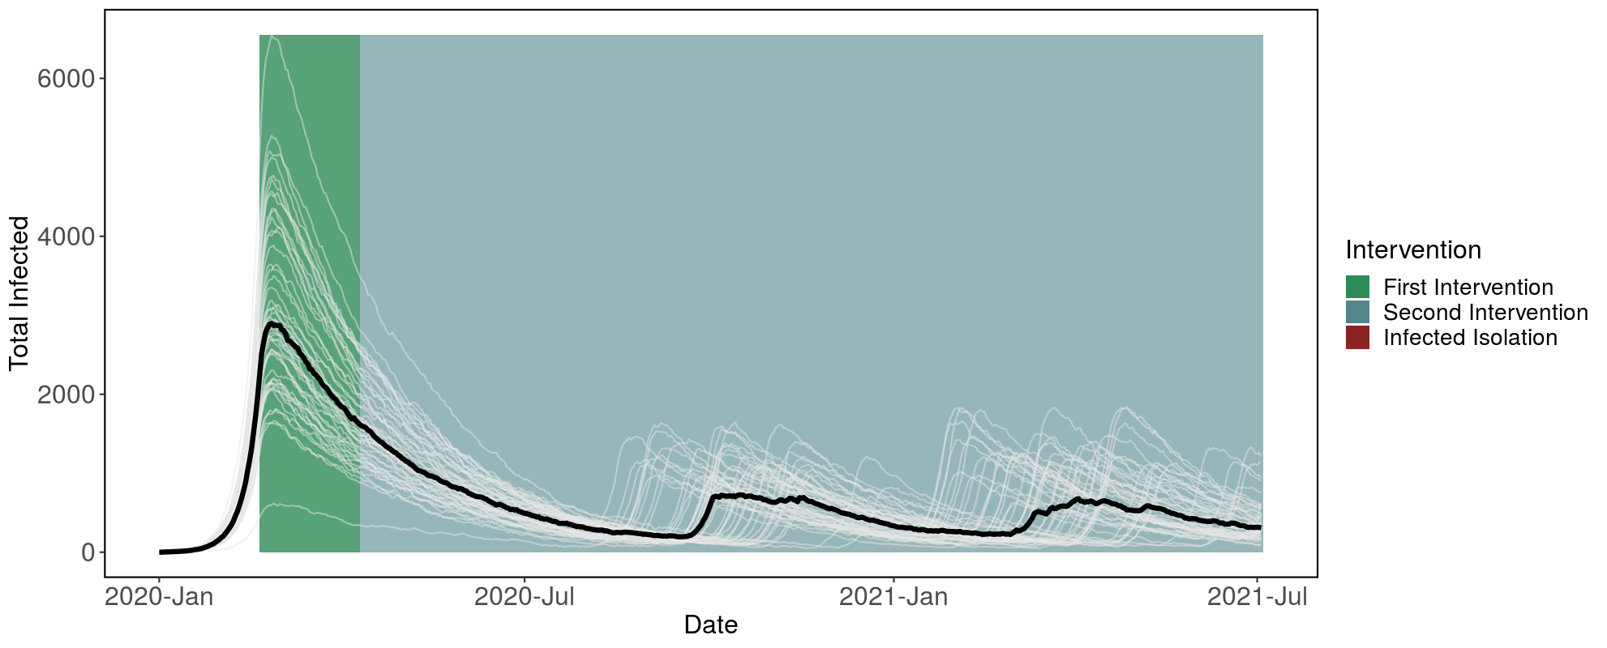

Slide 19
Thanks!
noamross
@
@EcoHealthNYC
@rOpenSci
ecohealthalliance.org
ropensci.org
Notes:
I'm Noam. I'm an ecologist at EHA.
Research at the confluence of conservation and public health, emerging inf. dis
Field ecologists, public health specialists, to our large + growing m&a team, and software engineering to turn our models into apps, and do large-scale ML for global disease surveillance.

