Slide 1


The Paper and The Data:
Authors, Reviewers, and Editors Webinar on Updated Journal Practices for Data (and Software)
Erin Robinson, Executive Director
Earth Science Information Partners
erinrobinson@esipfed.org @esip_erin
https://orcid.org/ 0000-0001-9998-0114
Shelley Stall, AGU Sr. Director, Data Leadership
sstall@agu.org @ShelleyStall
https://orcid.org/0000-0003-2926-8353
Randy Townsend, AGU Director, Publications Operations
rtownsend@agu.org
https://orcid.org/0000-0001-7001-5505
Notes:
The Paper and The Data: Authors, Reviewers, and Editors Workshop on New Journal Practices for Data (and Software)
Journal guidelines for data and software are evolving to better support open science. Use of citations, availability statements, and persistent identifiers recognize the value of data sets and code as contributions to the scientific record. Join us to discuss how best to prepare for your next grant and put into place the best practices for data and software that will make complying with the new journal guidelines much easier.

Slide 2
Agenda
Module 1: Introduction
Challenges with Accessing Data
AGU Data Position Statement
Recommendations from NAS
Updated Journal Guidelines
Benefits for Sharing Data/Software
Module 2: Data
What Data
What Repository
Availability Statement
Citation
Examples
Module 3: Software
What Software
Availability Statement
Citation
Github? Nope. But now what?
Examples
Module 4: Peer Review
Recommendation from AGU
Examples
Module 5: Persistent Identifiers
ORCID, DOI…
PID Graph
Resources

Slide 3
Module 2: Data
What Data?!?

Slide 4

Datasets
Big Data
Dynamic Data
Databases
Documents
Code/Software
Models
Images
Video
Audio
Other Digital Objects
These Data...
Notes:
Photo by Mark Basarab on Unsplash

Slide 5
Guide to Citing Data
What Data…
Why…
1. Any data created for this research
  Commonly referred to as primary data, or raw data.
  Does not include model data output
2. Any processed/synthesized data supporting the research results, visualizations, graphics
3. Any data previously existing used for your research
MOST IMPORTANT for future science – Is an important contribution to the scientific body of knowledge
Should be deposited in a domain repository if at all possible
MOST IMPORTANT for the transparency and reproducibility of your research
Give credit to the creators
Supports reproducibility

Slide 6
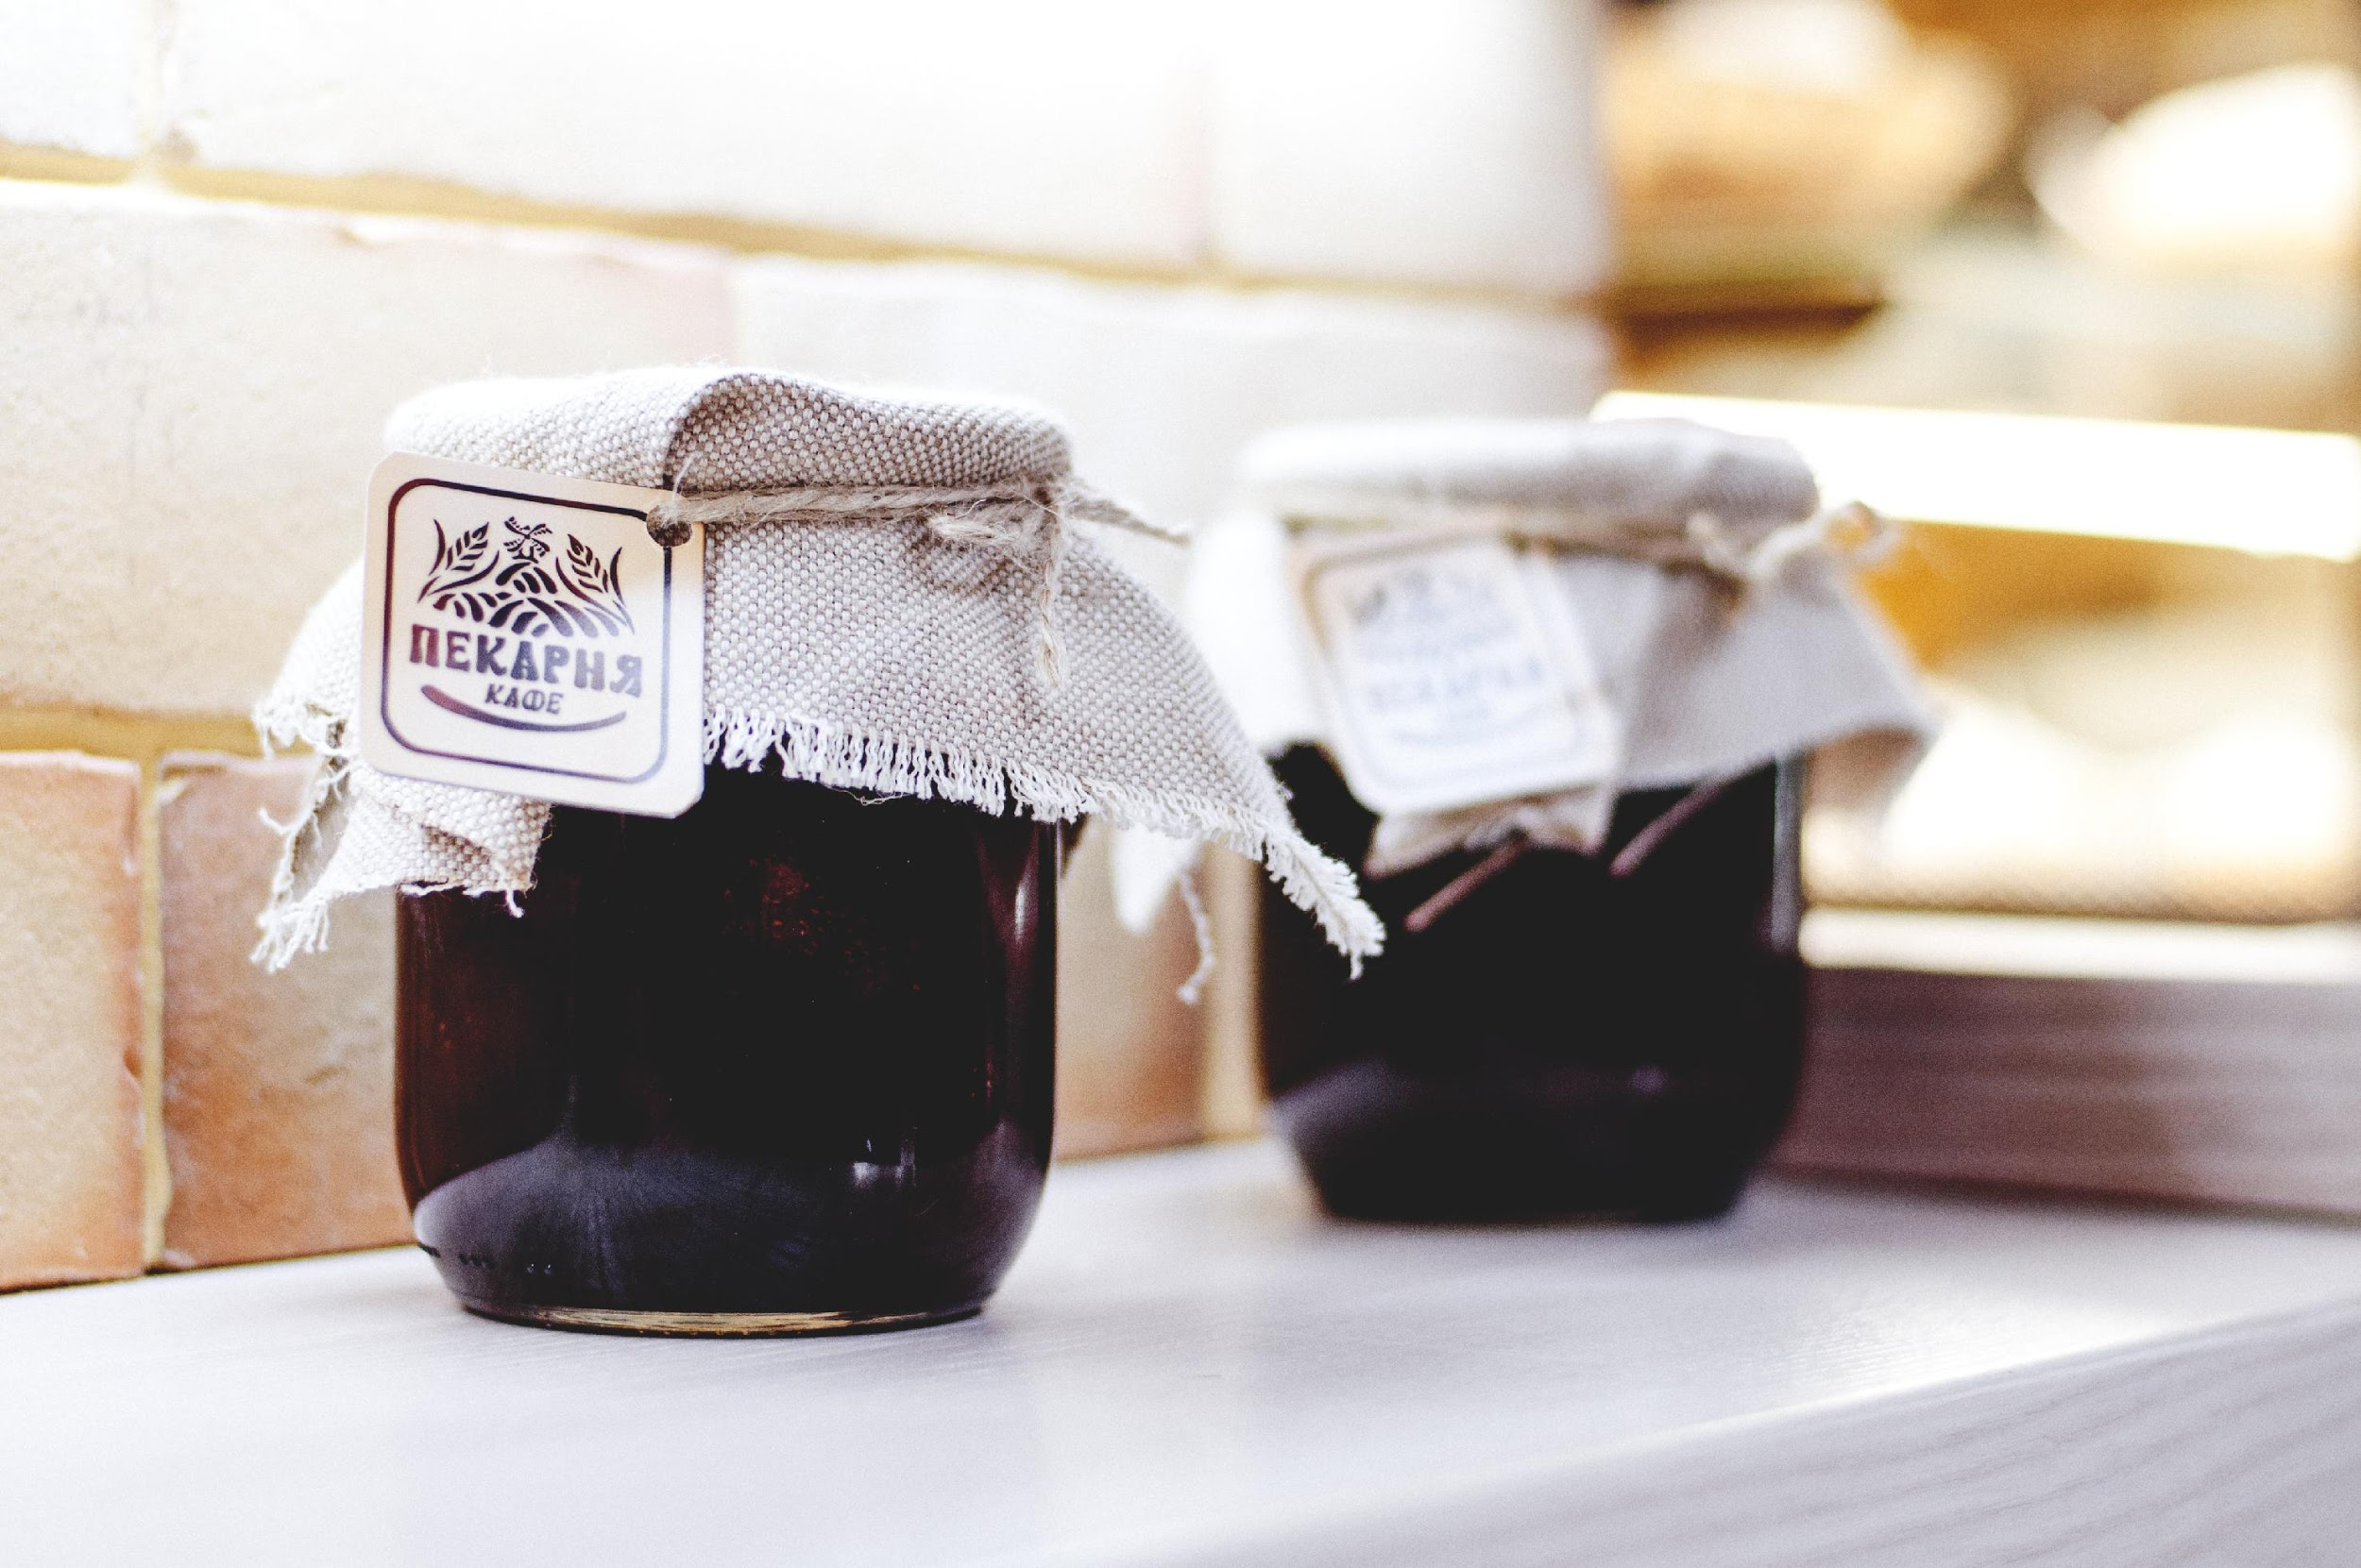
PRESERVATION and PUBLISHING
Discovery
Openness and Access
Documentation
Licensing
Citation
Notes:
Photo by Olia Gozha on Unsplash
Homemade jams from Ukraine
Archive your data and code Shelley
Why? - Maintenance, immutability, persistence
Domain (data curator does the transformation) vs. domain agnostic repositories (e.g. EDI, FigShare, Zenodo) and Thematic data model – CUASHI ODM. GBIF. GenBank. [You do the transformation]
Domain specific data models
Metadata
Annotation (e.g. vocabularies, gazetteers, identification systems)
Maintenance - Automated workflows via event notifications and APIs
Ongoing data collection and archiving - Data are public and can be useful for long-term projects that span personnel turnover.
ORCID - Linking to your products

Slide 7
Best for Understanding and Interoperability
REPOSITORY SELECTION
DOMAIN
Repository specific to a data type. Data Manager/Curator receive your deposit and transform the format to align with the repository standards and community practices.
E.g. BCO-DMO, EarthChem, IRIS
GENERAL / INSTITUTIONAL REPOSITORIES
Used for data that does not have a domain repository, or is aggregated data that support your research and understanding of the visualizations.
E.g. Dryad, Zenodo, Figshare, Open Science Framework
Best for Interoperability and Understanding
THEMATIC DATA MODEL
Similar to a DOMAIN REPOSITORY, but the transformation of your data is done by you.
E.g. CUASHI, ODM, GBIF, Genbank
Notes:
Archive your data and code Shelley
Why? - Maintenance, immutability, persistence
Domain (data curator does the transformation) vs. domain agnostic repositories (e.g. EDI, FigShare, Zenodo) and Thematic data model – CUASHI ODM. GBIF. GenBank. [You do the transformation]
Domain specific data models
Metadata
Annotation (e.g. vocabularies, gazetteers, identification systems)
Maintenance - Automated workflows via event notifications and APIs
Ongoing data collection and archiving - Data are public and can be useful for long-term projects that span personnel turnover.
ORCID - Linking to your products

Slide 8
Choosing the right repository provides these capabilities…
DISCOVERY
PERSISTENT IDENTIFIERS
Unique, globally-resolvable identifiers for your data, such as a Digital Object Identifier (DOI) are registered on your behalf by a repository.
OPTIMAL SEARCH CAPABILITIES
Robust metadata describing your data allows for accurate and optimal searching. This includes author names, location information, time, and other keywords.
OPENNESS, ACCESS, LICENSE
YOUR DATA ARE AS OPEN AS POSSIBLE,
AS CLOSED AS NECESSARY
Research transparency and reproducibility encourages that data supporting your research be made available for review. By making it as open as possible you provide the elements that went into your research results. Select a usage license that supports your level of openness.
DOCUMENTATION
WELL DOCUMENTED DATA (METADATA)
Data can be well understood as to what it is, how it was created, instrument used. quality, and uncertainty. Use guidance from your community and standard vocabulary.
Notes:
Immutable

Slide 9
Data availability statement [AGU Guidance]
For each dataset that supports your research, both a citation and a data availability statement must be present.
The data availability statement for each data set must be included in the Open Research section of your paper indicating where readers can access the data.
The availability statement should include an in-text citation, licensing information, and access restrictions.
Statements to the effect of "data available from authors" are not acceptable.

Slide 10
Data availability statement examples
1. For data stored in a repository: in-text data citation references, license, access restrictions
2. For data published in the literature: paper citation
3. For technical reports publishing the description of a dataset and its preparation, e.g. a data paper: paper citation and repository citation
4. For data not publicly available, but available to researchers with appropriate credentials: In-text reference, license, access restrictions if any
5. For data that are restricted by commercial, industry, patent, government policies, regulations, or laws: in-text citation reference from third party source, restrictions that include information concerning required NDA, licensing, agreements, and reason why not accessible. Provide process for how other researchers can gain access. NOTE: If your data are in this category, the editors will determine if this statement meets the [AGU] data guidelines sufficiently.

Slide 11
Data Citations
Your data citation(s) should include the data used in your paper.
This may include data that others have created, new data as a result of your research, and processed data used for your analysis.
It is especially important that newly created data are placed in a domain repository.
For guidance on how best to format a compliant data citation along with examples, reference ESIP’s Data Citation Guidelines For Earth Science Data.
Citation Formatter (uses DOI)
  Information: https://datacite.org/citation.html
  Tool: https://citation.crosscite.org

Slide 12
Modeling Data - Guidelines for authors where research is primarily based on models
When the primary data for the research comes from model simulations, follow these guidelines:
Citation of the model.
  BEST OPTION: Cite the model using a software repository that registers the version used for the paper with a globally resolvable persistent identifiers (e.g. Digital Object Identifier) and metadata that describes the model using community standards.
  GOOD OPTION: Cite the model, including the version information, using a general repository (e.g. Zenodo option for GitHub). The repository entry should include along with the model 1) a descriptive file (e.g. metadata) that preferably follows a standard appropriate for your community, 2) a preferred citation that accurately captures the authors/creators of the model.
  ACCEPTABLE OPTION: Cite the publication where the model is described with information about the version used for this paper.
Description of the model.
  Include a description of the model in the text of the paper that is adequate to support reproducibility.
Information about the configuration/parameters used to run the model.
  This information should be included in the paper text as well as providing the script used. The scripted should be cited, and preserved in a trusted repository. Any forcing datasets used should be described and cited.

Slide 13
Modeling Data - Guidelines for authors where research is primarily based on models
Data that Supports the Summary Results, Tables, and Figures.
  BEST OPTION: Cite a package in an appropriate repository that includes scripts, provenance information, and summary files that support the research, figures, and tables, consistent with archives maintained for transparency and traceability by assessments such as the IPCC.
  GOOD OPTION: Cite files (e.g. scripts, descriptive detail) in an appropriate repository that support evaluating the research and provide the details behind the tables and figures.
  ACCEPTABLE OPTION: Provide the necessary information for transparency and traceability of the analysis using your community standards or guidance.
Model Output Data (optional).
  If certain model output data are instrumental to evaluating the research, then deposit these in a trusted repository that supports the FAIR Data Principles. There are currently limited resources for preserving many files of large size. Selecting representative output from one or a few model runs as is recommended by a specific community may be necessary.
  If the model is not open because of the sensitivity of the research or proprietary concerns, then provide as much information as possible to support evaluation of the research and reproducibility.

Slide 15
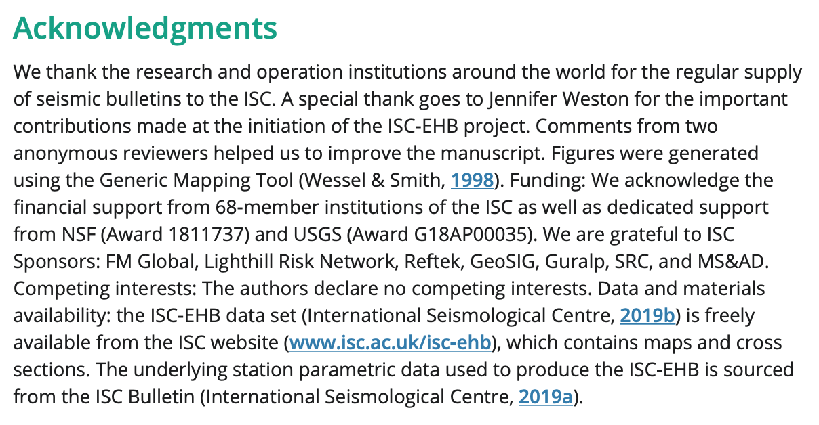

Data Availability in Acknowledgements –> now Open Research Section
Data Citations in References

Slide 16

Thank you.
Shelley Stall, AGU Senior Director, Data Leadership
sstall@agu.org @ShelleyStall
https://orcid.org/0000-0003-2926-8353
Randy Townsend, AGU Director, Publications Operations
rtownsend@agu.org
https://orcid.org/0000-0001-7001-5505
Erin Robinson, Executive Director Earth Science Information Partners
erinrobinson@esipfed.org @esip_erin
https://orcid.org/ 0000-0001-9998-0114

