Slide 1

Atmospheric Pressure Plasma Treatment of Sized Glass Fibres for Wetting Control
Daan J.H. Cederløf, Yuki Kusano and Søren Fæster DTU Wind

Slide 2
Contents
Background and motivation
Atmospheric pressure plasmas
  Dielectric barrier discharge (DBD)
  Plasma processing
Analysis of treated fibres
  X-ray photoelectron spectroscopy (XPS) (Elemental analysis)
  Dynamic micro-wetting test (Wetting characteristics)
  (Field emission type scanning electron microscope (FE-SEM) (Surface morphology))
Summary and Outlook
  New ‘Large DBD’ operational
  Future tests

Slide 3
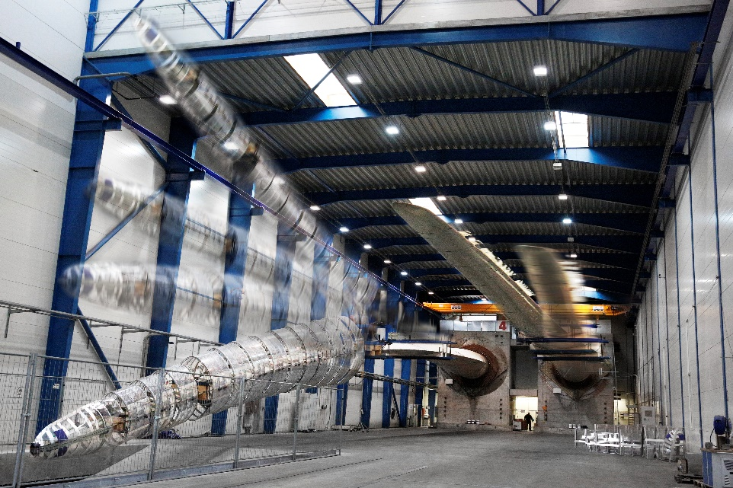

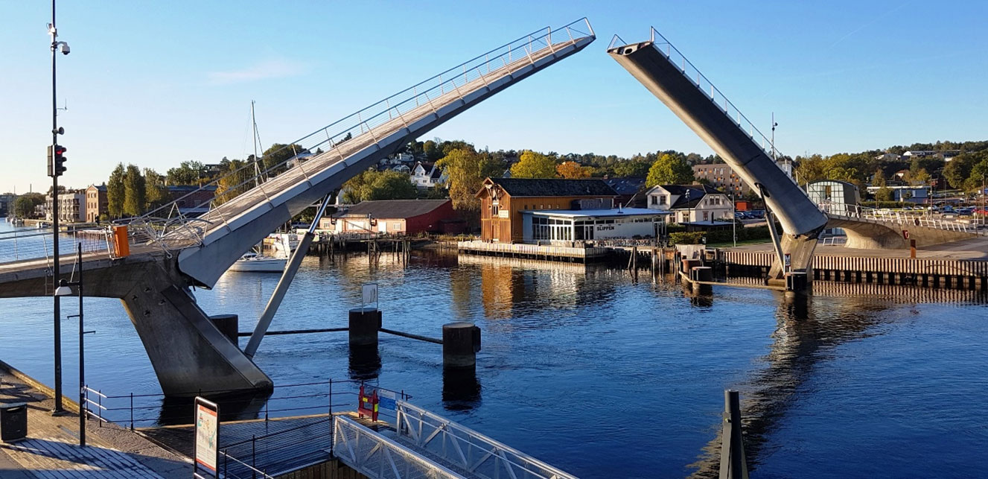
Background: DACOMAT
Damage Controlled Composite Materials
Objective: ‘To develop fibre reinforced plastic materials with high capacity to sustain damage and fractures, making them suitable for structures requiring high levels of durability.’
Photo: LM Wind Power
Photo: FiReCo

Slide 4
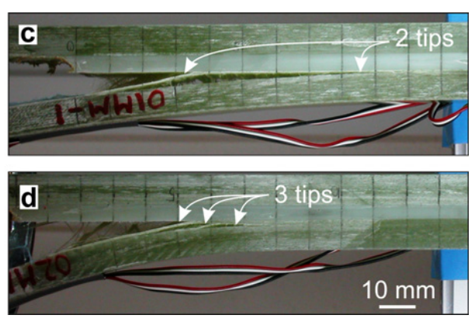
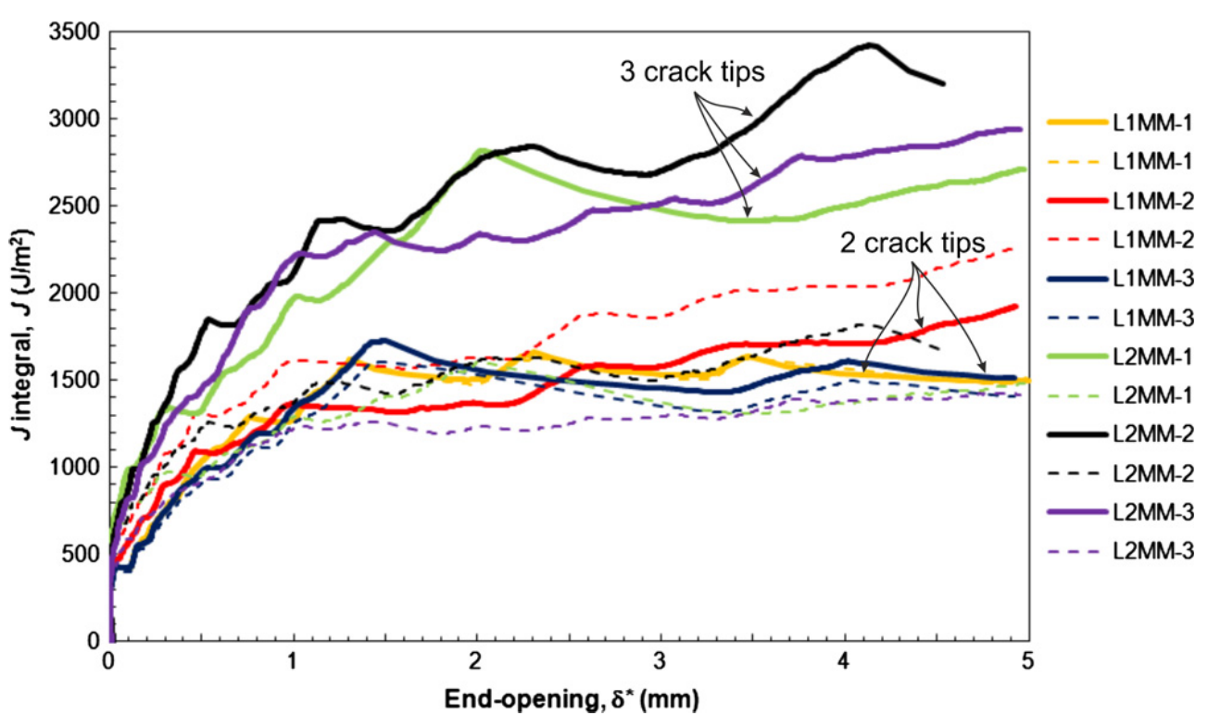
Multiple delamination cracks
Fracture Resistance
Mixed mode DCB specimen showing multiple cracks.
Source: Rask & Sørensen 2012
Fracture resistance curves for mixed mode DCB specimen showing multiple cracks.
Source: Rask & Sørensen 2012

Slide 5
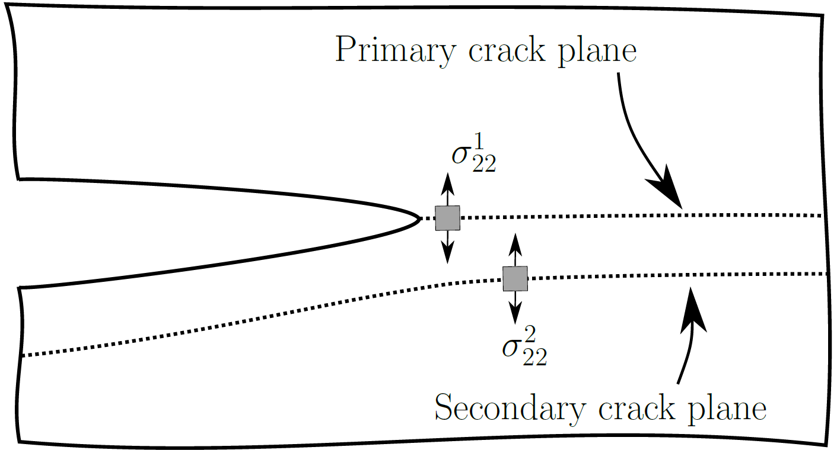
Controlling the formation of multiple cracks
x₂
x₁
^{ˆ}
^{ˆ}
Multiple crack formation in composite structure.

Slide 6
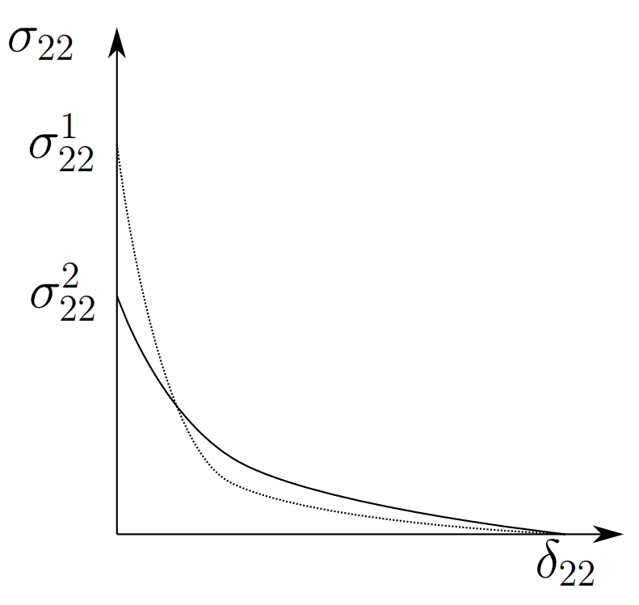
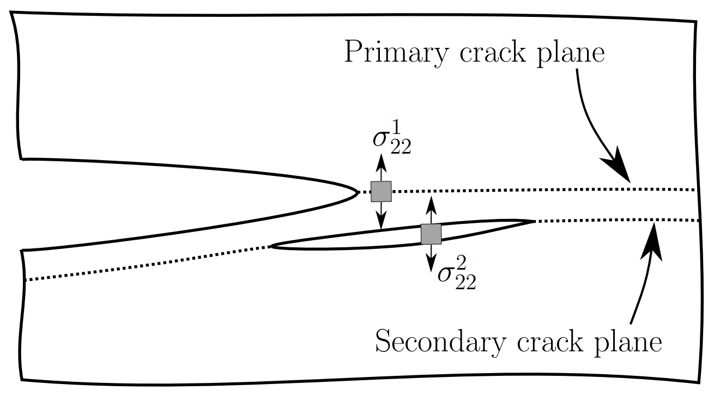
Controlling the formation of multiple cracks
^{ˆ}
x₂
^{ˆ}
x₂
x₁
x₁
^{ˆ}
^{ˆ}
^{ˆ}
Multiple crack formation in composite structure.
Cohesive law requirement for multiple crack formation:
Peak strength in x₂ direction must be lower in secondary crack plane.
Notes:
Include reference to peak strength

Slide 7
Controlling the formation of multiple cracks
Teflon/PTFE tape
  Physical barrier
  Prevents fibre bridging
  Zero interlaminar strength
Perforated PTFE tape
Plasma treatment in He/CF₄
  Introduction of fluorine
  Controlled ‘mild’ PTFE like behaviour

Slide 8
Atmospheric pressure plasmas
Characteristics of low temperature plasma
Surface modification with He/CF₄ plasma
High treatment effect
Bulk property unchanged
Easily generated at low pressures, but also possible at atmospheric pressure
Surface cleaning and weak domain elimination
Mechanical interlocking due to roughening
Substitution of fluorine onto fibre sizing surface
  Decreased wetting
Localized treatment possible

Slide 9
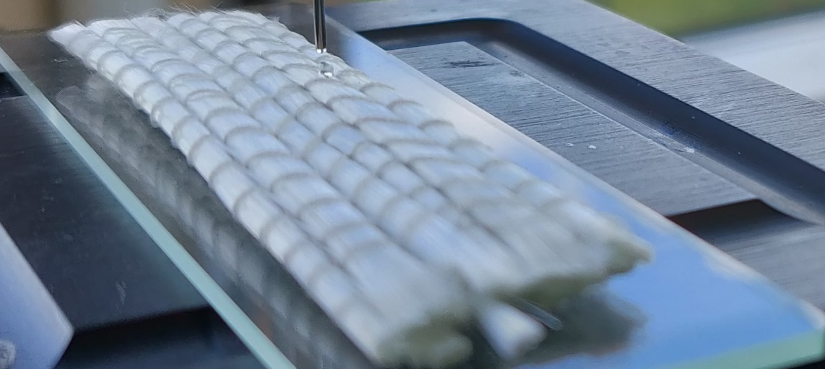
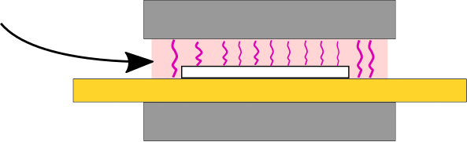
Atmospheric pressure plasma setup
Specimen | Commercial sized glass fibre bundles from UD fabric Approx. 60mm length
Plasma source | Dielectric Barrier Discharge (DBD)
Power [W] | 50 & 100
Gas input [SLM] | He: 3 CF₄: 0.22
Frequency [kHz] | Ca. 45
Time/exposure | 60 s
Fig: Prepared specimen
Electrode
Gas input
Plasma
Specimen
Dielectric Barrier
Standard liter per minute (SLM)
Electrode
Fig: Dielectric Barrier Discharge (DBD) setup
Notes:
Update drawing

Slide 10
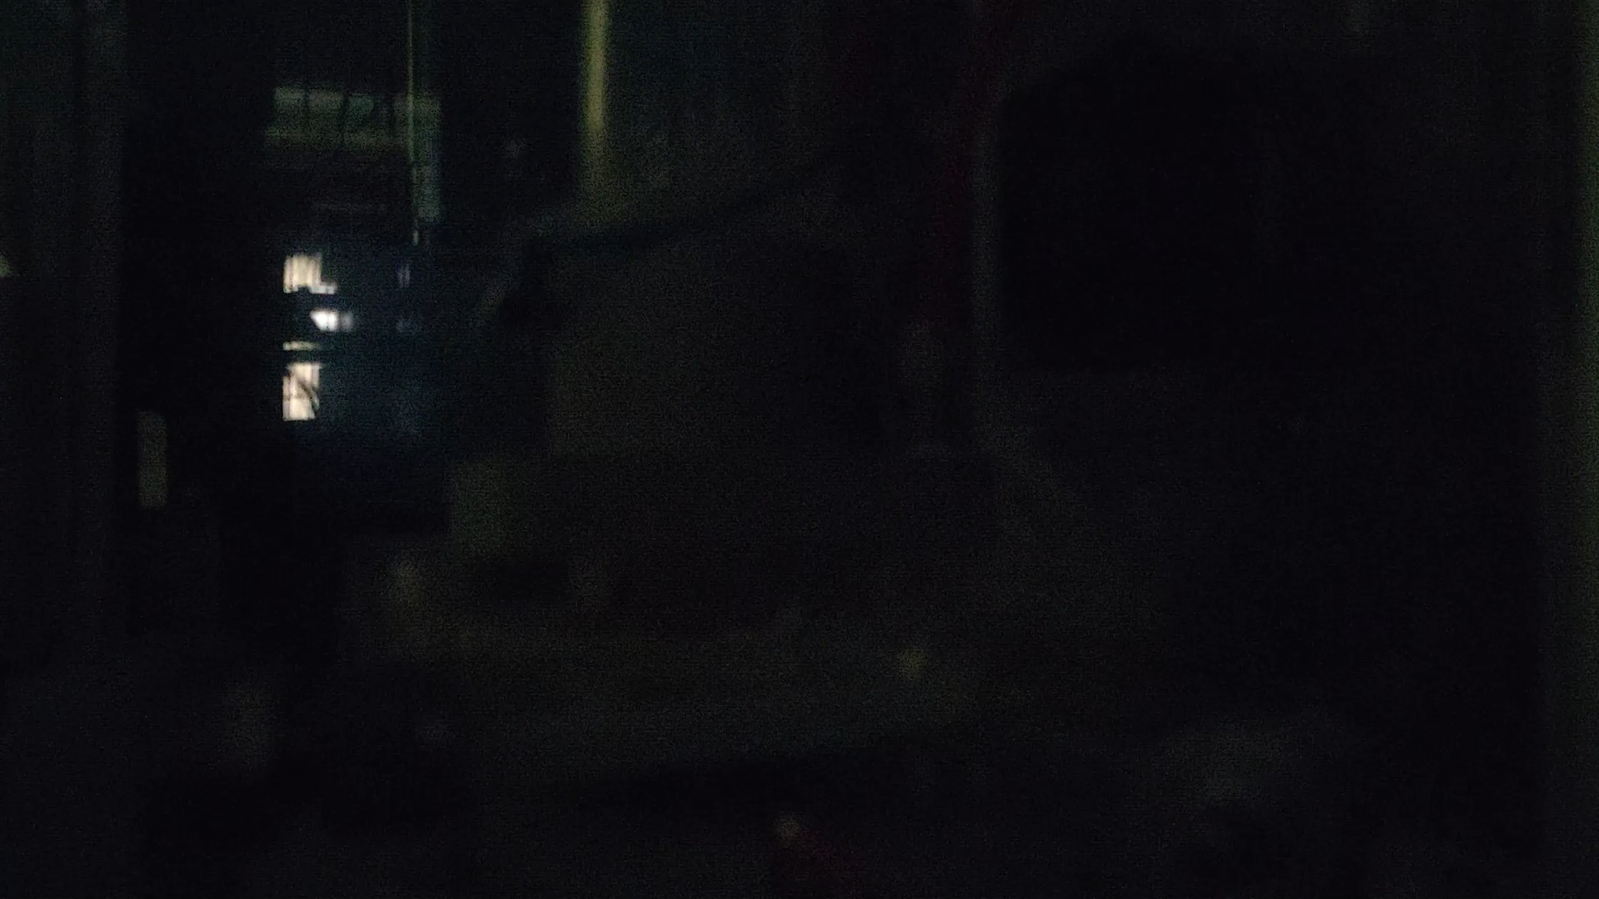
DBD Video

Slide 11
Analysis of treated sized glass fibre surfaces
X-ray Photoelectron Spectroscopy, (XPS).
Dynamic micro-wetting test.
Field Emission Scanning Electron Microscopy, (FESEM)
(extra slides)

Slide 12
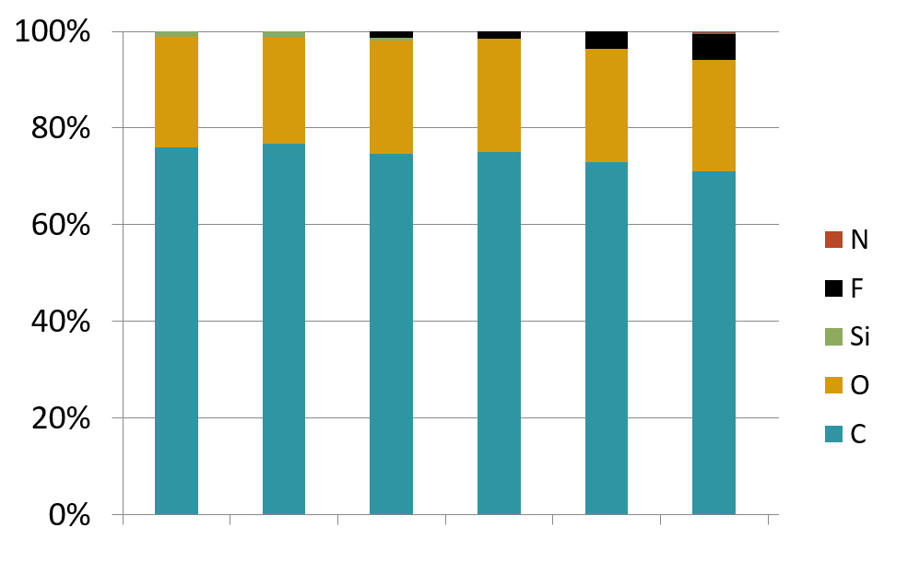
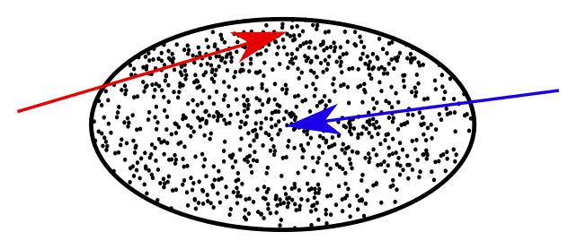
XPS Results – DBD He/CF₄– Elemental Analysis
Fluorine is introduced on fibres from the bundle interior and exterior
Increased plasma power introduces more fluorine
Silicone contaminants are removed
Interior
Fibres
Exterior
Fibres
Untreated exterior
Untreated interior
DBD 50W interior
DBD 100W interior
DBD 50W exterior
DBD 100W exterior
Bundle cross-section

Slide 13
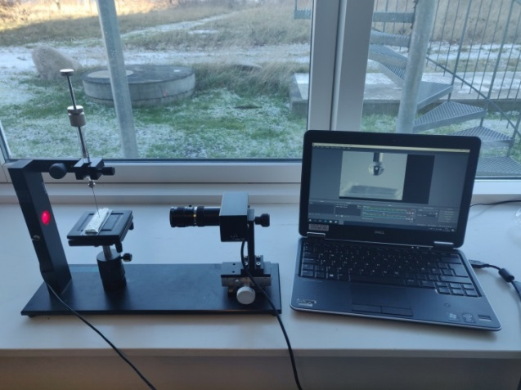
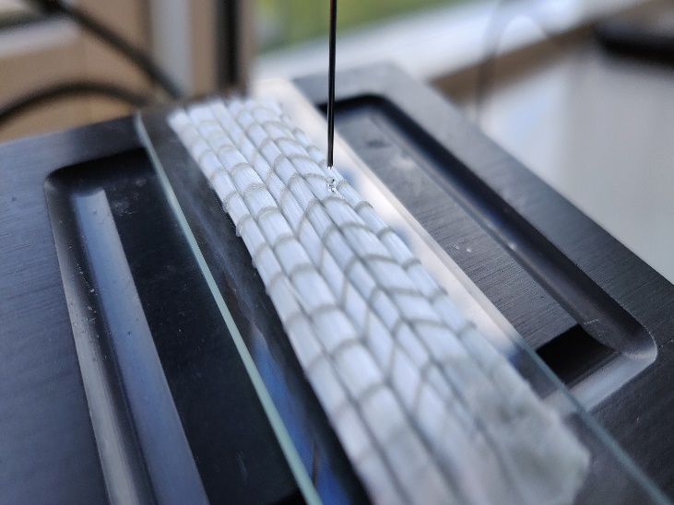
Dynamic micro-wetting
CCD camera
Each specimen consists of multiple bundles
Glycerol is used as a substitute for vinyl ester
A ca.1μL droplet is placed on a fibre bundle
The following treatments are analysed:
Untreated
DBD CF₄ (1min, 50W)
DBD CF₄ (1min, 100W)
Specimen
Syringe
Glycerol droplet
Fabric

Slide 14
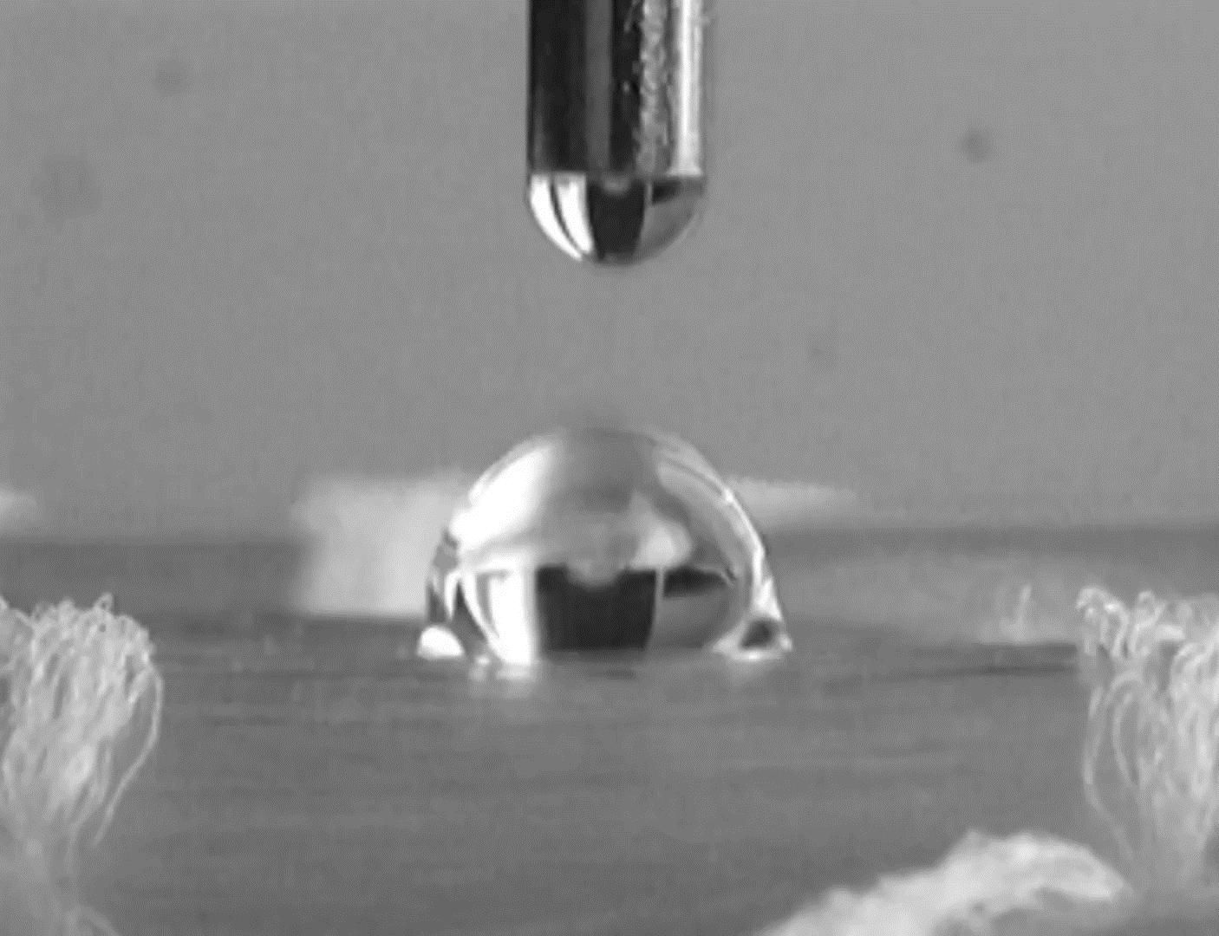
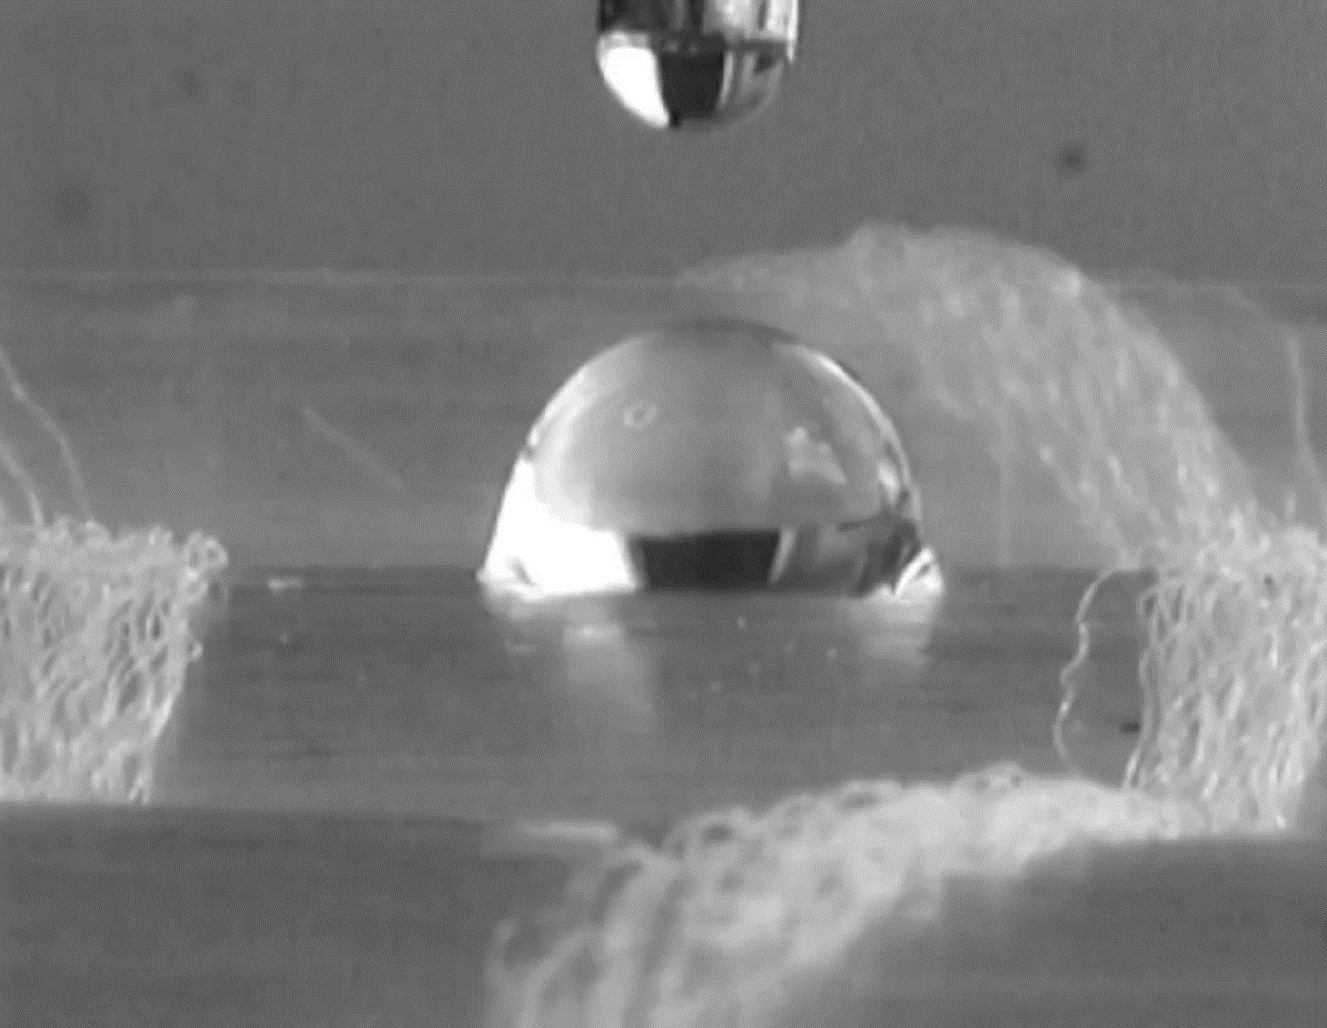
Dynamic micro-wetting
Needle
Vid: Dynamic micro-wetting of untreated sample.
(20sec, realtime)
Dynamic micro-wetting of sample treated with DBD in He/CF₄ (100W). (20sec, realtime)

Slide 15






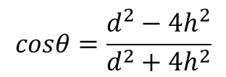

Dynamic micro-wetting
$$Measurement$$
h
$$α=−0,001$$
θ
d
$$cosθ=\frac{d^{2}−4h^{2}}{d^{2}+4h^{2}}$$
$$α=−0, 1$$
θ
$$α=−1$$
assuming
$$cosθ=1−A\exp\left(αt\right)$$
$$α [s_1] \text{is} \text{the}\text{ "}\text{wetting} \text{rate}\text{"}$$
$$A and α can be obtained by fitting.$$
Fig: Example of dynamic micro-wetting data analysis

Slide 16
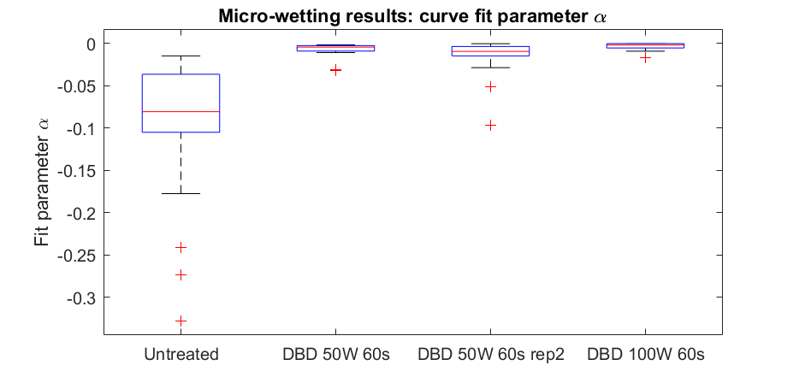
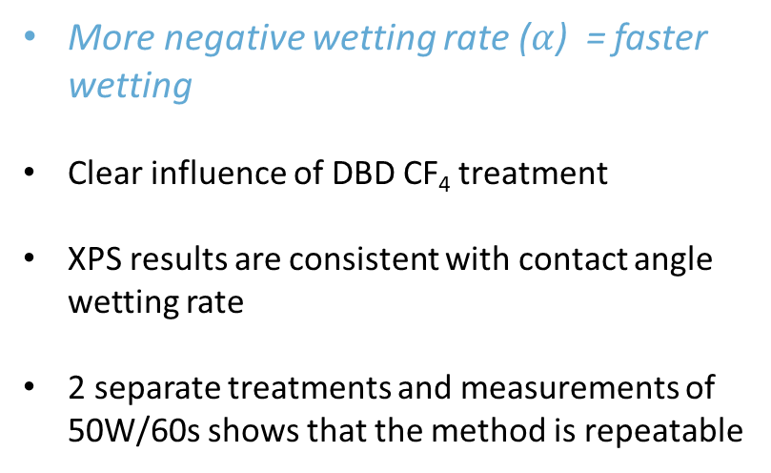

Dynamic micro-wetting results
More negative wetting rate ($α$) = faster wetting
Clear influence of DBD CF₄ treatment
XPS results are consistent with contact angle wetting rate
2 separate treatments and measurements of 50W/60s shows that the method is repeatable
Wetting rate $α [s_1]$
Fig: Summary of wetting rates after plasma treatments
Notes:
GRAPH TO BE CHANGED

Slide 17
Summary and Outlook
Summary:
To facilitate multiple delaminations, a weaker interlaminar interface is required.
Fluorine can successfully be introduced on fibre sizing surface by plasma treatment.
A decrease in wetting rate is observed after plasma treatment.
Future studies (with DACOMAT partners)
Interlaminar tensile strength (ILTS) by curved beam test (ASTM D6415) @ DTU.
New ‘Large DBD’ device calibration @ DTU.
Time of flight secondary ion mass spectrometry (TOF-SIMS) @ SINTEF, Norway.
Single fibre contact angle measurement @ UNIS, Scotland.
Interfacial Shear Strength (IFSS) by microbond test @ UNIS, Scotland.
Notes:
Include dcb test as final validation

Slide 19
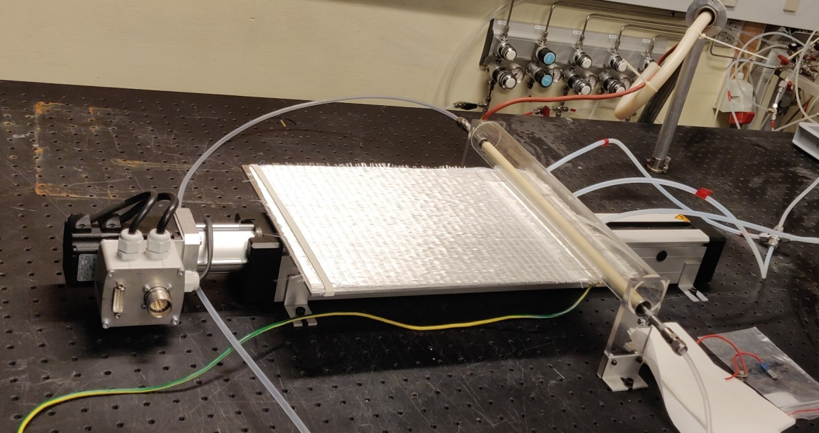
New ‘large DBD’
Movable stage/electrode (with fabric sample mounted)
Treatment of ~250x400mm fabrics
Localised treatment possible
Possibility of applying ultrasound for enhanced plasma effect
Gas inlets
Water cooled electrode

Slide 20
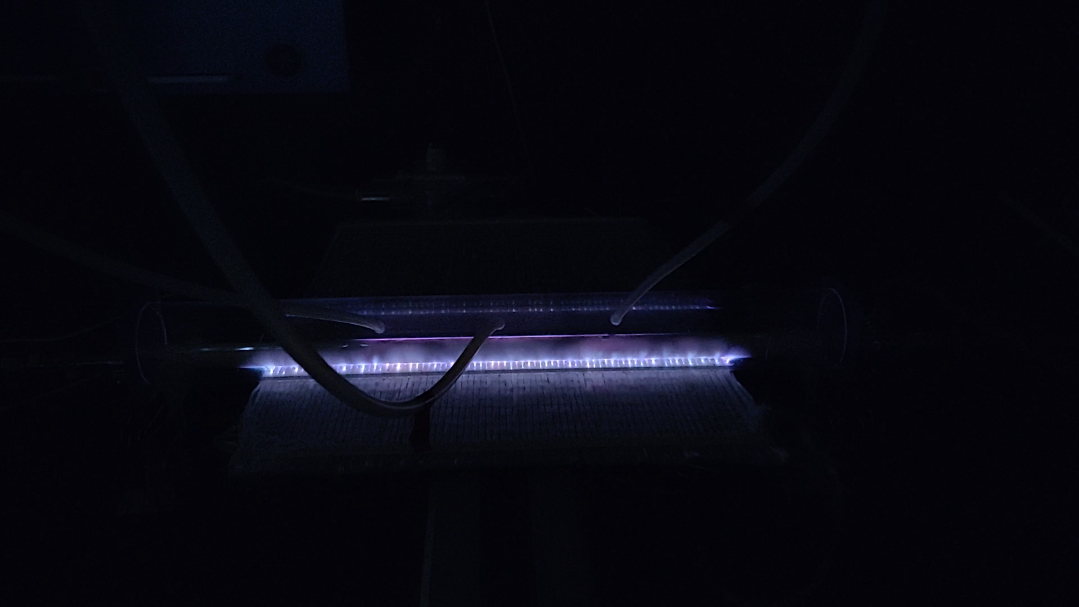
VIDEO: First test of new DBD device
Movable stage/electrode (with fabric sample mounted)
Gas inlets
Water cooled electrode
(Video in separate file)

Slide 21

VIDEO: First test of new DBD device

Slide 22
FE-SEM Results 3000x Magnification (low magnification)
Untreated
DBD CF₄ 50W
Unevenness represents local shape and structure of the sizing

Slide 23
FE-SEM Results 18-25Kx Magnification
Untreated
DBD CF₄ 50W

