Slide 1




ORCID from the perspective of an instructor and consortium manager
Paloma marín arraiza
Tu wien bibliothek & são paulo state university

Slide 2
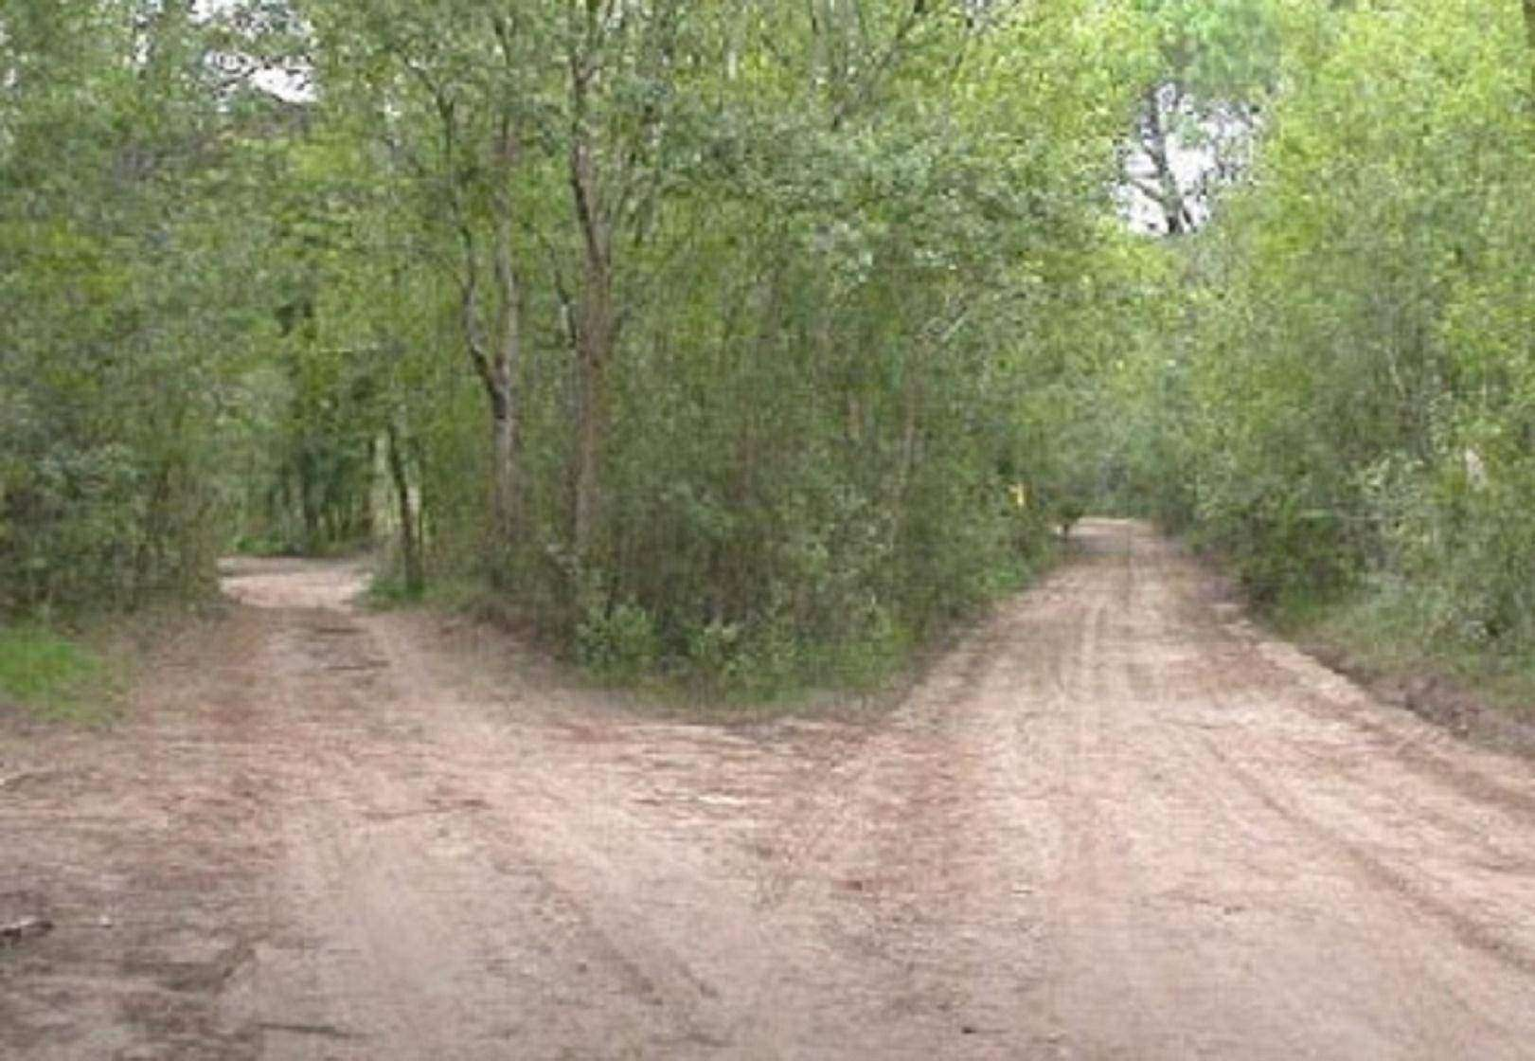


Instructor vs. consortium manager
Instructor
Target group:
ORCID users (researchers and young researchers)
Consortium manager
Target group:
Research support offices and libraries (“back stage“)

Slide 3
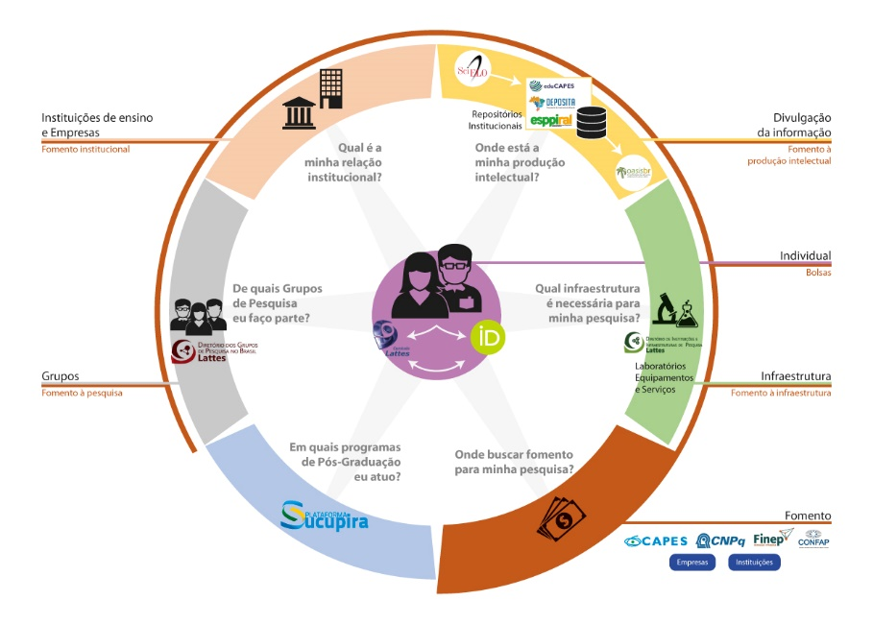
ORCID in Brazil

Slide 4



For most (young) researchers…
Another registry/CV to fill in…

Slide 5
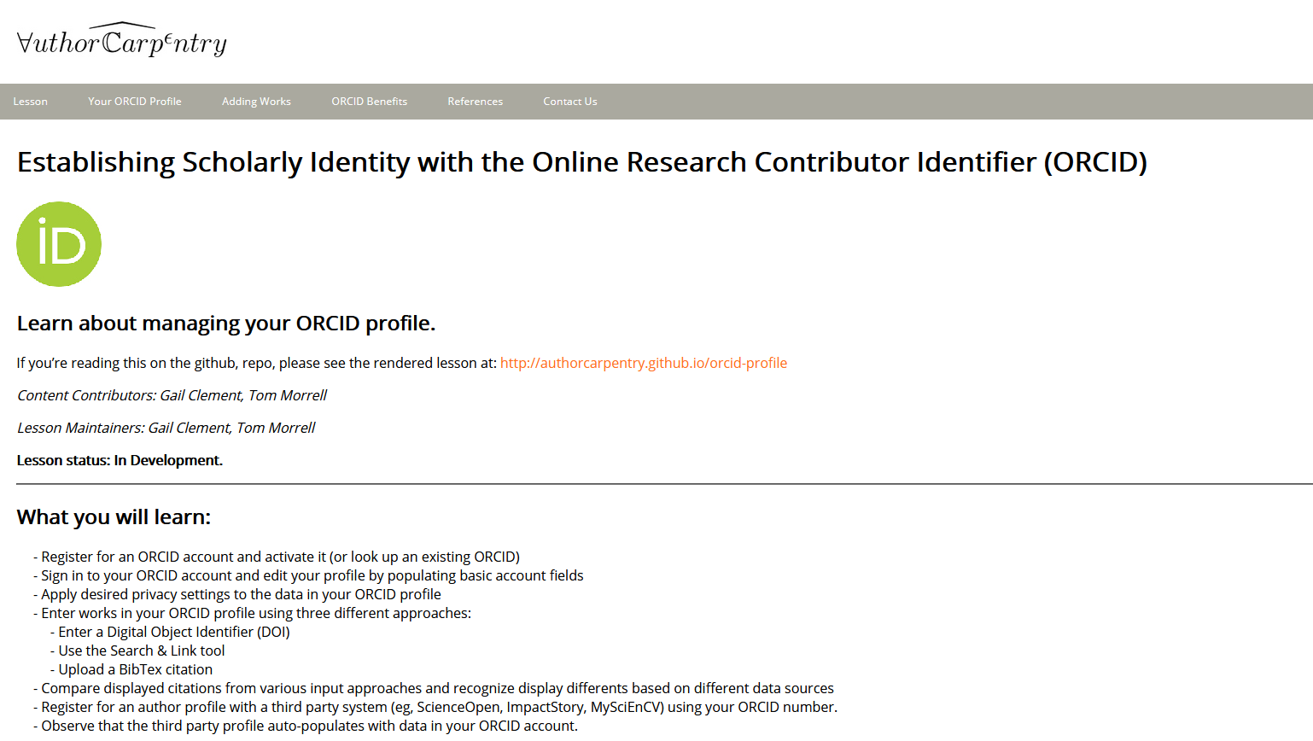
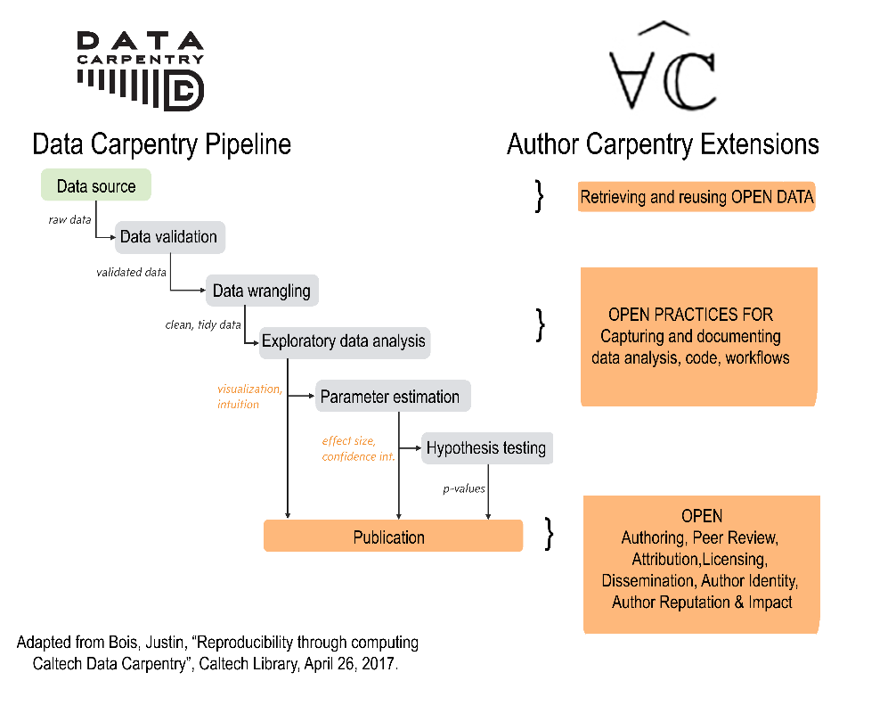
Author carpentry
Sources:
https://authorcarpentry.github.io/
https://authorcarpentry.github.io/orcid-profile/

Slide 6

The workshop
Participants:
Master‘s students and PhD candidates in Information Science
Duration:
4 hours (in two separate days)
Goals:
Teaching the use of ORCID iD and the funtionalities of ORCID
Showing opportunities for academic libraries (and academic/data librarians)
Students and alumni Forum of the Postgraduate programme in Information Science (São Paulo State University)

Slide 7


The workshop (II)
Day 1:
ORCID
ORCID Record
Search and Link Options
Day 2:
Data exchange and privacy settings
ORCID APIs
Opportunities for librarians
Slides (in Portuguese) available here: http://doi.org/10.5281/zenodo.3367326

Slide 8

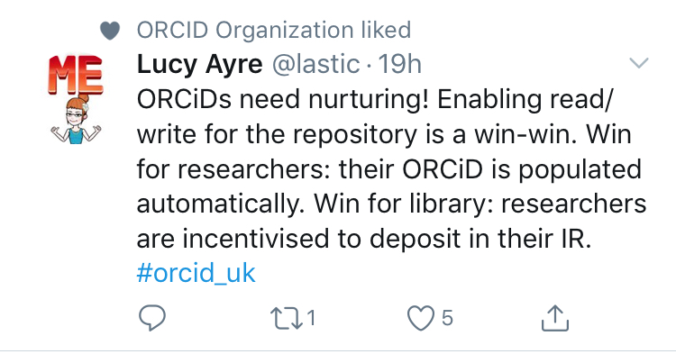

Researchers-Institutions balance
Learn how to use ORCID
Connect ORCID to journal and repository platforms
Use ORCID for grant proposals
Implement ORCID in institutional system
Collect researchers information
Automate processes
Offer PID-related services

Slide 9
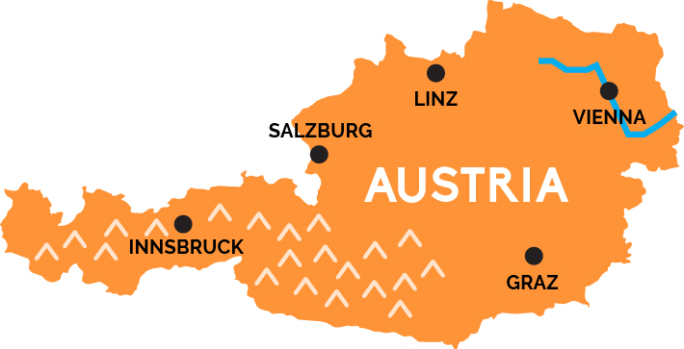
ORCID Austria
10 Universities + 1 Funder
5 possible prospective members
Challenges:
- Heterogeneous research information systems landscape
- Internal organisational aspects
TU Wien
Uni Wien
BOKU
WU Wien
FWF
VetMedUni
Uni Salzburg
Paracelsus MedUni
Uni Graz
TU Graz
Montanuniversität Leoben

Slide 10




Integrations and systems overview
Active integrations
- University of Vienna
  CRIS “u:cris” (PURE)
- Technical University of Graz
  CRIS (PURE)
- Montanuniversität Leoben
  CRIS (PURE)
Test or planning phase
  TU Wien
    CRIS “TISS“ (self developed)
    Repository “reposiTUm“ (DSpace)
  University of Vienna
    Journals (OJS)
    Repository “Phaidra“ (Fedora)
    Data repository “AUSSDA“ (Dataverse)
  WU Wien
    Repository „ePubWU“ (EPrints)
  FWF
    Funding system (ResearchFish)
  […]
Important software for future integrations:

Slide 11
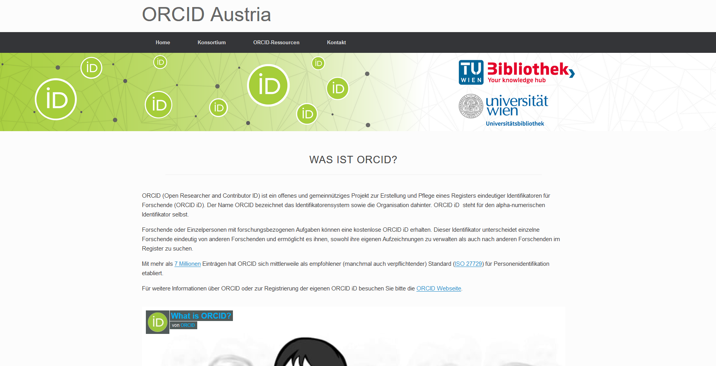

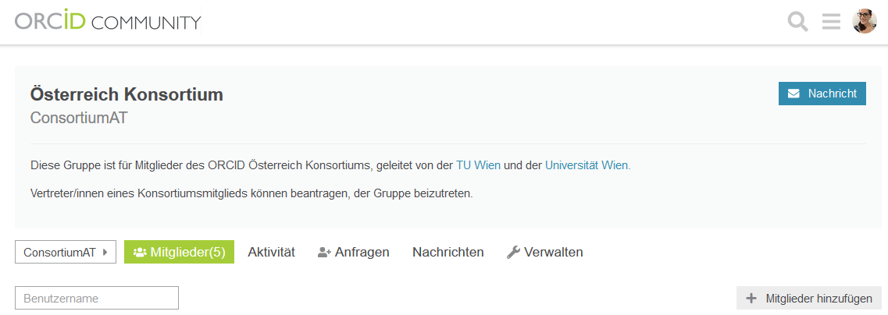
Organisational part of a consortium
Links:
https://www.tuwien.at/kooperationen/orcid/
https://doi.org/10.25365/phaidra.104

Slide 12



ORCID Austria: Next steps
- Develop outreach activities (mainly webinar)
- Present ORCID use cases (particularly for Arts and Humanities)
- Improve the central technical support (useful: ORCID API Bootcamp)

Slide 13



Contact
paloma.arraiza@tuwien.ac.at
@pmarrai
https://orcid.org/0000-0001-7460-7794

Slide 14

Thank you very much for your attention!

