Slide 1
Coping with Altmetrics‘ Heterogeneity
A Survey on Social Media Platforms‘
Usage Purposes and Target Groups for Researchers
Steffen Lemke and Isabella Peters
17th International Conference on Scientometrics & Informetrics
September 2-5, 2019
These slides can be found on https://zenodo.org/record/3381492

Slide 2
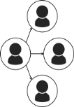


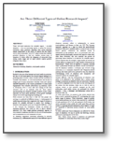







The Problem
Grand challenge for the interpretation of altmetrics: heterogeneity (see also Haustein 2016)
Source types
Instances of sources
User interactions counted as altmetrics
+1
+1
…
Haustein, S. Scientometrics (2016) 108: 413. https://doi.org/10.1007/s11192-016-1910-9
Differences regarding
… use cases
… functionalities
… target groups
… demographics
… user motivations
Source type- and pen icons by Freepik from Flaticon.
Different meanings
1
Notes:
Reason: highly varied lot of sources
Even apparingly similar sources serve different needs (e.g. compare Facebook to LinkedIn)

Slide 3
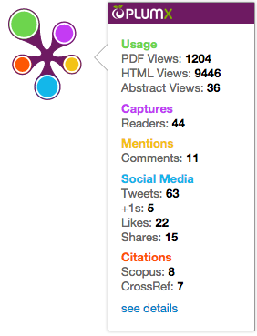
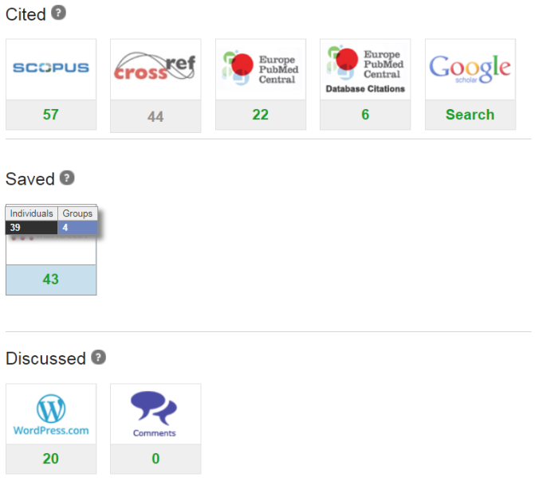
How to deal with this?
Aggregations of altmetrics from different sources are often desirable, but tend to obscure existing differences between sources
To reduce such loss of information, evidence-based strategies for meaningful groupings of sources are needed
For social media platforms, we propose to determine similarities based on usage purposes they help their users to fulfil and target groups users try to reach on them
2

Slide 4


Our Approach
Survey among researchers regarding social media platforms they use for work,
usage purposes platforms fulfil and target groups they are trying to reach.
In preparation of the survey, we had to identify:
  Relevant social media platforms
  Common usage purposes for researchers
  Target groups to reach on social media
Focus on researchers from the social sciences and economics. Distribution mainly via national and international mailing lists.
Previous *metrics survey (2017)
Group interviews w. researchers
Literature review
Survey icon from https://icon-library.net/icon/survey-icon-free-17.html
3

Slide 5
Survey - Demographics
1,018 responses (~4% RoR) from 70 countries
4

Slide 6
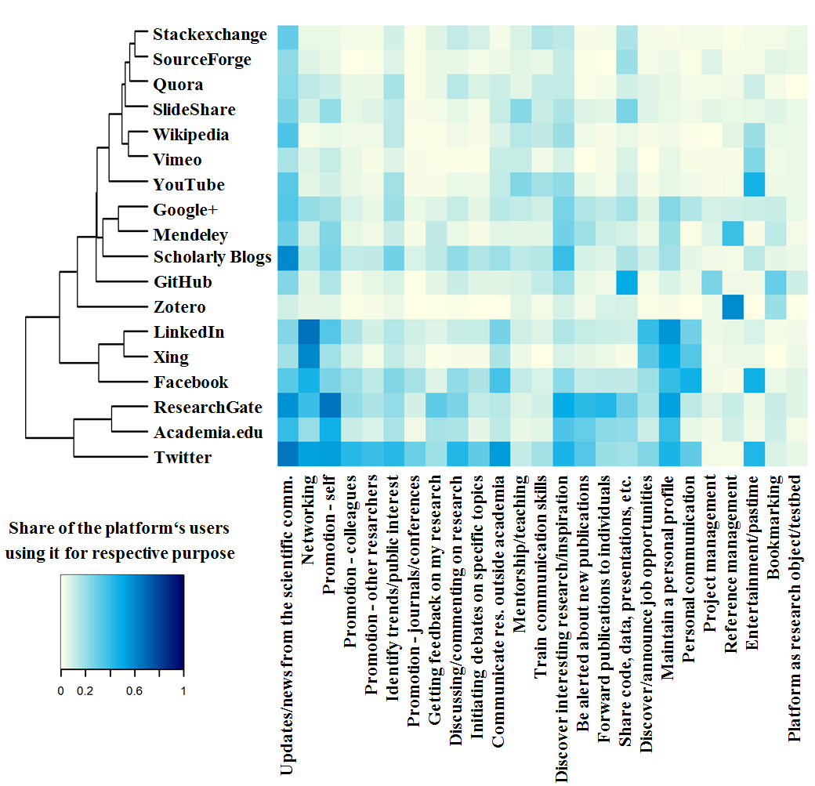
Usage Purposes on Platforms
Similar usage purposes on the six social networks, especially Networking, Mainting a personal profile, Receiving updates/news, and self-promotion
Other platforms seem more specialized; or their true usage purposed might not have been represented
Twitter seems particularly diverse in its use cases
0% 20% 60% 100%
5
Notes:
LinkedIn behaves similar to its German counterpart Xing, both being used much for networking, discovering or announcing job opportunities, maintaining a personal profile and personal communication. In a similar fashion the academic social networks ResearchGate and Academia.edu form one cluster. Interestingly, one level higher Facebook forms a cluster with the two employment-oriented platforms, as all three services share particular emphases on the purposes of personal communication and networking. The two academic social networks on the other hand form a cluster with Twitter, shared focuses lying on updates/news, self-promotion, discovering interesting research and alerts about new publications.

Slide 7
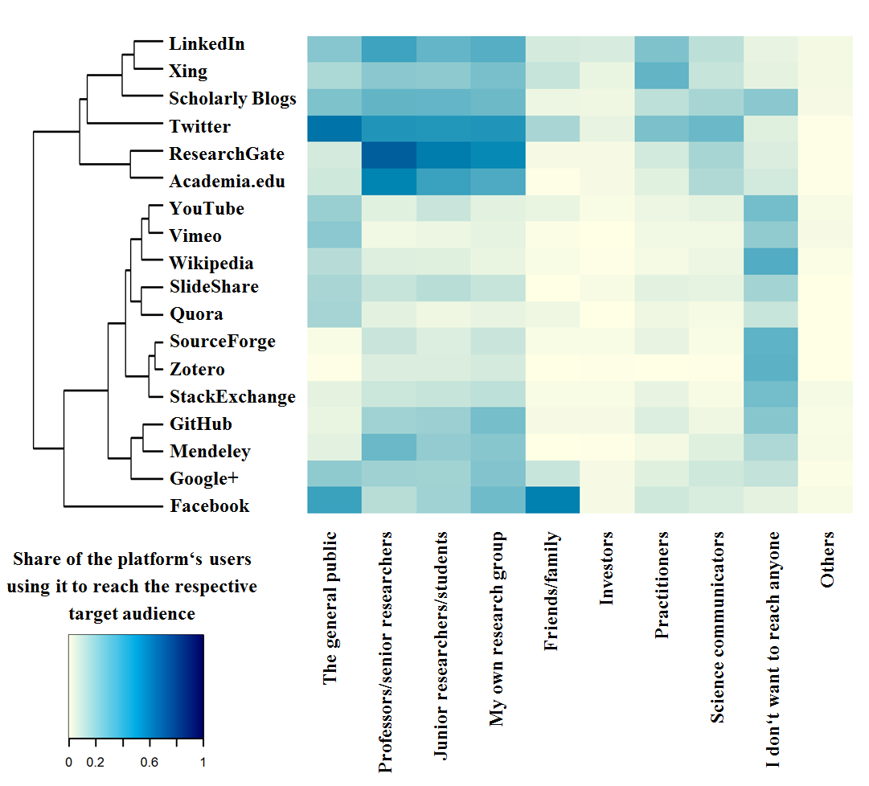
Target Groups on Platforms
Rough subdivision into two groups: services used heavily for (professional) outreach versus platforms where this is not the case
Among the latter are several platforms on which many users do not seek to reach out to anyone; for others there is less focus on professional outreach
Facebook stands out as the platform for communication with friends/family, Twitter for communication with the general public
0% 20% 60% 100%
6

Slide 8
Conclusions
We observed distinct clusters of platforms that behave similarly regarding communication goals they help researchers to fulfil
  Step towards a framework guiding users of altmetrics towards their evidence-based aggregation and interpretation
Findings might also
  help to characterize scholarly information we can expect to find on different platforms
  inform theory-building on altmetrics‘ meaning
Outlook/limitations:
We only looked at
  The source type of social media,
  The user group of researchers,
  The disciplines economics and social sciences,
  Similarities in usage purposes and target groups,
so plenty of opportunities to enrich this work in progress-framework with additional input remain.
7

Slide 9
Thank you very much!
    Email: s.lemke@zbw.eu
    Twitter: @stl90

