Slide 1
FAIR Ethics
Making Ethical Review Processes more Machine Actionable
Daniel Mietchen, Data Science Institute, University of Virginia, USA, daniel.mietchen@virginia.edu
Verena Schwaiger, RWTH Aachen, Germany
Oya Beyan, Fraunhofer FIT, Germany
RDA 12th Plenary, IG Ethics & Social Aspects session, Gaborone, 7 November 2018

Slide 2
IG Ethics and Social Aspects of Data
Ethics of data
Social aspects of data
but also
data and metadata about ethics and social aspects of data

Slide 3
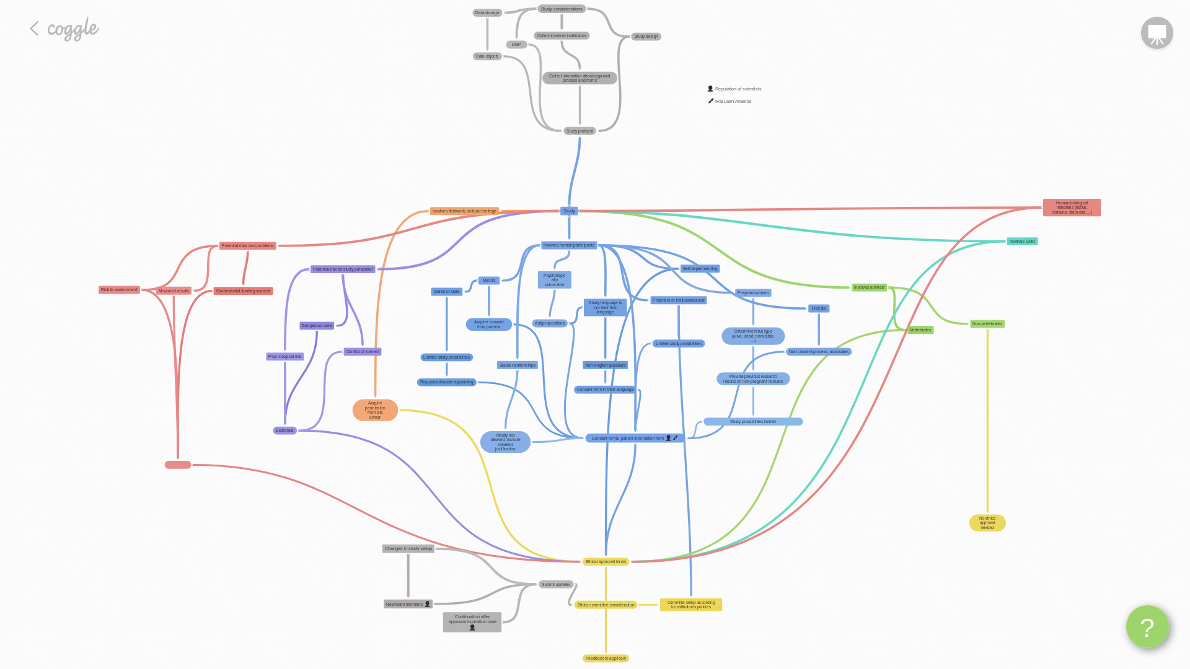
Multiple perspectives on the ethical review process
Research ethics
Patient / participant
Reader / reuser
Physician
FAIR
Technical
Policy
Legal
...

Slide 4
Research ethics perspective
The purpose of ethical review is to consider the features of a proposed study in the light of ethical principles, so as to ensure that investigators have anticipated and satisfactorily resolved possible ethical objections, and to assess their responses to ethical issues raised by the study.
1991 International Guidelines for Ethical Review of Epidemiological Studies

Slide 5
Patient perspective
Make all documentation around ethical approval and consent freely available—Blank consent forms should be made publicly available alongside trial registration, accompanied by the participant information sheet. Similarly, correspondence with ethics committees and other bodies with a similar role should routinely be made publicly available. This will allow ethics processes to be independently reviewed, publically discussed, and learnt from.
Mendel, J., Goldacre, B., Ernst, E., & Whittle, S. (2016). Problems with ethical approval and how to fix them: lessons from three trials in rheumatoid arthritis. BMJ, i4626. doi: 10.1136/bmj.i4626

Slide 6
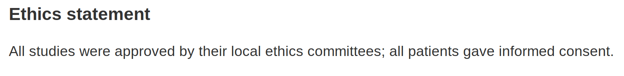
Reader perspective
Which aspect of the research triggered the need for ethics approval?
Which were these local ethics committees, and who sat on them?
How to find relevant documentation (e.g. the consent forms)?
What options did the relevant Ethics Committee(s) have to choose from?
Was there any discussion within the Committee(s)?
Was there any discussion with the team who had requested the approval?
Was there any modification to the request following such discussions?
How to find past approvals or rejections for similar research?
How long did the process take?

Slide 7
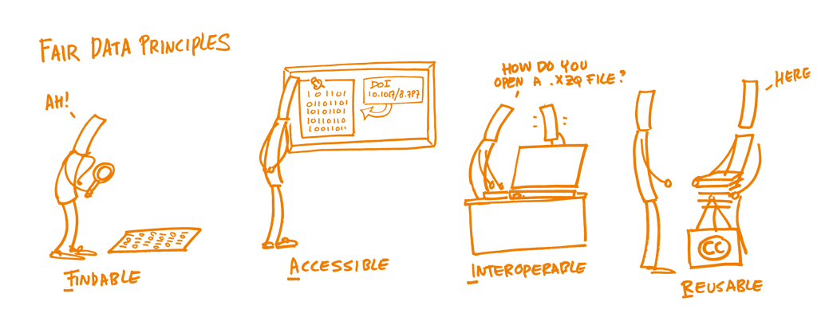
FAIR perspective
Wilkinson et al. (2016) doi.org/10.1038/sdata.2016.18 [image: fosteropenscience.eu CC0]

Slide 8
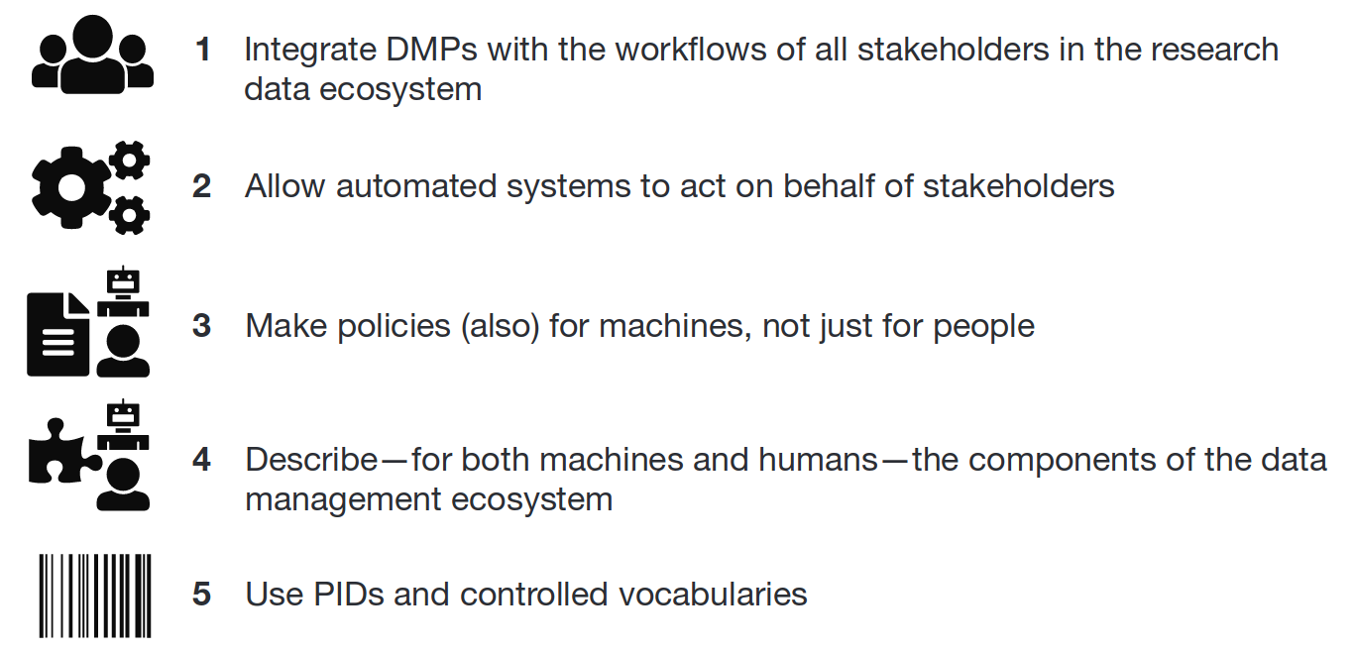
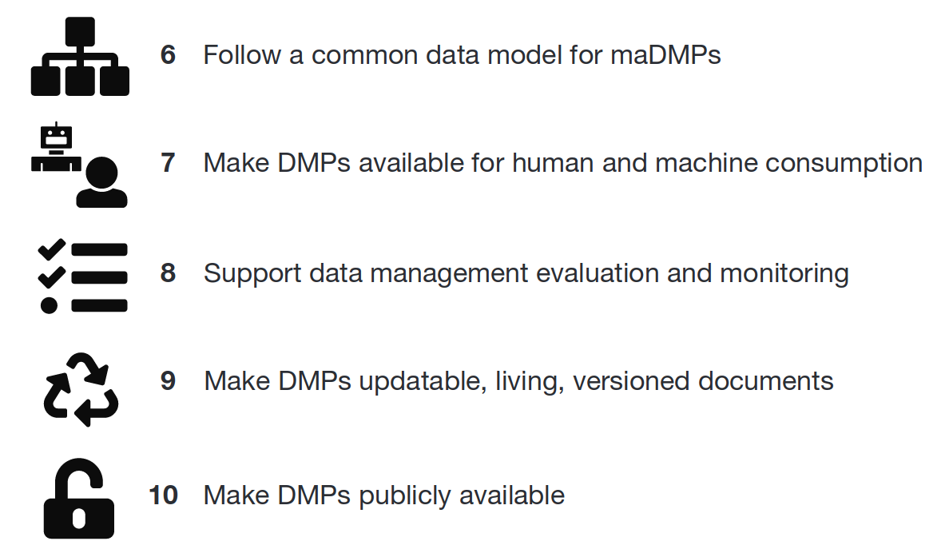
Technical perspective: making ethics data FAIR
Inspiration from progress towards machine actionable Data Management Plans, e.g. through
  DMP Common Standards WG
  Exposing Data Management Plans WG
  Ten principles for machine-actionable data management plans
PIDs = Persistent Identifiers; DMPs = Data Management Plans

Slide 9
Zooming out again: the ethics approval process

Slide 10

More examples
"The proposed investigation received the approval of the Ethics Committee of the United Oxford Hospitals."
"The study was approved by the ethics committee of the hospital, and the patients gave informed consent."
"The project was approved by two local Ethics Committees and one national committee"
"The data collected anonymously will be made available to any research group in the world following the data-sharing agreement initiative (http://www.wellcome.ac.uk/News/Media-office/Press-releases/2016/WTP060169.htm), provided that they have a clear, non-redundant research question and a biomedical research Ethics committee approval"
"Does your work need IRB approval? Better check, says author of retracted paper"
"you may need the approval of your IRB or Ethics Committee to use the data"
"The article included the statement ‘Ethics approval Regional Medical Ethics committee of medical and health research ethics, South East Norway, and the Norwegian data inspectorate’, when in fact the study did not itself have approval."
"The relevant ethics approval for this study was granted by a Department of Primary Industries NSW Animal Ethics Committee of qualified scientific and lay members (AEC Number 100802/04). Field work was carried out under NSW Fisheries Scientific Collection Permit P01/0059(A)-2.0."
emphasis added to highlight opportunities for using persistent identifiers
PID

Slide 11
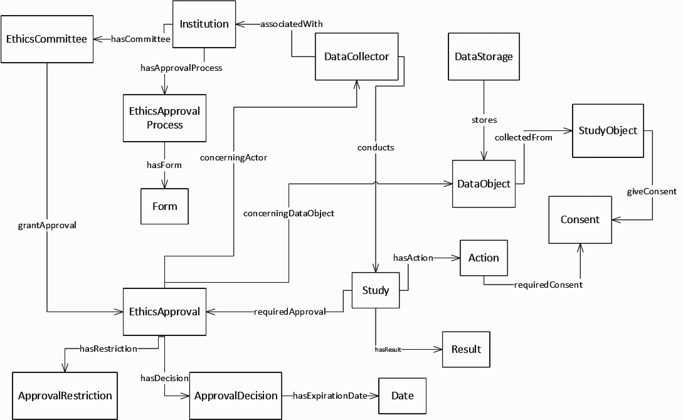
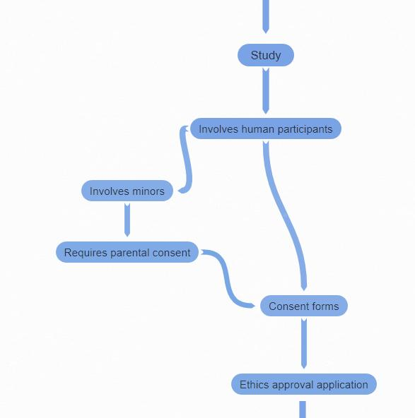
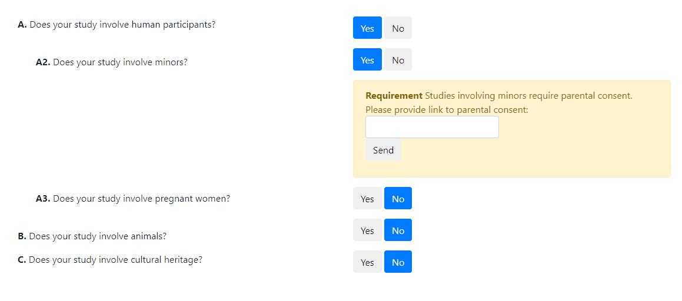
Zooming back in
Process components represented in ontology
Process details determined by questionnaire

Slide 12
Process flow (excerpt)
Application process is based on study subjects
Different subjects have different requirements and restrictions
Questionnaire to determine correct process (with requirements, restrictions)
Ontology represents relevant concepts

Slide 13
Questionnaire

Slide 14
PIDs and Decision tree
Decision pattern: A.A2
Generate PIDs for provided documents

Slide 15
Ontology

Slide 16
Use of PIDs in ethics statements
"This study was cleared by the Research Ethics Committee (CEP/CONEP) (CAE number: 13813613.9.0000.0006)"
"The research was approved by the Human Research Ethics Committee at Charles Sturt University, Australia, protocol number H17013."
"approved by the Western Sydney University Human Research Ethics Committee (approval number H10384)."
"Approval for the study was given by The University of Southampton Ethics Committee (ERGO Ethics Number: 2411)"
"Ethics of Animal Experiments Committee of Konkuk University, South Korea (Permit Number: KU16192, KU16193)."
"Balearic Islands Human Research Ethics Committee in January 2017 (CEI-IB, #IB 3341/16 PI)"
"conducted under CSIRO Social Science Human Research Ethics Committee Approval: project 055/16"
"The study protocol was approved by the Ethics Committee of the Faculty of Tropical Medicine, Mahidol University (MUTM2013-021-01) and the Oxford Tropical Research Ethics Committee, University of Oxford (OXTREC 1013-13)."
"The study was conducted in accordance with the guidelines contained in the Declaration of Helsinki II and was approved by the local ethics committee of the University of Granada, Spain (protocol: 23/CEIH72015)."
"The study has been approved by the local ethics committee (Medical University of Graz, Austria) in compliance with the current revision of the Declaration of Helsinki, ICH guideline for Good Clinical Practice and current regulations (EK-number: 24-123 ex 11/12)."
"Collars weighed less than 2.5% of the body mass of the baboons and were approved for use by Swansea University Ethics Committee (Swansea University IP-1314-5)"
"Ethical approval was obtained from the London Westminster Research Ethics Committee (11/LO/1667), and informed consent was obtained."

Slide 17
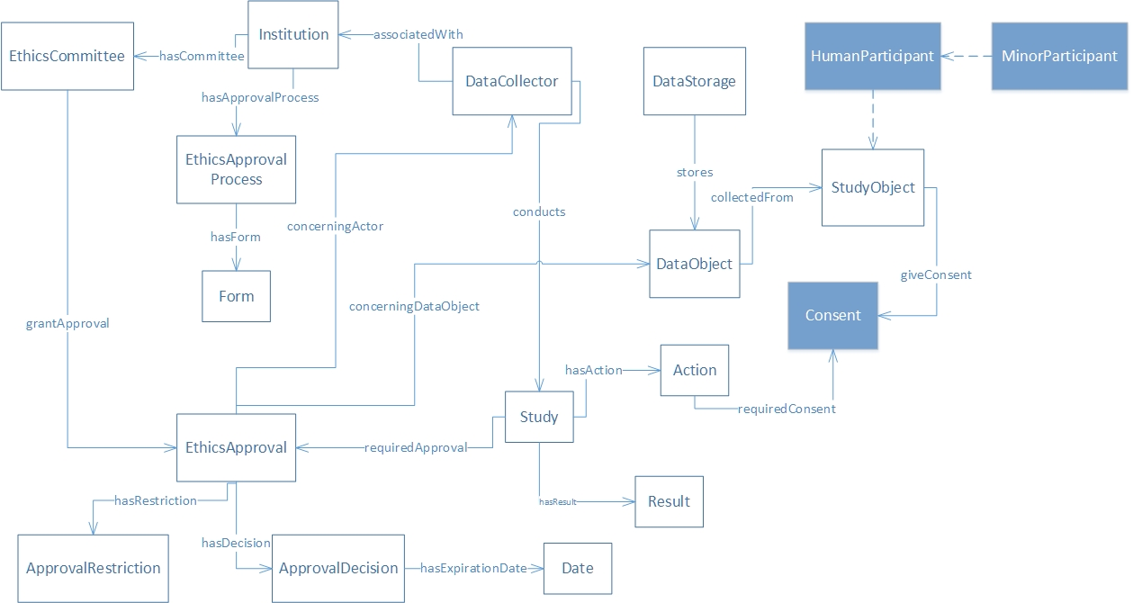
Ontology - Associated PIDs from process excerpt
PID
PID
PID

Slide 18
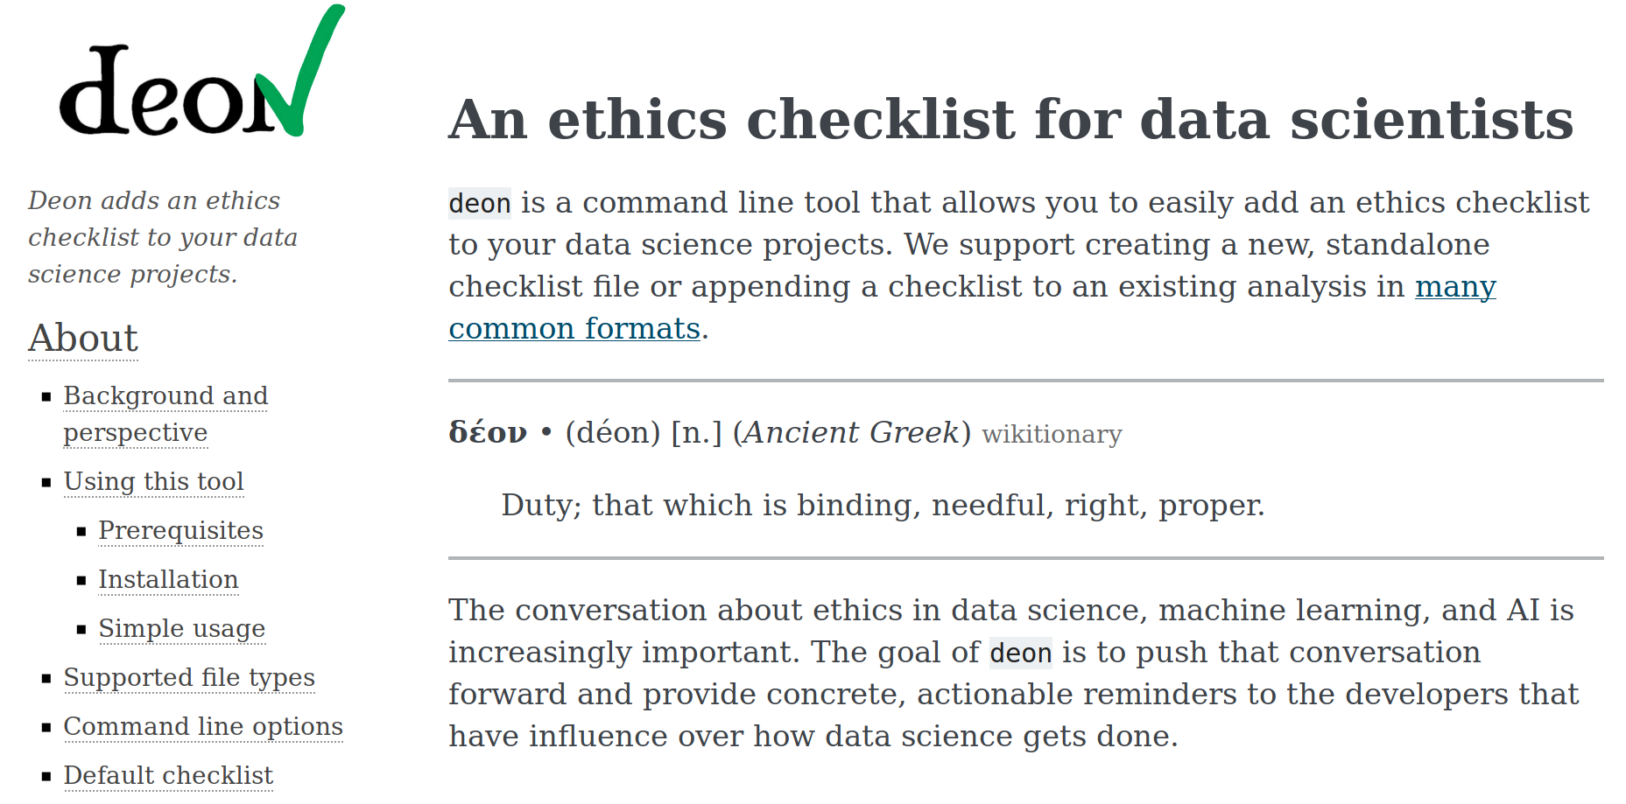
Similar efforts

Slide 19
Outlook & input for the panel discussion
The more machine actionable the system becomes,
  the more likely it is that the bureaucratic burden on people can be reduced
  the more possible it becomes to find similar cases to inform current deliberations
    just imagine case law without the cases being accessible
  the more we can measure relevant aspects of the process
    and from there derive data to
      measure compliance with current policy
      inform future policy
The more transparent the system becomes,
  the more likely standards are to be applied consistently
  the more possible it becomes to
    teach ethics consistently across sites
    address issues of equity
  the more informed potential participants can be about specific lines of research they might engage in

