Slide 1



The Questionnaire Design and Documentation Tool (QDDT)
a DDI based tool for assisting questionnaire design teams in their work
Hilde Orten, Stig Norland (NSD – Norwegian Centre for Research Data)
  Sarah Butt (ESS HQ, City University of London)
EDDI 2018 - 10th Annual European DDI User Conference, Berlin, December 4 – 5 2018
License: CC BY 4.0 (exception on last slide)
Notes:
SERISS: Synergies for Europe's Research Infrastructures in the Social Sciences
DASISH: Data Service Infrastructure for the Social Sciences and Humanities

Slide 2
Outline
QDDT - what is it?
The questionnaire module design workflow of the European Social Survey
QDDT – digitalization of the workflow using DDI
  Components and steps
  Items reusability
  Keeping track of changes
Further ideas

Slide 3

What is it?
A web-based tool helping researchers to develop thematic questionnaire modules (concepts and questions) for a conceptual questionnaire
Captures and displays the development history of the different items, for example questions
Notes:
A conceptual questionnaire is a questionnaire independent of mode and population

Slide 4
What is it?
Standardbased
  DDI 3.2 is basis for the conseptual model
Open source
Use-case is the questionnaire design process of the European Social Survey (ESS)

Slide 5
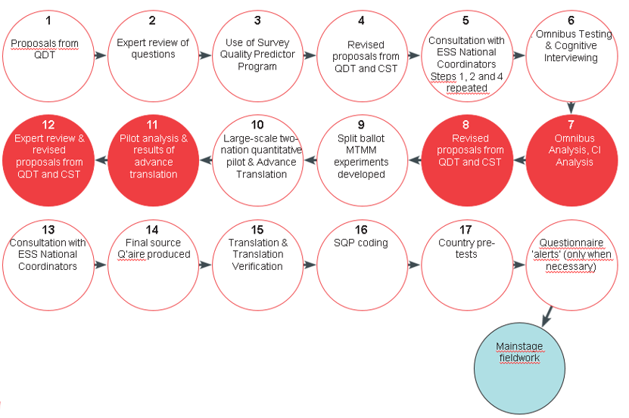
The ESS Questionnaire Design Process
Notes:
- ESS questionnaire design process: Two topical modules developed for each ESS round.
- Prosess over two years.
- Involves different usergroups: ESS HQ (main responsibility), Questionnaire design teams (QDTs), National Coordinators, experts on questionnaire design and translation
- Tested by SQP (Multi Trait Multi Method tests), cognitive testing and Omnibus in a selection of countries.
- Pilot.
- Module content is discussed in meetings at selected milestones.
- The figure shows the complexity of the workflow
- The QDDT is currently used for the first time in the questionnaire design process for the ESS round 10, which is at the National Coordinator’s consultation step (step 5) just now.

Slide 6
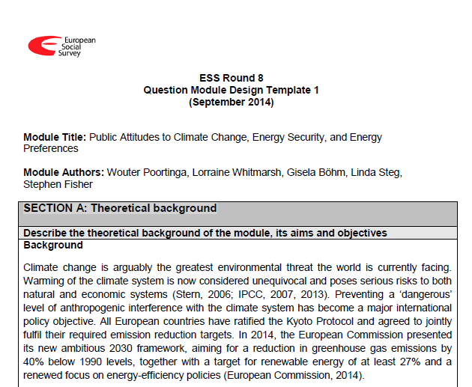
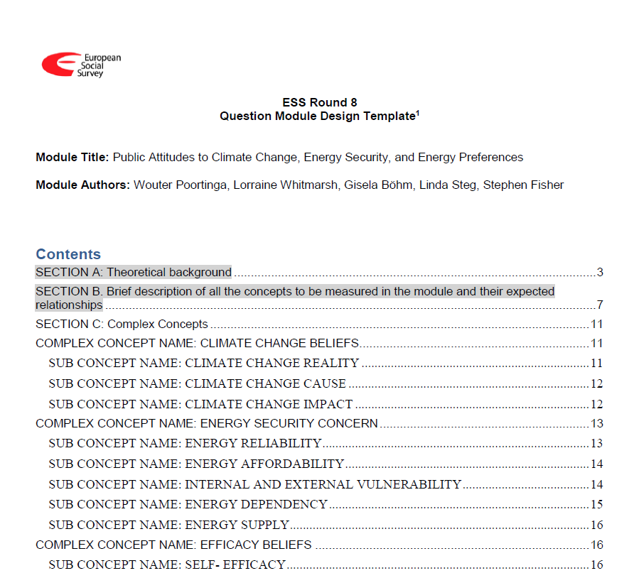
QDDT – digitalization of work processes
From Word templates
Notes:
Example from ESS Round 8:
17 word templates are produced, several of them on more than hundred pages
Workflow at each step (ESS round 1 – 9):
Starting out with a word document describing module content (concepts and questions) at each step.
Collecting input from discussions and tests
Provide a new version of the template
Send to everyone involved

Slide 7
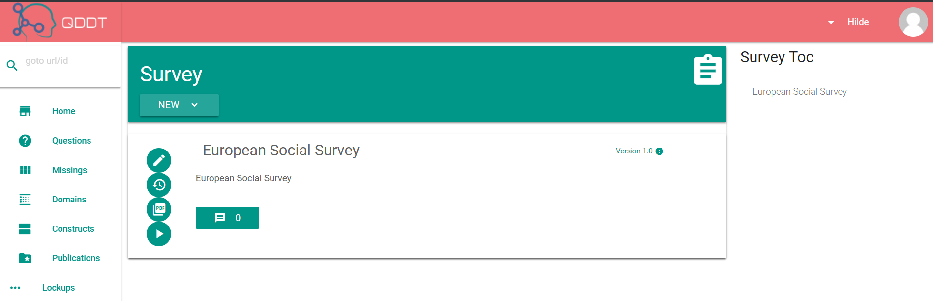
To tool
QDDT landing page
Notes:
QDDT landing page
- Menue on the left to manage concepts, questions and response domains

Slide 8
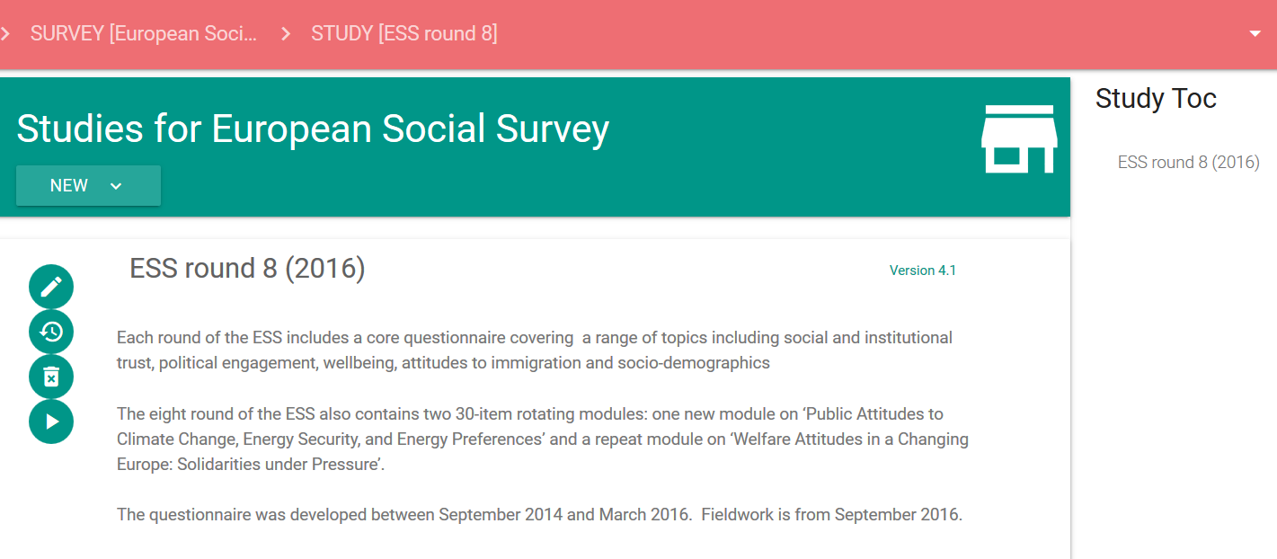
Studies
Notes:
Studies represent rounds, waves, or sweeps of a survey

Slide 9
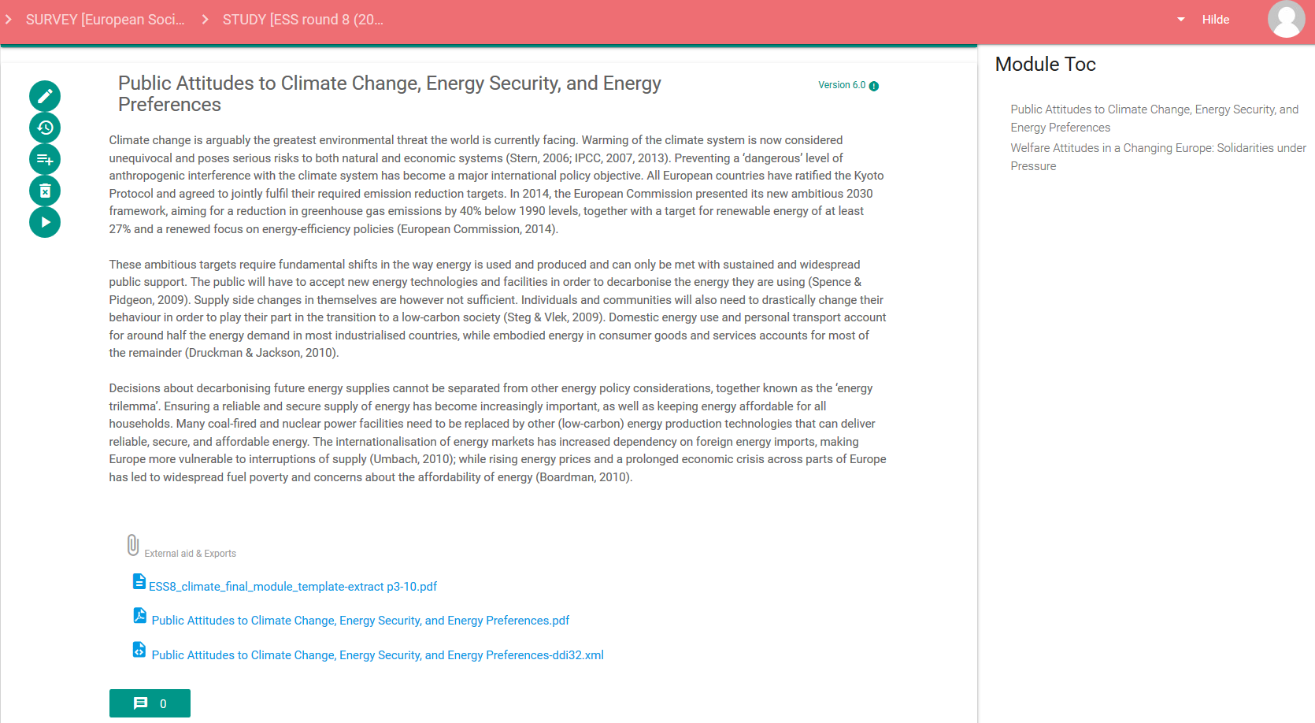
Questionnaire modules
Two modules in ESS round 8
Public Attitudes to Climate Change, Energy Security, and Energy Preferences
Welfare Attitudes in a Changing Europe: Solidarities under Pressure
Notes:
Climate change is arguably the greatest environmental threat the world is currently facing.
Public attitudes to climate change was selected as one of the two topical modules for the ESS round 8 - 2016 questionnaire .
A questionnaire design module team was selected to work on this module together with the ESS HQ team at City University of London.
At the questionnaire module page the user can make a new module by entering a name and a description, or reuse an existing one by copy.
The user can also upload more high level conceptual content related to the module and upload relevant background documents.
The Module Toc to the right shows which modules are available for the study (ESS round 8 in the example)

Slide 10
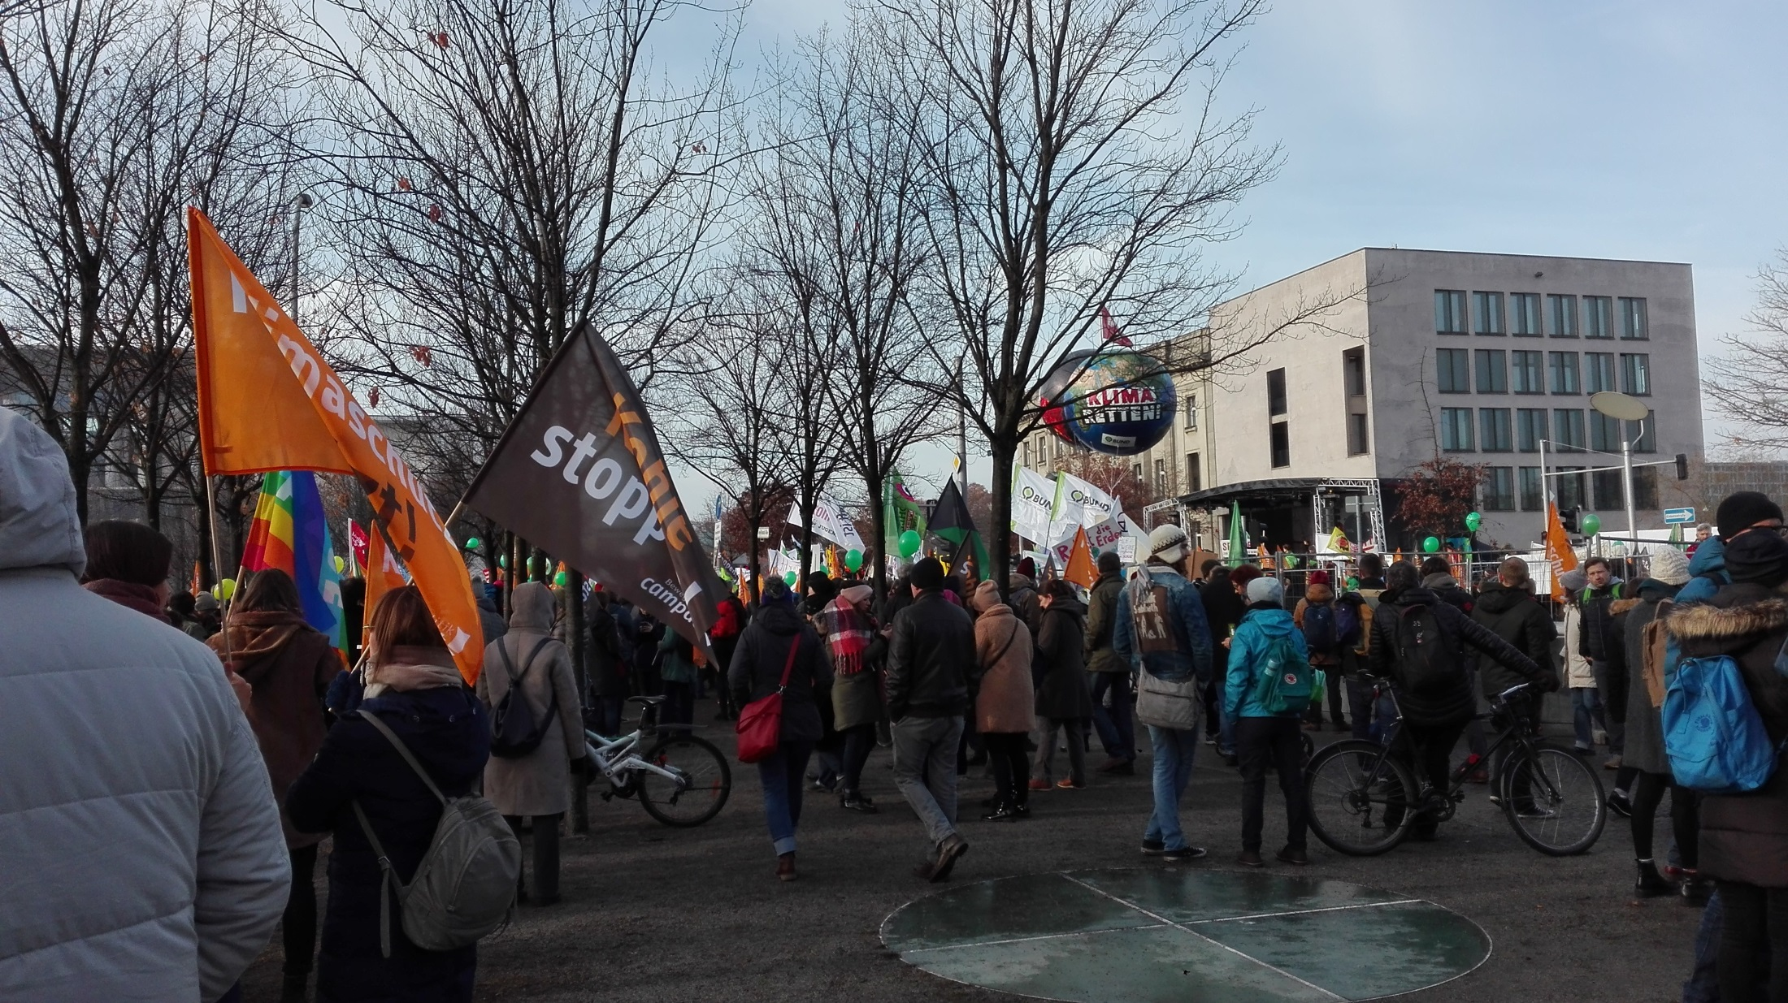
Attitudes to climate change – Berlin December 1st

Slide 11
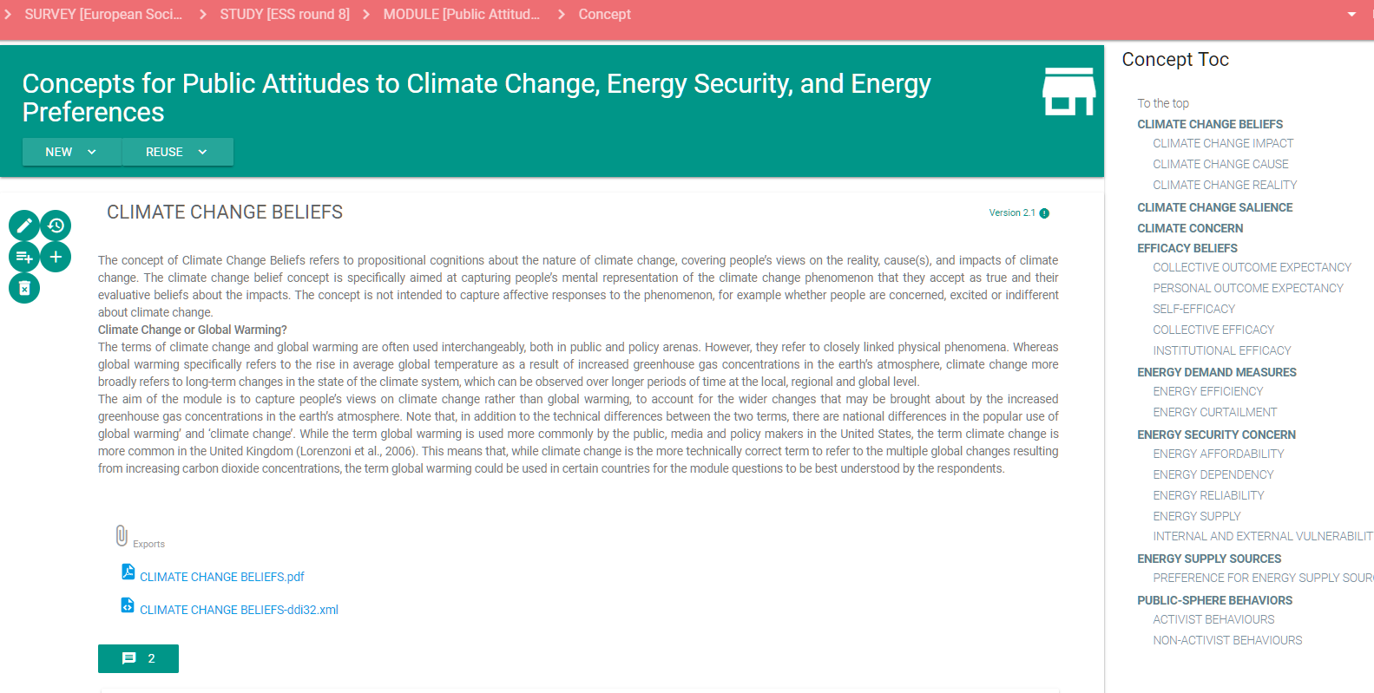
Concepts
Capture peoples views on Climate Change rather than global warming
Notes:
The entered concepts for the module ‘Political attitudes to climate change….’ can be accessed easily from the concept Toc to the right.
From this page the user can
- Enter a new concept
Edit an existing concept and version it
Delete a concept that will not be used in the module
View changes to a concept over time
Copy in an existing concept – for example from a previous ESS round
Add a sub-concept of an entered top-level concept
Add an operationalisation of the concept – that is a question, to the concept.
Export concept and related questions to PDF
(DDI 3.2 xml export - in development)

Slide 12
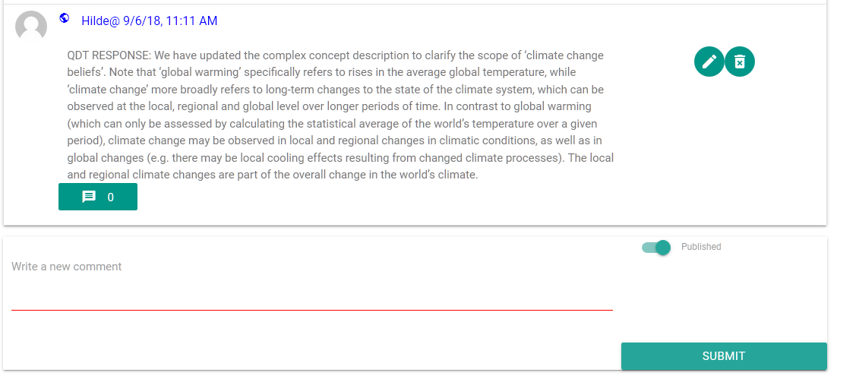
Comments
Clarification of concept ‘Climate Change’
Notes:
- Comment fileds are available for all items.
- A user can write a comment and decide if the comment should be public and included in the publication of the item, or just remain internal in the tool.
- It is also possible to submit a comment to an existing comment.

Slide 13
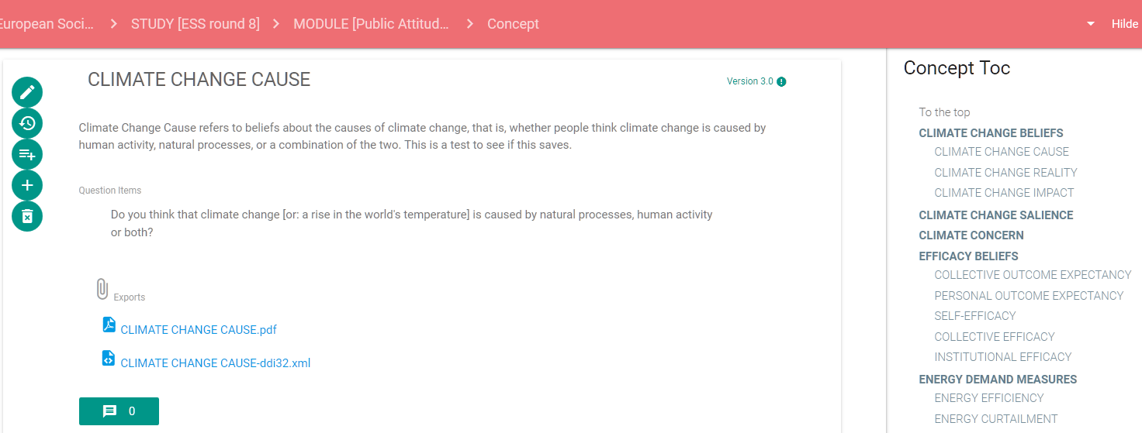
Measurement concepts
Question associated with Climate Change Cause
Climate Change Beliefs has three sub-concepts
Climate Change Cause
Climate Change Reality
Climate Change Impact

Slide 14
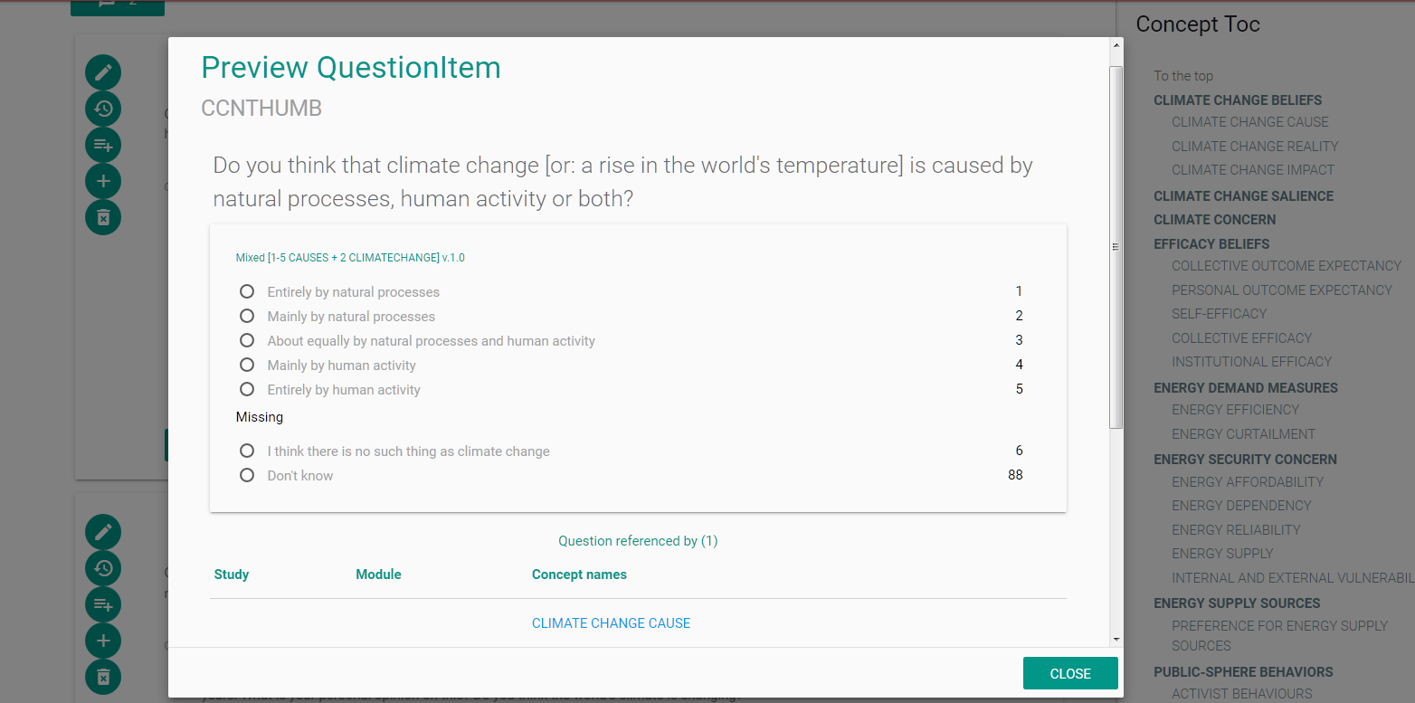
Question for Climate Change Cause - preview
Do you think that climate change [or: rise in the world's temperature] is caused by natural processes, human activity or both?

Slide 15
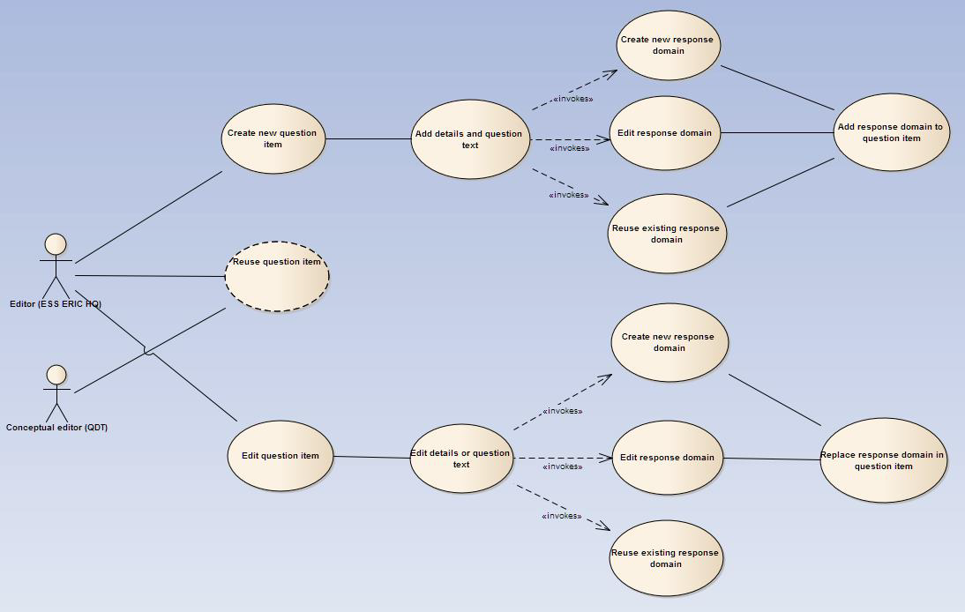
Question item usecase
Create new
Add text
and details
Response domain:
Create
Edit
Reuse
Reuse
Use or reuse by reference in QuestionItem
Edit
Edit text
and details

Slide 16
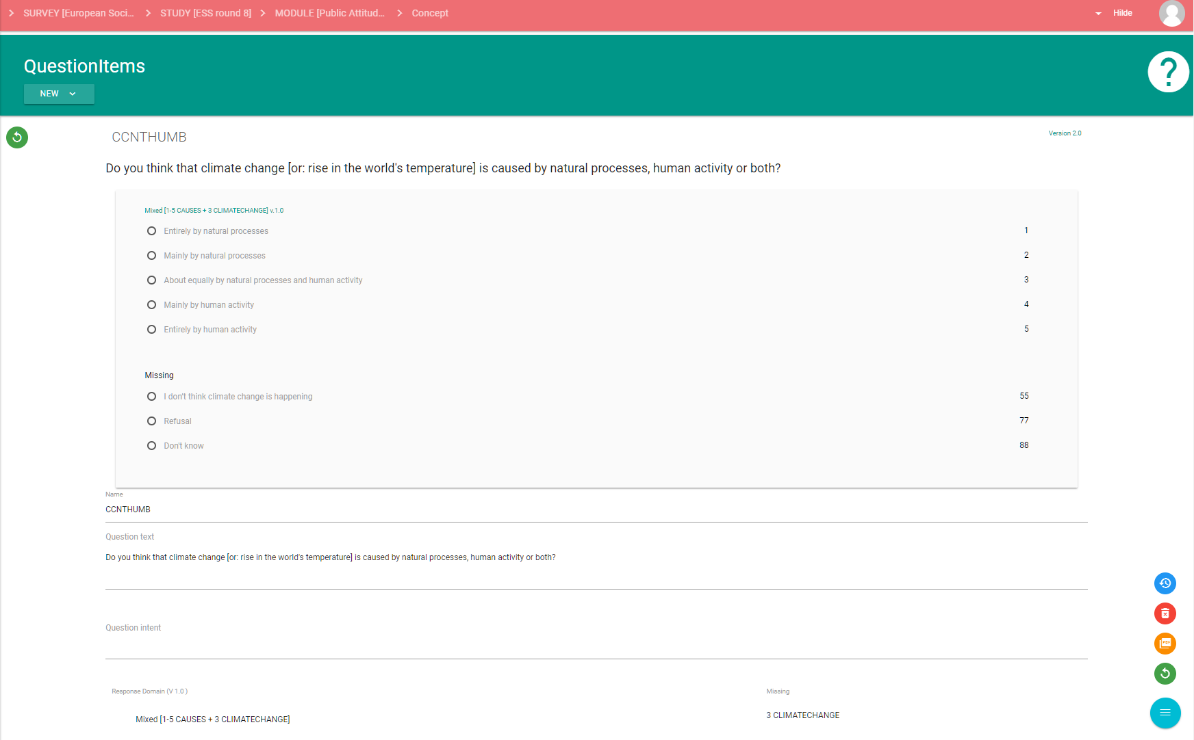
Structuring Question Items and Response Domains for reuse
Question text
Valid domain/representation
Structured mixed response domain
Missing/representation
Only core content is added at the question item level
Responses are maintained separately and linked to the question by reference
Valid responses are maintained and reused separately from the missings

Slide 17
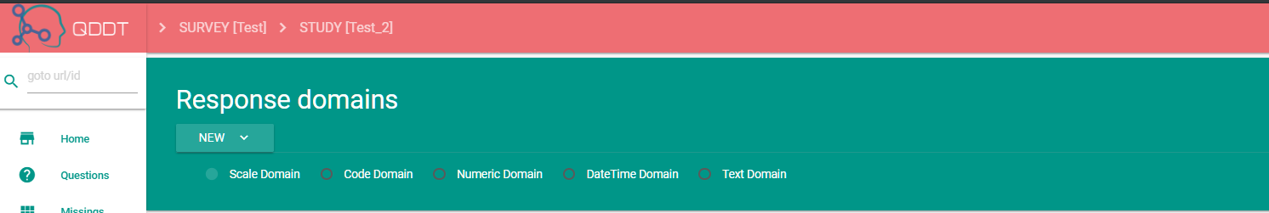
Response domain - types
ScaleDomain
CodeDomain
NumericDomain
DateTimeDomain
TextDomain

Slide 18
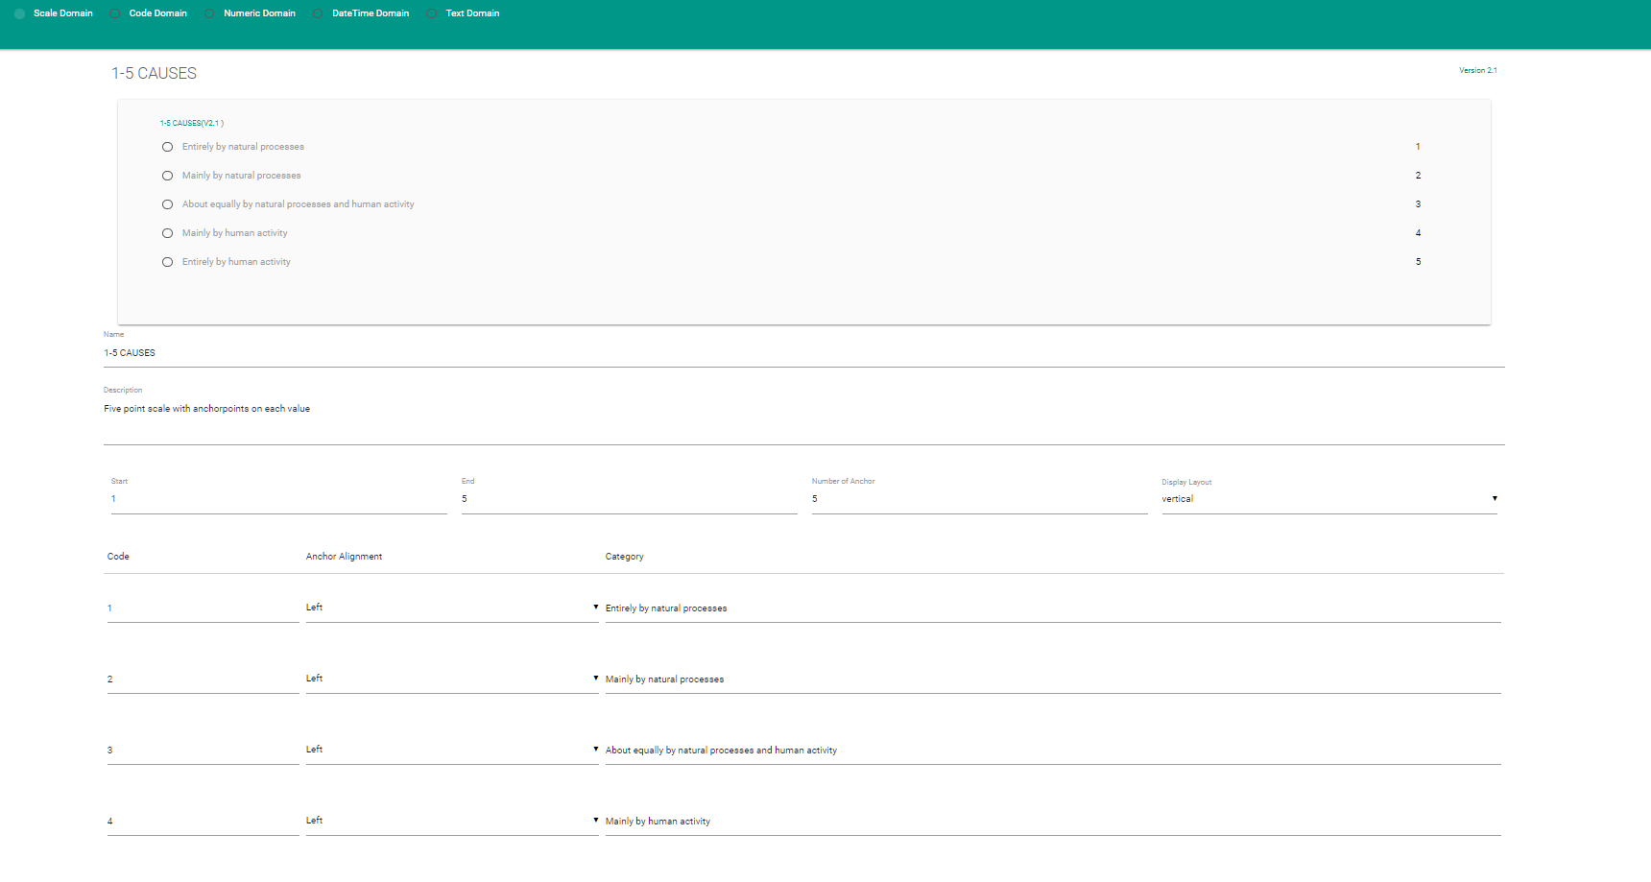
Scale domain
Example: Five point likert with anchorpoints on each value
-Entirely by natural processes 1
-Mainly by natural processes 2
-About equally by natural processes
and human activity 3
-Mainly by human activity 4
-Entirely by human activity 5
‘Horizontal vs. Vertical’
Notes:
Our example represents a five point likert with anchor point categories attached at each scale value (1-5).
The scale has a vertical layout.
Ancorpoints and their alignment can be changed.

Slide 19
Edit Question Item
Do you think that climate change [or: rise in the world's temperature] is caused by natural processes, human activity or both?
Notes:
Edit question item:
Change the question text to make it more compatible with the concept definition
Edit question text by removing the reference to temperature rise

Slide 20
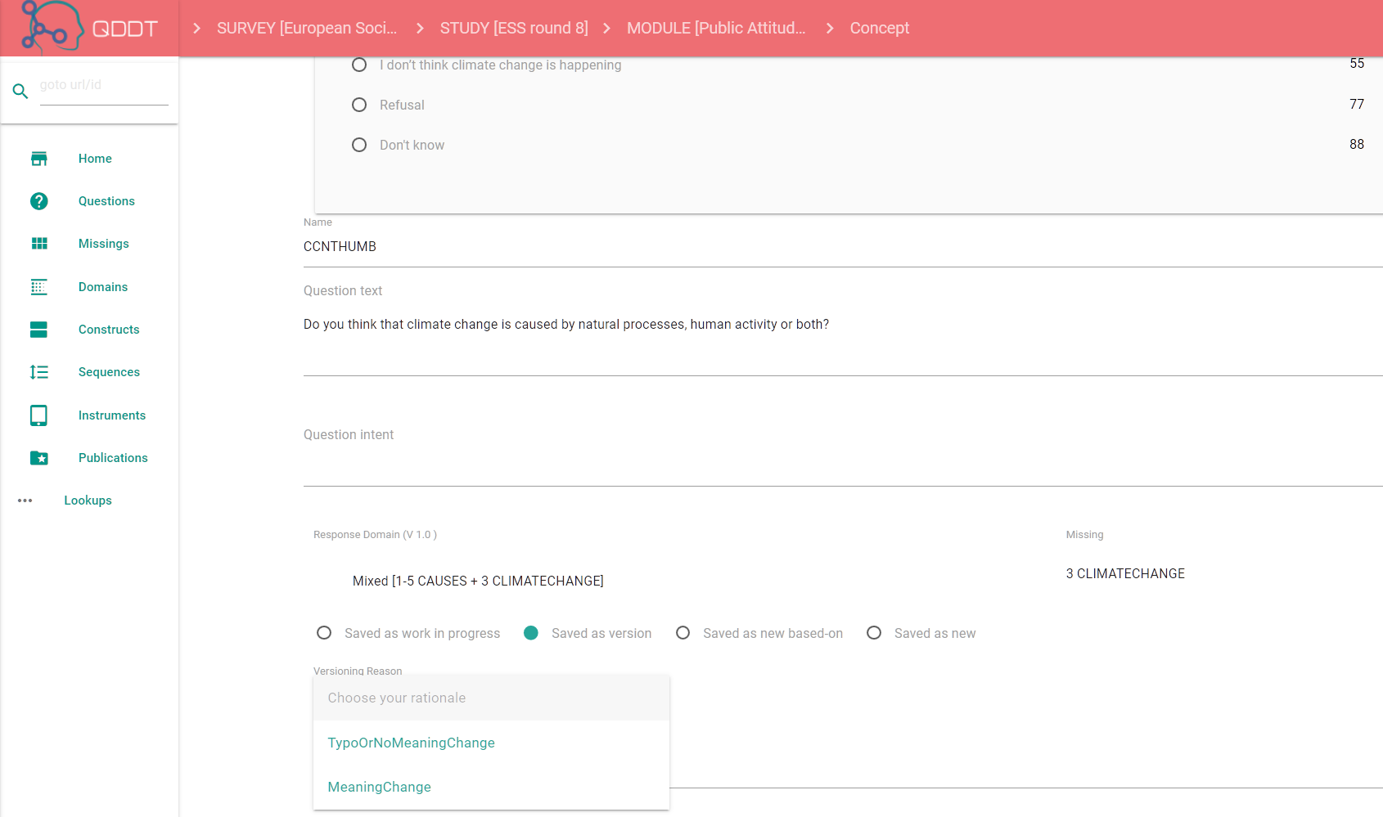
Saving the change - choose savetype
Save as work in progress
Save as a version
  Meaning change
  Typo or no meaning change
Save as new, based on
Save as new
Notes:
Now we need to decide which type of save we are making:
Is this work in progress, a version change, a new item based on an existing item, or a completely new item?

Slide 21
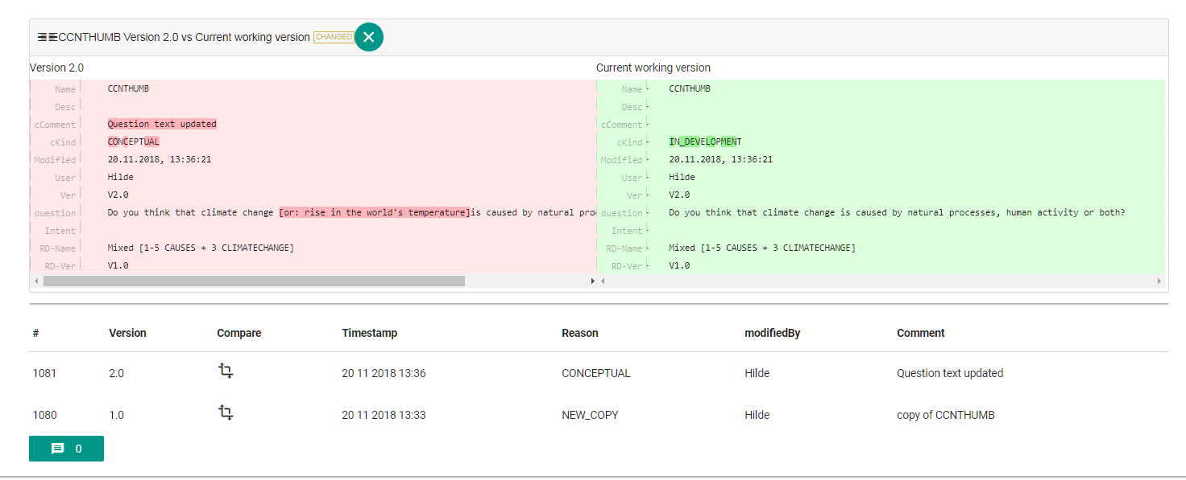
Compare changes to the latest version
[or: rise in the world's temperature]
Notes:
We can compare the current change to the last business version the item to review the change made.
We see that there has been a change in the question text, and we decide that the change represents a conceptual clarification

Slide 22
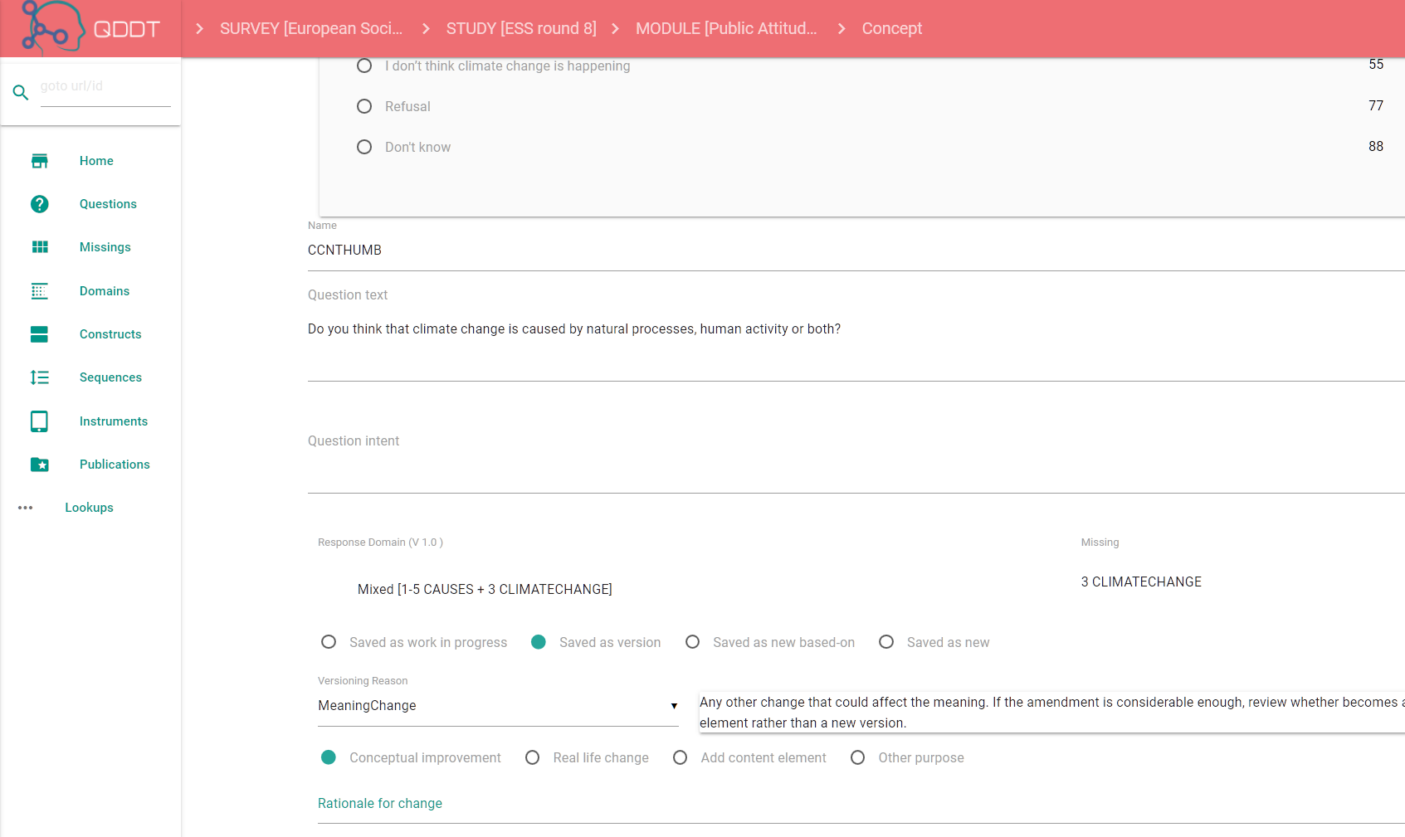
Save a major version change
Select version rationale code:
  Conceptual improvement
  Real life change
  Add content element
  Other change
Add description
And save
Select version rationale code:
  Conceptual improvement
  Real life change
  Add content element
  Other change
Add description
And save
v2.0
v3.0
v2.0
v3.0
Notes:
We decide that the version change represents a ‘meaning change’, and choose the rationale code ‘Conceptual improvement’ to denote the version rationale
The first digit of the version number is changed automatically by the tool, based on our choices.
Meaning changes like a conceptual improvement triggers a major version change and the first digit of the version number is changed.
Typos or changes that don’t affect the meaning triggers a minor version change and the second digit of the version number is changed.
We now feel that the question is as good as ready for the questionnaire, but we need to add some questionnaire related details.

Slide 23
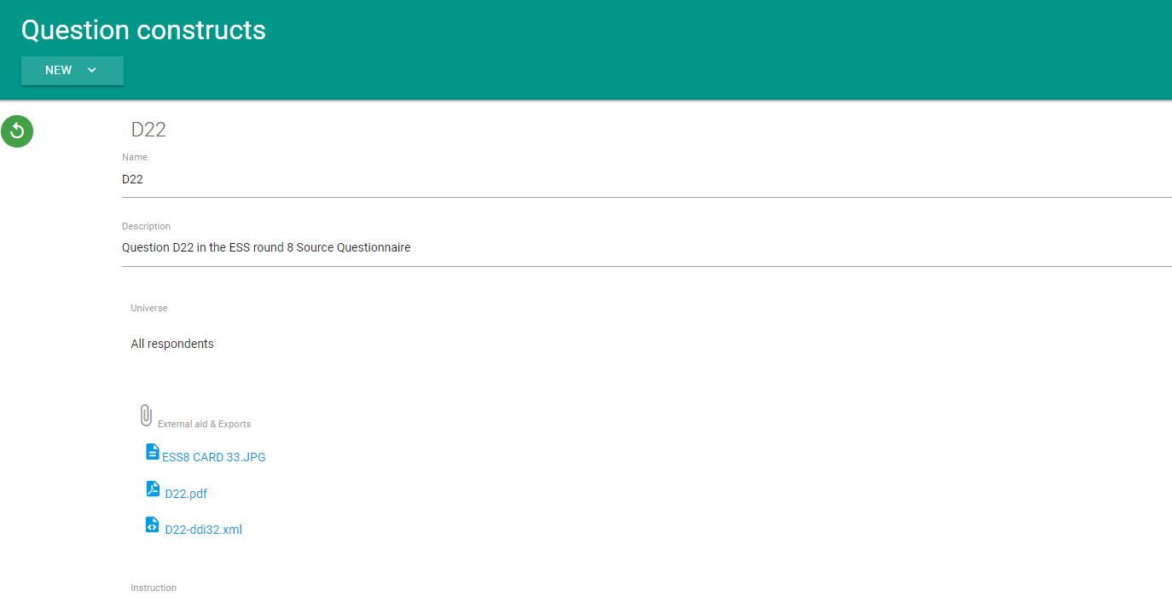
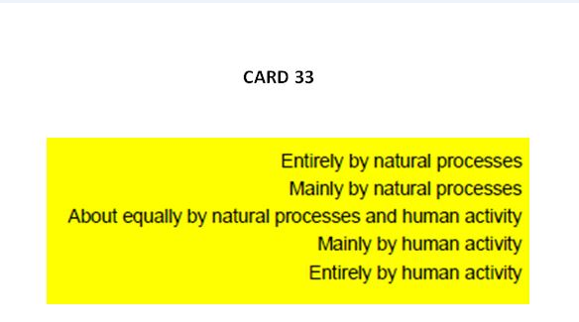
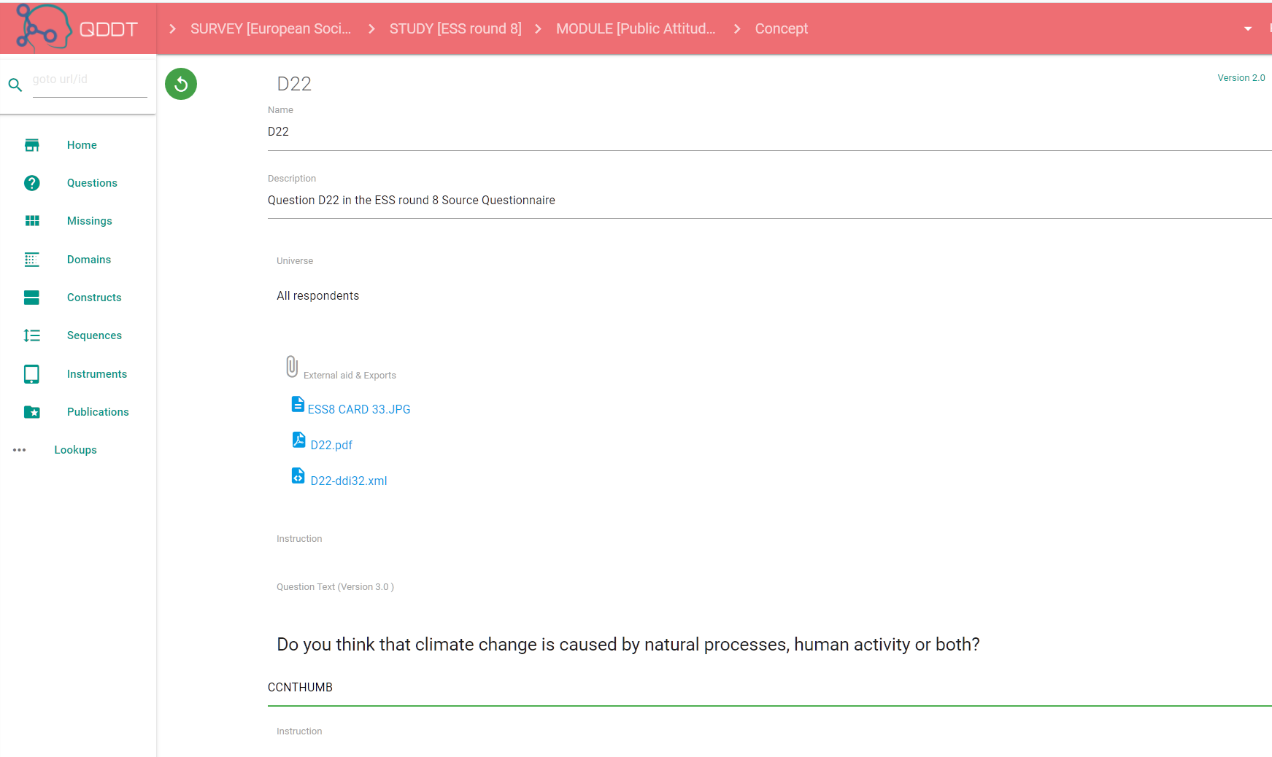
Question Construct - the question as in the instrument
Add questionnaire specific content
Construct name
Instructions
Universe
External aid, e.g. showcard

Slide 24
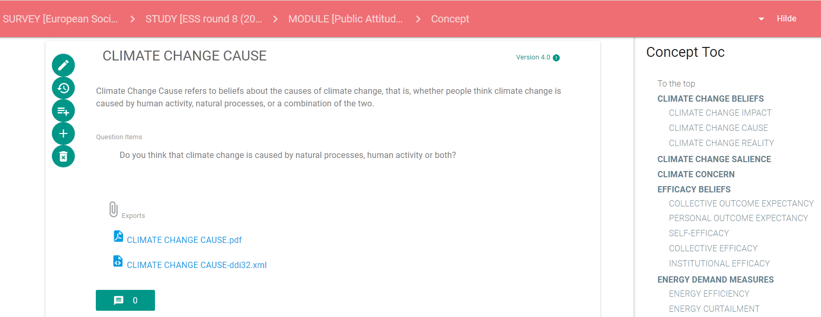
Associate corrected question version with the concept
‘Do you think that climate change is caused by natural processes, human activity or both?’
Notes:
We also want to link the latest version of our final question to the measurement concept

Slide 25
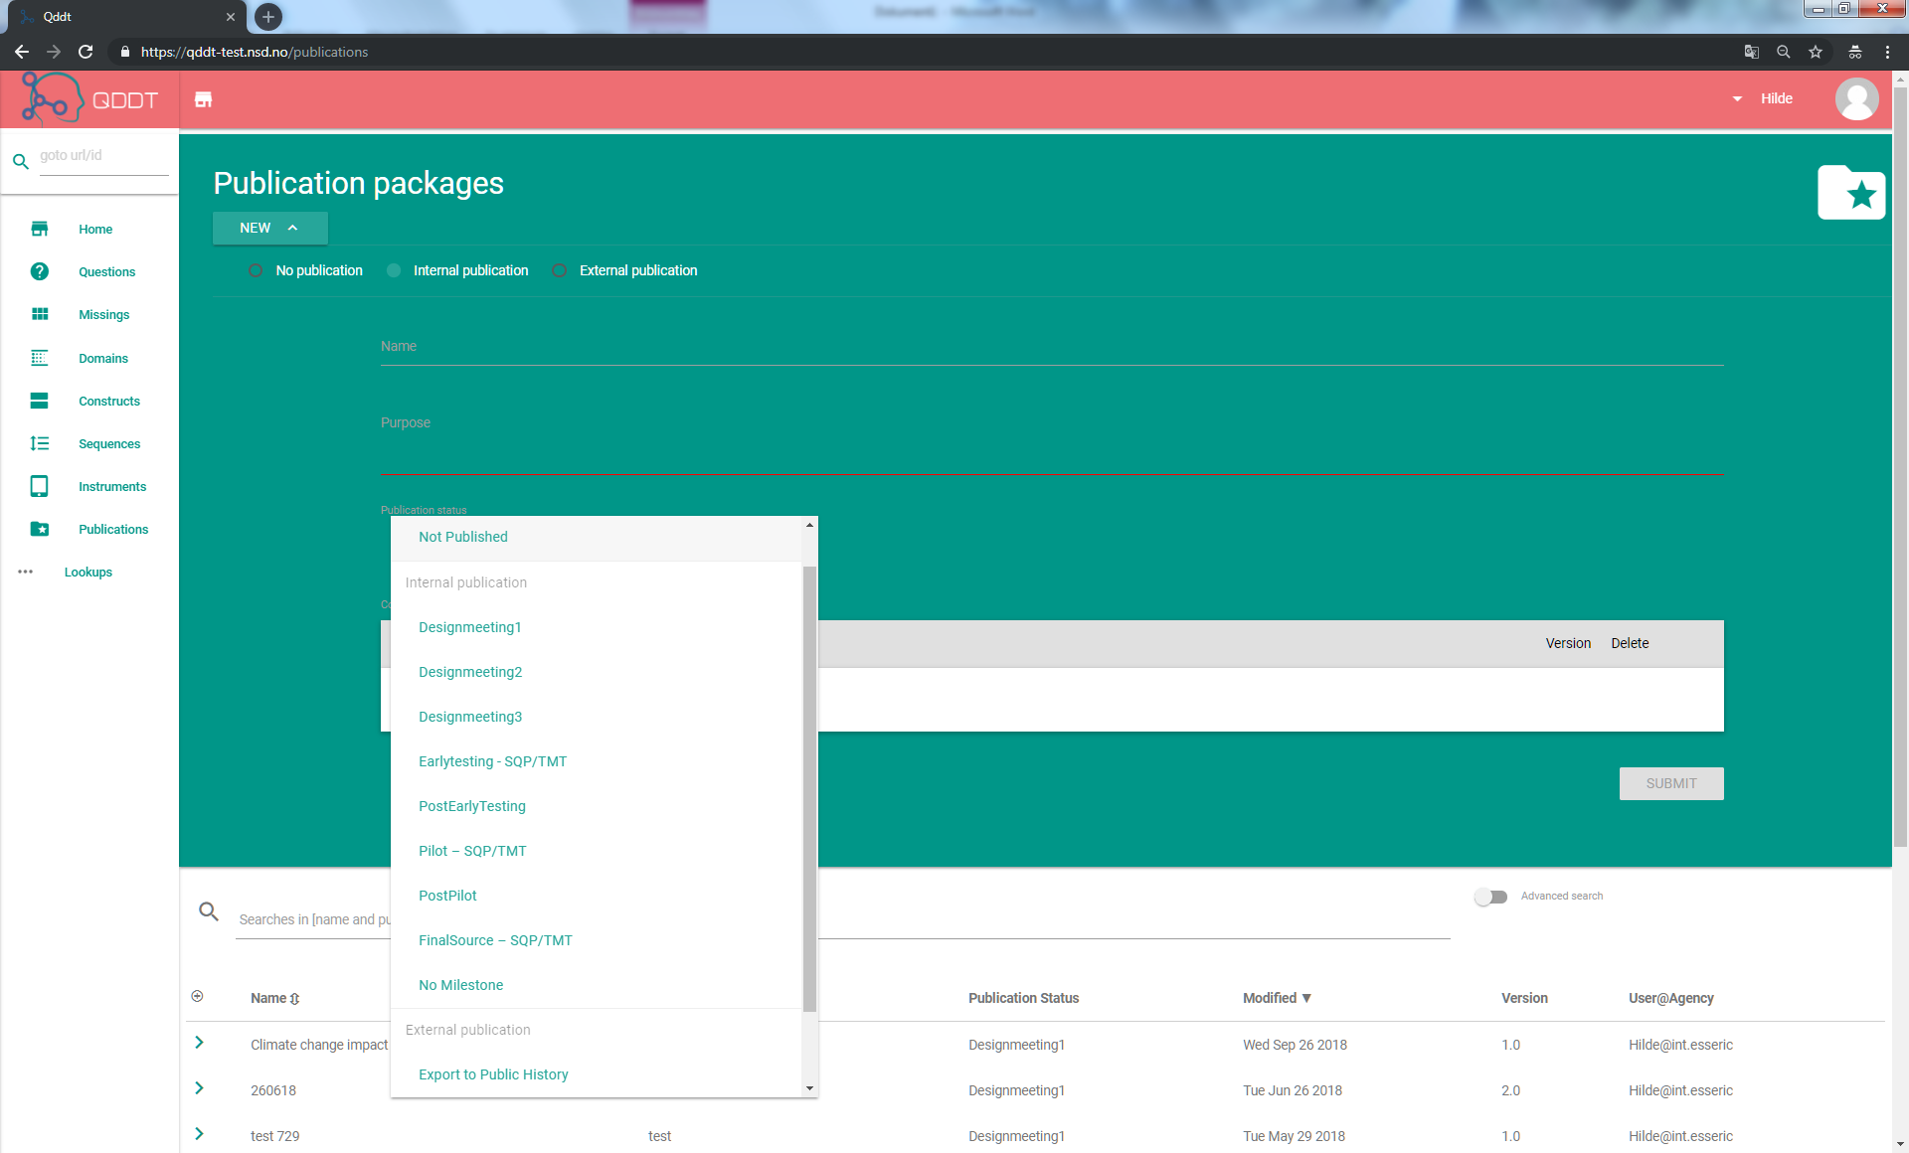
Publish concept and question for review
Internal publication for the
‘Pilot’ milestone
Notes:
We are now happy with how the concept climate change cause and the related question looks and want to publish them for an internal review.
Action: Make a new publication package and publish it for a specific purpose.
We create a new publication package, make it an internal publication and choose a publication status for the publication. We choose the publication status ‘Pilot stage’.

Slide 26
Ideas for upgrade and further development
UI enhancements
Questionnaire sequences (question batteries, skip logic)
Question grids
Web survey (implemented instrument)
Import to the tool
Notes:
Further upgrade requires funding

Slide 27
Special thanks to
Dag Ø. Heradstveit, Håvard V. Bakkmoen, Knut Kalgraff Skjåk, Benjamin Beuster
Norwegian Centre for Research Data - NSD
Yvette Prestage, Virginia Roos, Sally Widdop
ESS HQ, City University, London
Joachim Wackerow
Consultant

Slide 28
Thank you for your attention!
QDDT project site:
https://github.com/DASISH/qddt-client/wiki
Please contact us at: surveytools@nsd.no

Slide 29


This presentation is offered under license CC-BY 4.0
The license does not apply to the following copyrighted material used in this presentation:
License
The logo of NSD:
The logo of SERISS:
The logo of DASISH:

Slide 30
QDDT Architecture
Angular 6 + Typescript
  No Javascript in dev tools, only in browser
  Typescript can transpile to ES3
  Supports «evergreen» browsers (Chrome, FireFox, Opera, Safari, and IE10/11)
Spring MVC API
  RESTful API
  JSON for free
  no need for a SOAP service stack
Spring security (OAuth2)
  Tokenbased
  No state for requests
Persistence Layer implemented with Hibernate + Envers
  Revisions
  Database agnostic
  Since qddt is open source, we chose Postgres
Browser
Angular 6
Http/JSON
REST Backend
Router Layer
Service Layer
Persistence Layer
Database

